Slide 1

“How to Avoid
Religious Trappings”
The delusions, deceptions, and desires that lead us astray.
James 1:26-27 (et. al.)

Slide 2
If anyone thinks himself to be religious, yet does not bridle his tongue but deceives his own heart, this person’s religion is worthless.
James 1:26 (NASB)

Slide 3
Pure and undefiled religion in the sight of our God and Father is this: to visit orphans and widows in their distress, and to keep oneself unstained by the world.
James 1:27 (NASB)

Slide 4
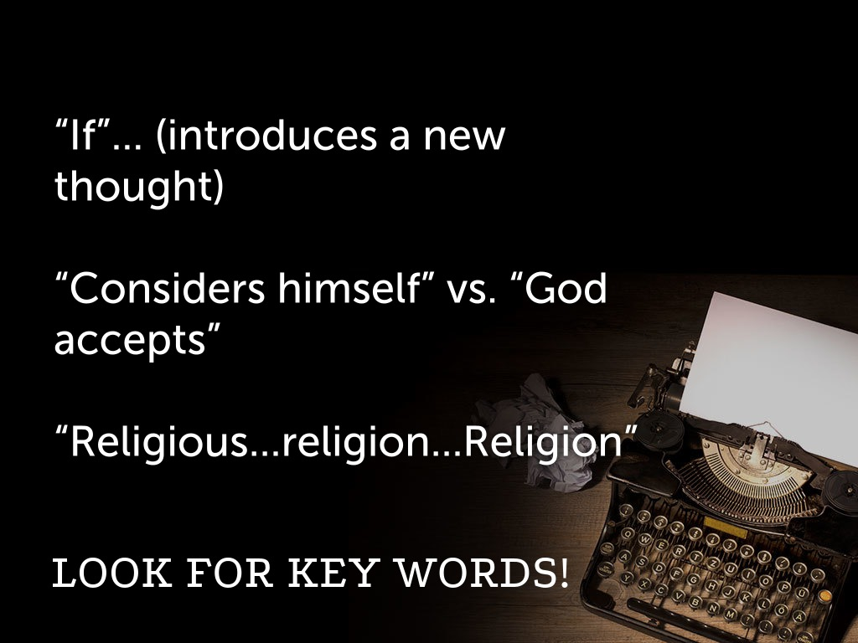

Slide 5

Textual Analysis

Slide 6
I. The Delusion of Hearing (22)
But prove yourselves doers
of the word, and not merely hearers who delude themselves.

Slide 7
II. The Deception of Religion (26)
If anyone thinks himself to be religious, and yet does not bridle his tongue but deceives his own heart, this man’s religion is worthless.

Slide 8
III. The Desire for Wisdom
a.) About God (13, 16-18)

Slide 9
III. The Desire for Wisdom
a.) About God (13, 16-18)
b.) About yourself (14-15, 20, 26)

Slide 10
III. The Desire for Wisdom
a.) About God (13, 16-18)
b.) About yourself (14-15, 20, 26)
c.) About others (27)

Slide 11
IV. A Purified Religion Comes from a Holy Relationship
a.) A bridled tongue (26)

Slide 12
IV. A Purified Religion Comes from a Holy Relationship
a.) A bridled tongue (26)
b.) An abandoned child (27)

Slide 13
IV. A Purified Religion Comes from a Holy Relationship
a.) A bridled tongue (26)
b.) An abandoned child (27)
c.) A bereaved widow (27)

Slide 14
“How to Avoid
Religious Trappings”
The delusions, deceptions, and desires that lead us astray.
James 1:26-27 (et. al.)

