Slide 1
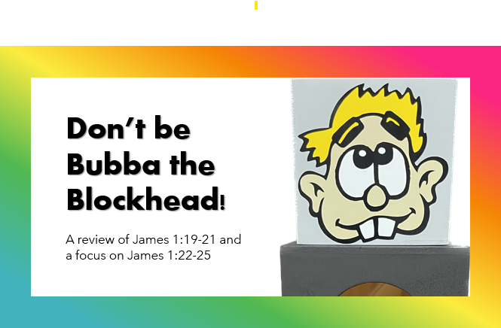

Slide 2

We need to have:
Open ears.
A controlled tongue.
A calm spirit.
A clean heart.
- Review of James 1:19-21

Slide 3

Listen Up
vv. 22-23a

Slide 4
₂₂ But prove yourselves doers of the word, and not merely hearers who delude themselves.
_{23a} For if anyone is a hearer of the
word and not a doer …
(NASB)

Slide 5
2. Look At
vv. 23b-24

Slide 6
_{23b} … he is like a man who looks
at his natural face in a mirror;
₂₄ for once he has looked at himself and gone away, he has immediately forgotten what kind of person he was.
(NASB)

Slide 7

Time goes by fast. Make it count for the Lord!

Slide 8
3. Long For
v. 25

Slide 9
₂₅ But one who looks intently at
the perfect law, the law of liberty (freedom), and abides by it, not having become a forgetful hearer but an effectual doer, this man
will be blessed in what he does.
(NASB)

