Slide 1
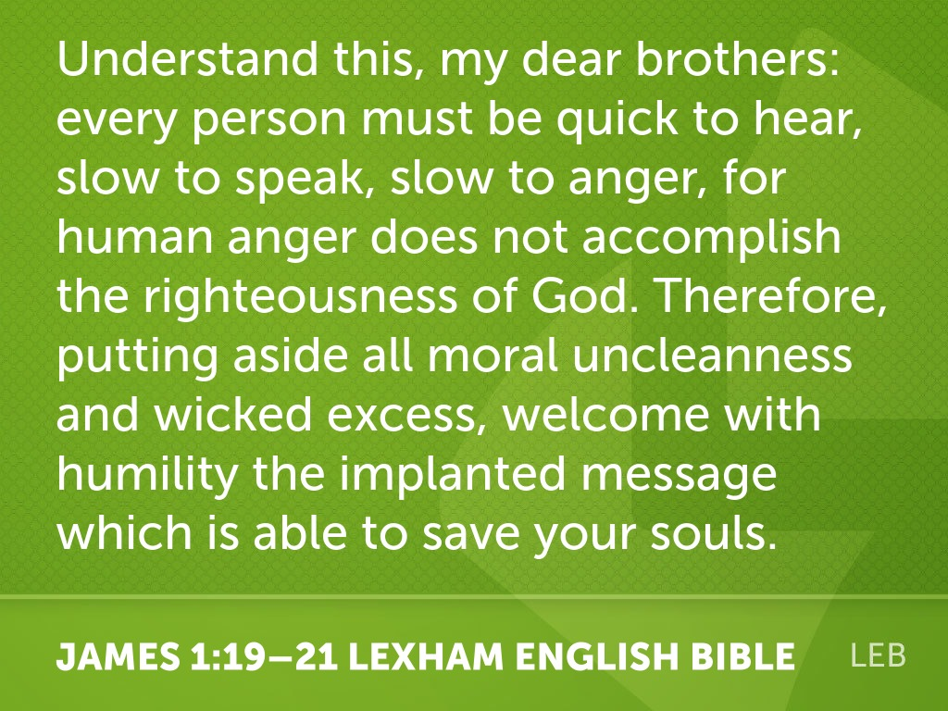

Slide 2

“Mulligans in the Marshlands”
- James 1:19-21

Slide 3
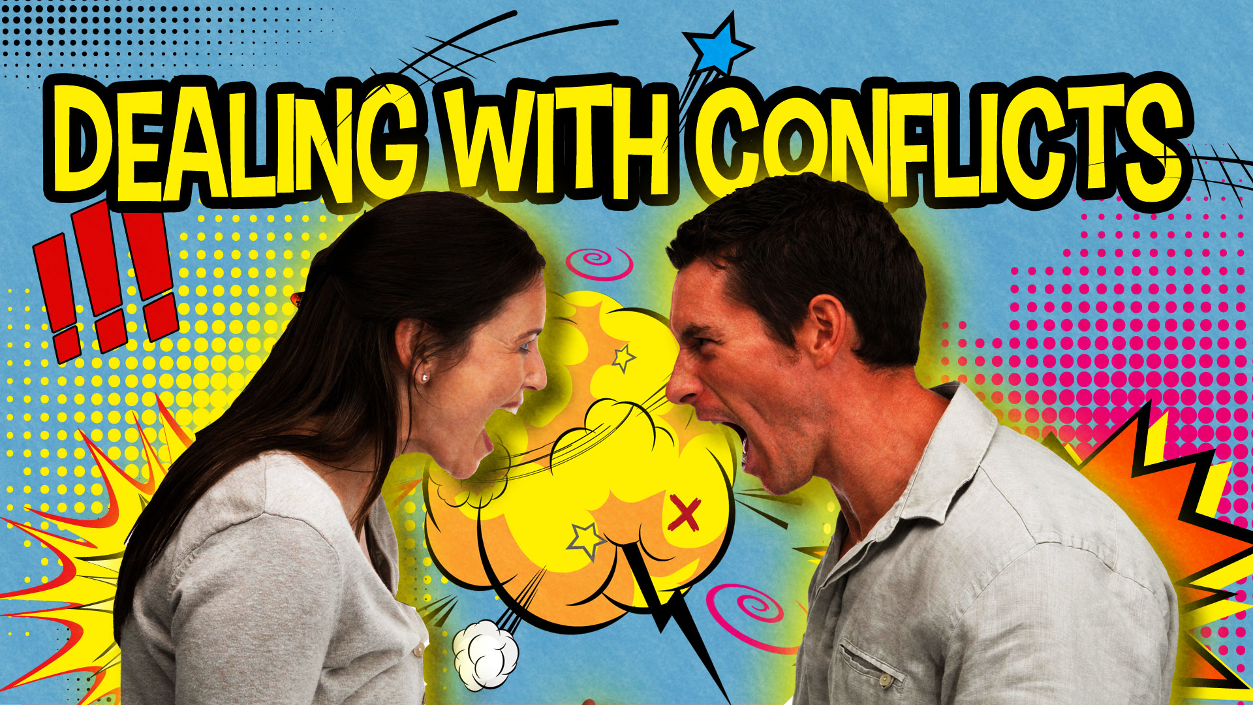

Slide 4
Ἴστε, from οἶδα (to understand, know)
imperative verb
Understand this … (LEB, HCSB, NLT)
Know this … (ESV)
Take note of this … (NIV)
This you know … (NASB)
___________________________________________
ὥστε (so that)
conjunction
Wherefore … (KJV - 1900)
So then … (NKJV - 1979)
Ἴστε….
….οἶδα
ὥστε….
…my dear brothers, every person (not YOU!)

Slide 5
Listen carefully (19a)
_____ righteously (19b-20)
_____ your past (21a)
_____ for the message (21b)

Slide 6

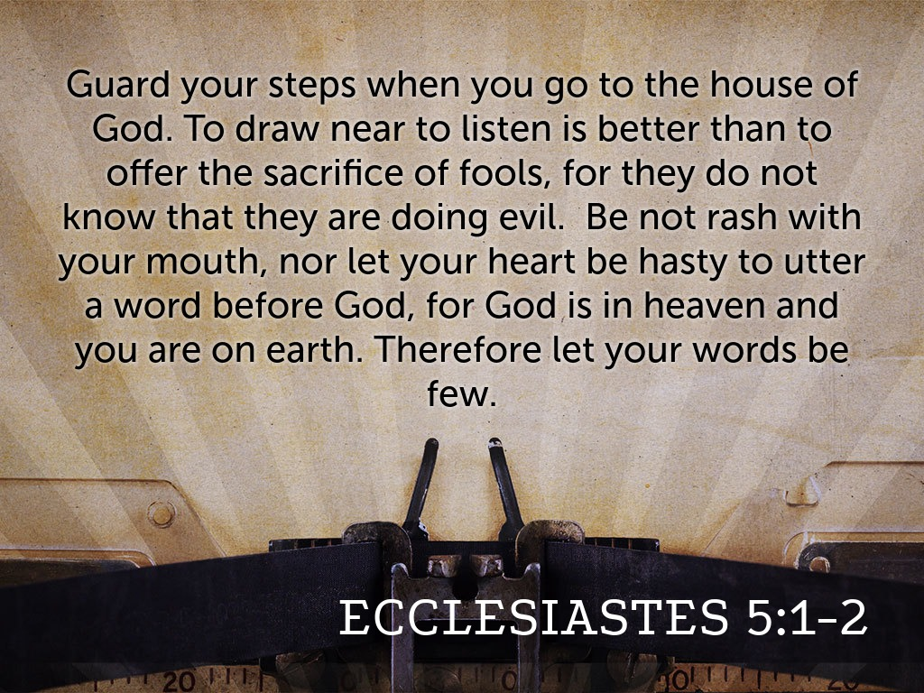

Slide 7
Listen carefully (19a)
Live righteously (19b-20)
_____ your past (21a)
_____ for the message (21b)

Slide 8
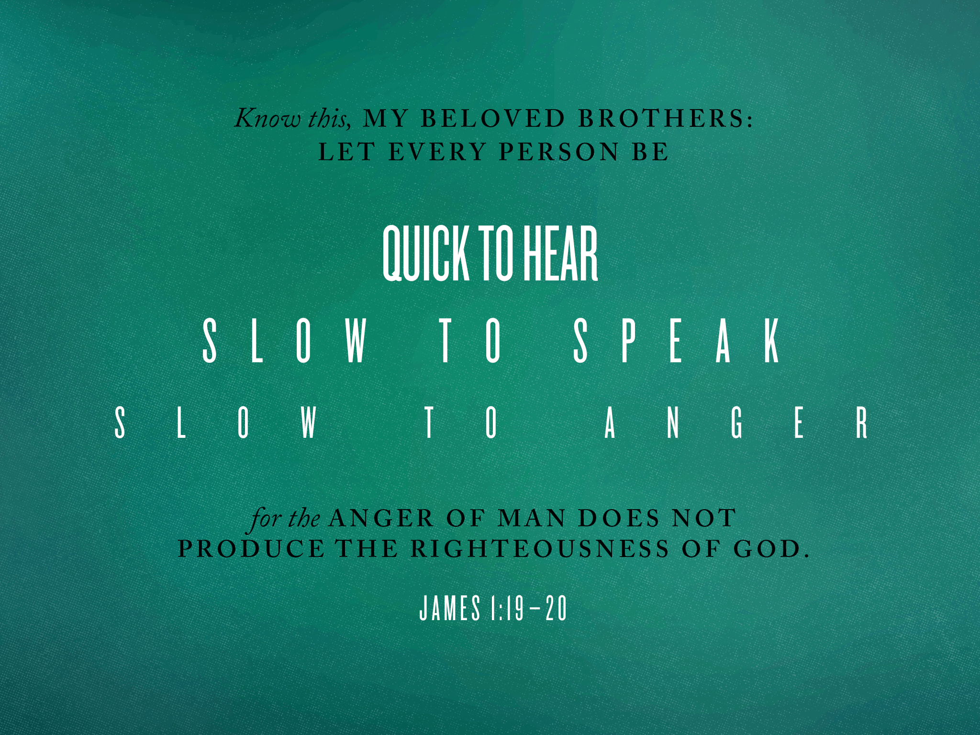

Slide 9
Listen carefully (19a)
Live righteously (19b-20)
Leave your past (21a)
_____ for the message (21b)

Slide 10
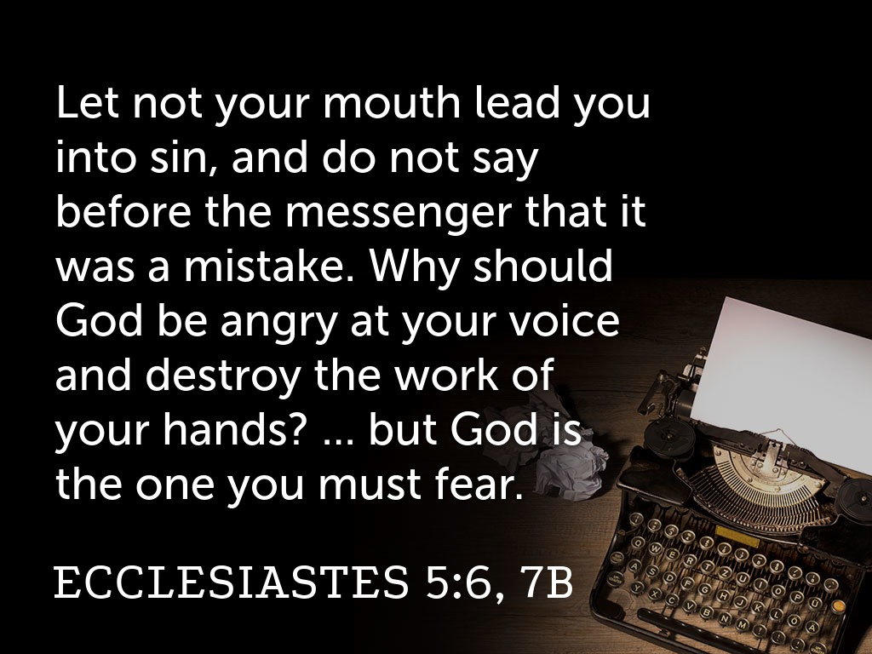

Slide 11
Listen carefully (19a)
Live righteously (19b-20)
Leave your past (21a)
Long for the message (21b)

Slide 12


