Slide 1


Slide 2

16 – Do not be deceived,
my dear brothers.

Slide 3
16 – Do not be deceived,
my dear brothers.

Slide 4

17a – Every good and perfect gift
is from above

Slide 5
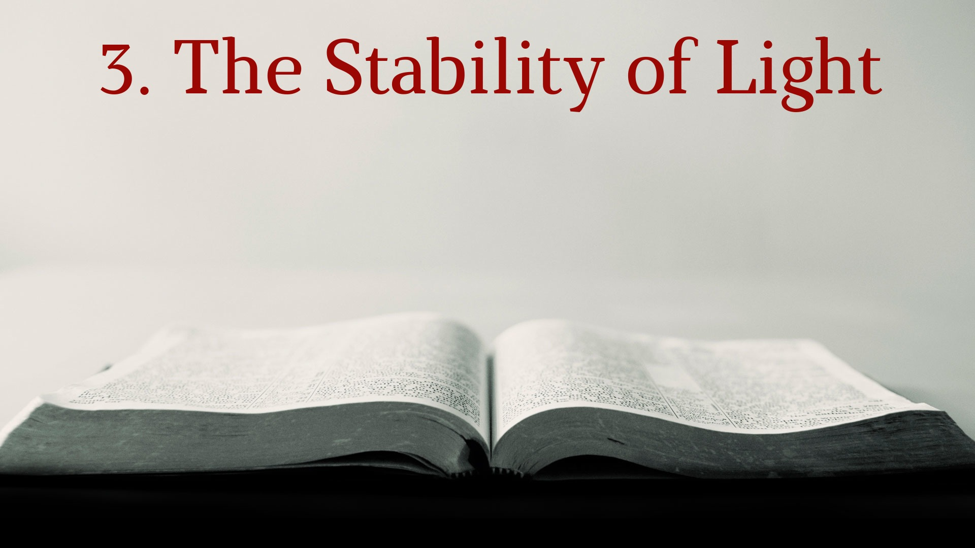
17b – coming down from
the Father of the heavenly lights,
who does not change like shifting shadows.

Slide 6

18a – He chose to give us birth through the word of truth

Slide 7

18b – that we might be a kind of firstfruits of all He created.

