Slide 1
James
Ἰάκωβος
The first book of the New Testament
Background and James 1:1

Slide 2
The Author
James, son of Zebedee, brother of John (one of the 12 Disciples). Martyred 44 AD.
James, son of Alpheus, “James the younger.” No support.
James, the father of Judas (not Iscariot). Barely considered.
Pseudo-author?
James, the ½ brother of Jesus, “James the Just” – but why didn’t he give credentials?

Slide 3
The Date
Jesus appeared to him 27/29 AD (1 Cor 15:7).
Led the Jerusalem Council 48/49 AD.
Met Paul in Jerusalem 55/56 AD.
James was martyred 62 AD.

Slide 4
The Structure
Universal (catholic) letter
Sermonettes (carnival ducks)
Proverbs
Sermon on the Mount
Pastoral admonition – rebukes and exhorts
There are more imperative verbs in James than in any other book in the NT.

Slide 5

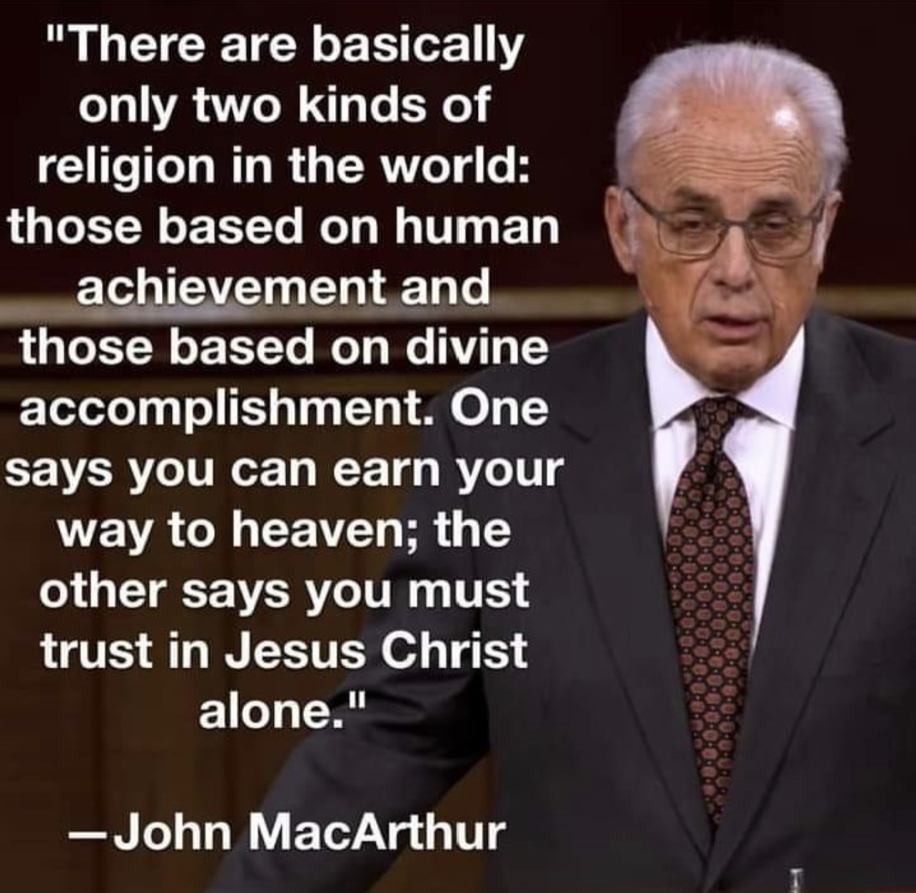
Martin Luther:
Paul vs. James

Slide 6


Slide 7
James 1:1 (NIV)
James, a servant of God and of the Lord Jesus Christ, to the twelve tribes scattered among the nations: greetings.
ESV - in the Dispersion: Greetings.
NKJV – bondservant … scattered abroad: Greetings.

Slide 8
Servant – Bondservant - Slave
SERVANT – 100% voluntary - alliance to a Rabbi or leader. You are my Master.
BONDSERVANT – willingly submitting yourself to another to fulfill a requirement (Jacob worked 7 years for Leah, then another 7 years for Rachel). Think, “fulfill a debt.”
SLAVE – owned by another. Even after fulfilling a legal debt, one could stay on to work for their master.
  First recording of slavery in the Bible – Gen. 37 when Joseph was sold by his brothers.
  δοῦλος (128x)

Slide 9
Ephesians 6:5-7 (ESV)
Bondservants, obey your earthly masters with fear and trembling, with a sincere heart, as you would Christ, not by the way of eye-service, as people-pleasers, but as bondservants of Christ, doing the will of God from the heart, rendering service with a good will as to the Lord and not to man …

Slide 10
Baker Encyclopedia of the Bible
“By Roman times Slavery was so extensive that in the early Christian period one out of two people was a slave.”

Slide 11
The Audience
Dispersion (diaspora)
722 BC Assyria …………586 BC Babylon ………….. Only some returned to Jerusalem.
Egypt, Palestine, Rome …………military service …… Acts – “Syria, Asia Minor, Greece.”
Used 3x: John 7:35; James 1:1; 1 Peter 1:1

Slide 12
Why does this matter?
How do I apply this “data” to my life?

Slide 13
Key take-aways from James 1:1
A Humbled Position- James, a servant
A Holy Submission - of God and of the Lord Jesus Christ,
A Heavenly Inclusion - to the twelve tribes scattered among the nations: Greetings.

