Slide 1


Slide 2


“Maintain a Heavenly Focus”
James 1:2-12 (focus on 9-12)

Slide 3
Recap:
Find JOY in God’s nurturing (2)
  a.) Trials produce steadfastness, perseverance, endurance (3)
  b.) Trials produce spiritual maturity (4)
Find WISDOM in God’s care (5a)
a.) Wisdom is generously given (5b)
b.) Asking requires faith without doubt (6)
c.) An antithesis example is given (7-8)

Slide 4
BUT…δε’
KJV-ESV-HCSB-NIV
NASB – SBLGNT-EGINT

Slide 5
3. Find WORTH in God’s calling (9-11)
a.) The poor are made rich in Christ (9)
b.) The rich should remain humble in Christ (10a)
c.) A metaphor of life’s brevity is shared (10b-11)

Slide 6
Social Classes:
Senatorial Order
Equestrian Order
Municipal Aristocracies
Plebeians and Other Free Persons
Freedmen
Military
Slavery
Roman Citizenship

Slide 7
V. 9 – “The poor are made rich in Christ”
“Let the lowly brother boast in his exultation,”
… boast, exult, glory (not brag)
… poor, low in position

Slide 8
Jeremiah 9:23-24
1 Cor 1:31 … 2 Cor 10:17

Slide 9

MIRROR …. WINDOW

Slide 10
v. 10a – The rich man should remain humble in Christ
“… and the rich in his humiliation …”
                Matthew 23:12
                Romans 12:16
                Matthew 6:24

Slide 11
To the poor …
Those who were rich had unfair advantages.
Those who were rich had unfair privileges.

Slide 12
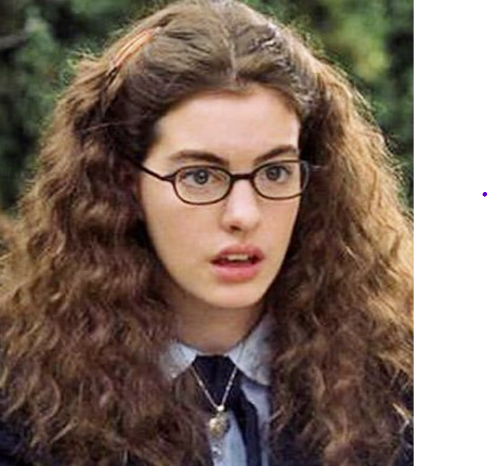


Slide 13
No matter your “place” in life,
in Christ
you are loved, wanted, and highly valued.
IOW, you are to die for!

Slide 14
1 Peter 1:6-9
Trials are invaluable for they produce a priceless reward.

Slide 15
3. Find WORTH in God’s calling (9-11)
a.) The poor are made rich in Christ (9)
b.) The rich should remain humble in Christ (10a)
c.) A metaphor of life’s brevity is shared (10b-11)
James is referencing Isaiah 40:7-8

Slide 16
We are to find joy in God’s nurturing.
We are to find wisdom in God’s care.
We are to find worth in God’s calling.
We are to find comfort in God’s crown.

Slide 17
4. Find COMFORT in God’s crown (12)
a.) The blessing is real (12a)
b.) The promise is true (12b)

Slide 18
“Maintain a Heavenly Focus”
James 1:2-12 (focus on 9-12)

