Slide 1

Advent –
Is the four weeks of Christmas
where we focus on hope, love,
joy, and peace in the birth of
our Savior, Jesus Christ.

Slide 2
“Jesus is the Promise of Hope”
Luke 2:25-35 (ESV)

Slide 3
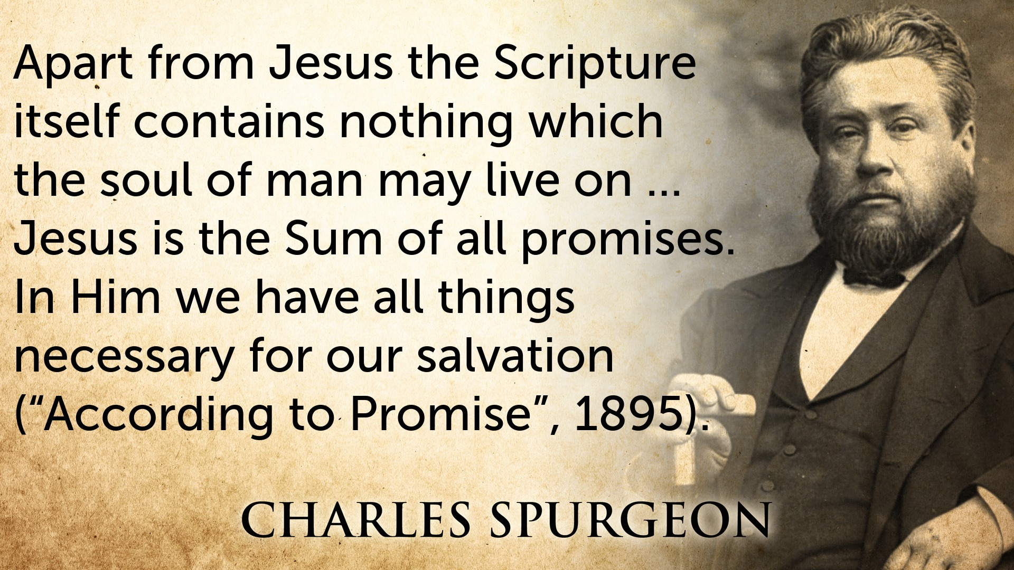

Slide 4
What is hope?
Isaiah 49:23 Psalm 37:9 Jeremiah 29:11

Slide 5
Old Testament Hope
Looked Forward
to a Future Promise
(Prophesies Proclaimed)

Slide 6
New Testament Hope
Looked Backward
at the Life of Christ
(Prophesies Fulfilled)

Slide 7
1 Tim 1:1
Rom 15:13
Rom 8:24-25
Gal 5:5
Titus 2:13

Slide 8
Simeon’s Story
The man who connected the OT prophesies with the NT fulfillment.

Slide 9
Luke 2:25-35 (ESV)

Slide 10
“Jesus is the Promise of Hope”
1. The SIGNS of God give us hope.

Slide 11
Jesus is the Promise of Hope
The SIGNS of God give us hope.
The PRESENCE of God gives us hope.

Slide 12
Jesus is the Promise of Hope
The SIGNS of God give us hope.
The PRESENCE of God gives us hope.
The SACRIFICE of God gives us hope.

Slide 13
Simeon saw the day when the Promise of Hope was fulfilled.
Our hope is birthed in history’s promise.

Slide 14
Simeon say the day when the Promise of Hope was fulfilled.
Our hope is birthed in history’s promise.
Our hope, while delayed, is evident in present reality.

Slide 15
Simeon say the day when the Promise of Hope was fulfilled.
Our hope is birthed in history’s promise.
Our hope, while delayed, is evident in present reality.
Our hope for a bright future changes lives.

Slide 16
Jesus is that hope.

Slide 17
Jesus is that hope.
Jesus is OUR hope.

Slide 18
Jesus is that hope.
Jesus is our hope.
He is our ONLY HOPE.

Slide 19
Jesus is that hope.
Jesus is our hope.
He is our only hope.
Jesus is the Promise of Hope!

