Slide 1
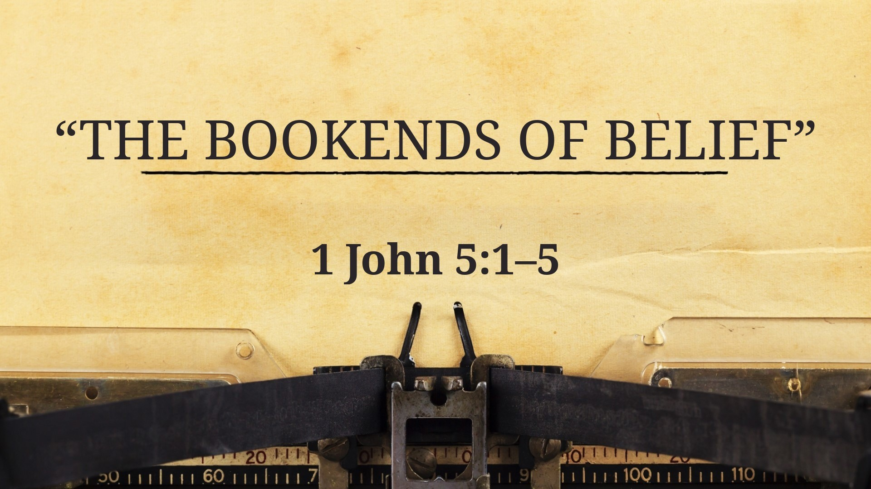

Slide 2
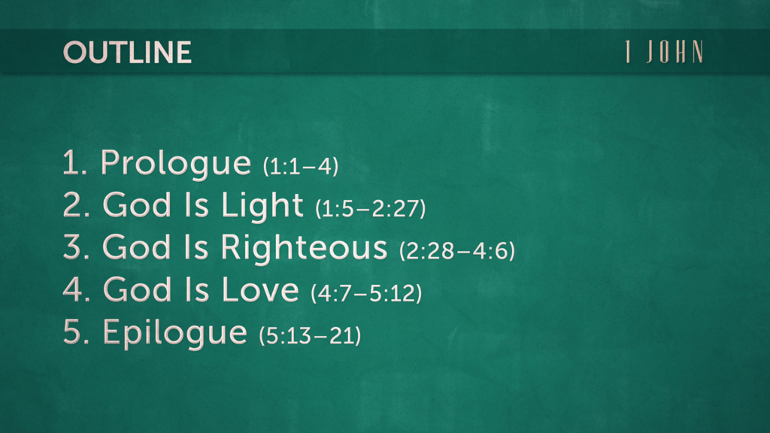

Slide 3
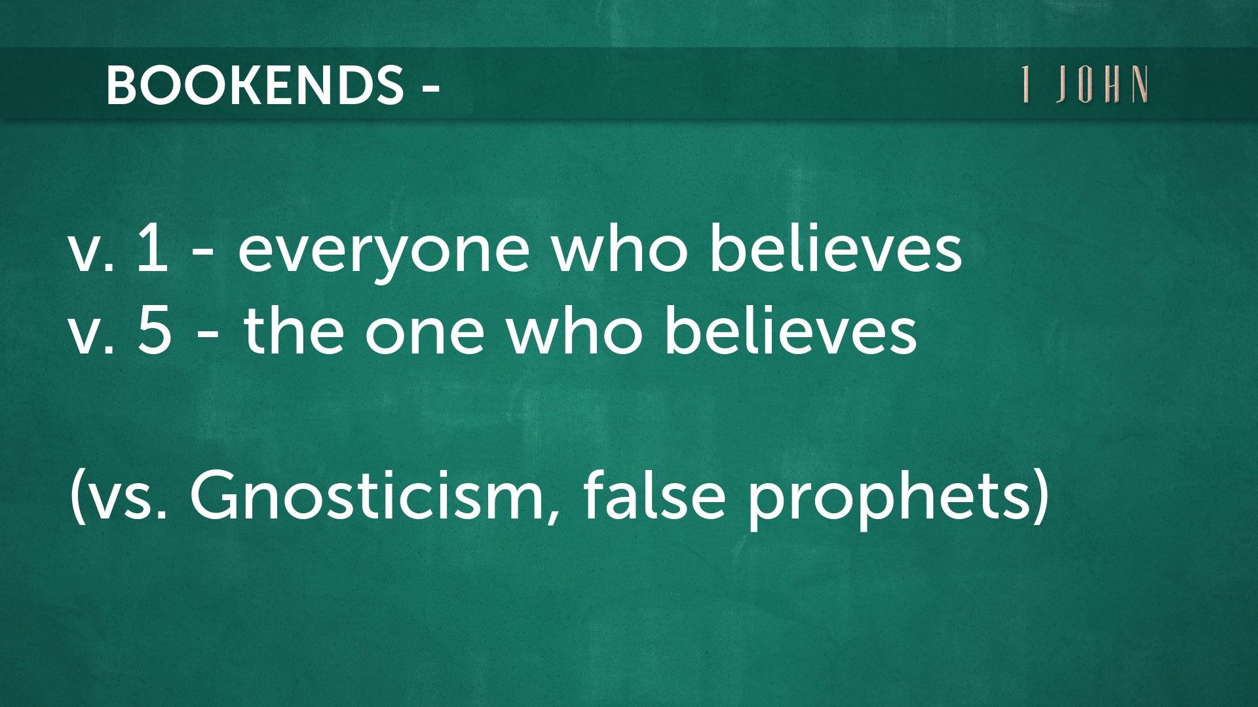

Slide 4
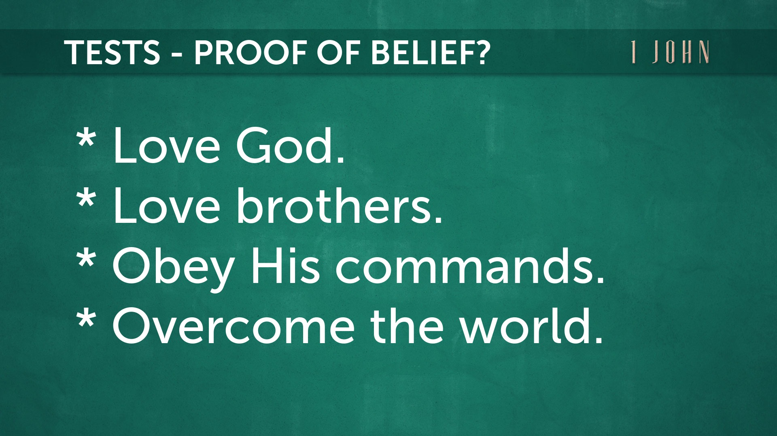

Slide 5


Slide 6

1 John 5:1a (NASB)
Whoever (everyone who) believes that Jesus is the Christ (Messiah) is born of God, and whoever loves the Father loves the child born of Him.

Slide 7


Slide 8
1 John 5:1b (NASB)
Whoever (everyone who) believes that Jesus is the Christ (Messiah) is born of God, and whoever loves the Father loves the child born of Him.

Slide 9
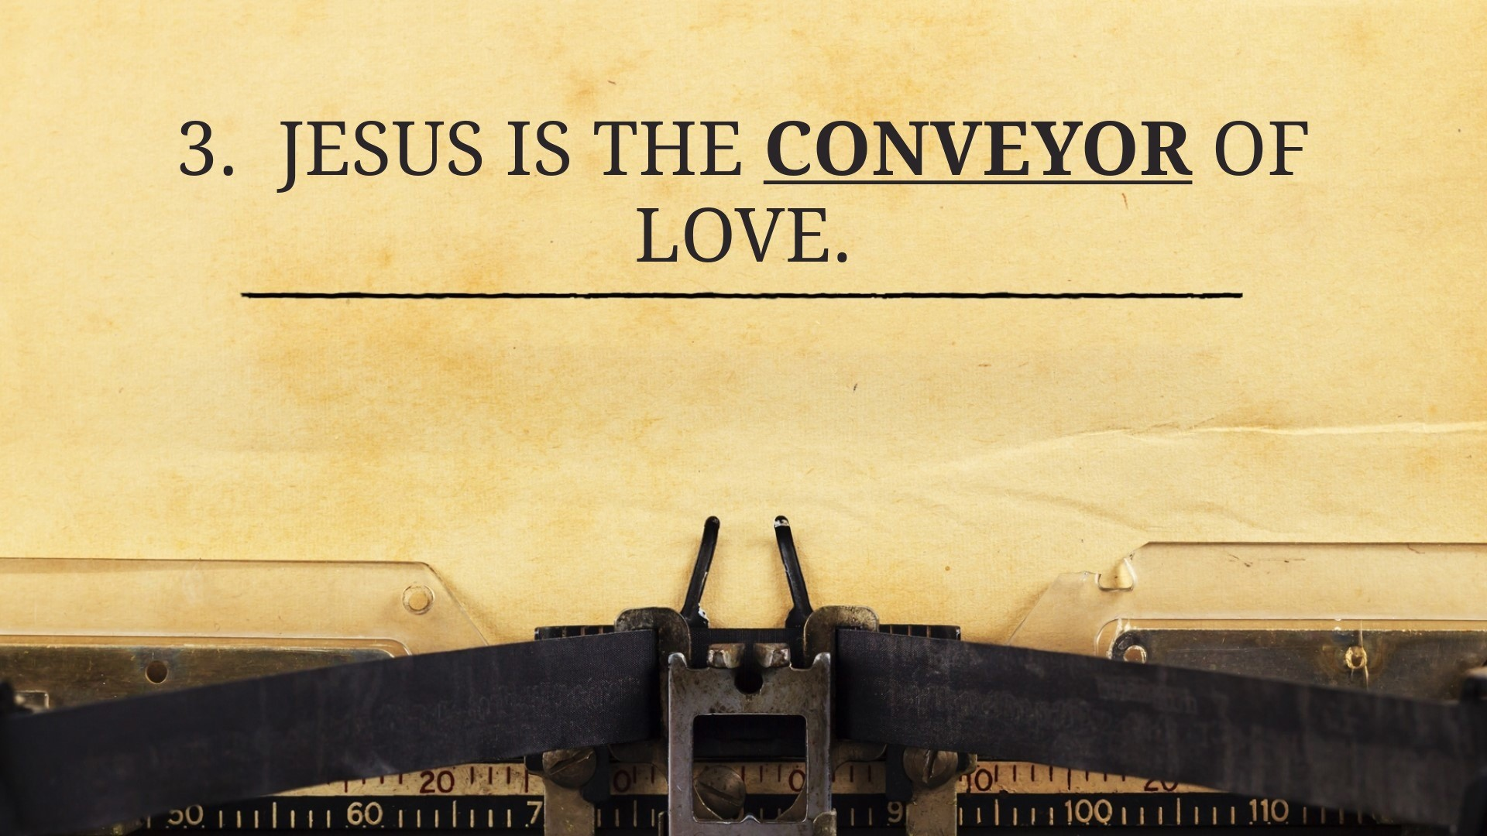

Slide 10
1 John 5:2 (NASB)
By this we know that we love the children of God, when we love God and observe (obey, carry out) His commandments (commands).

Slide 11
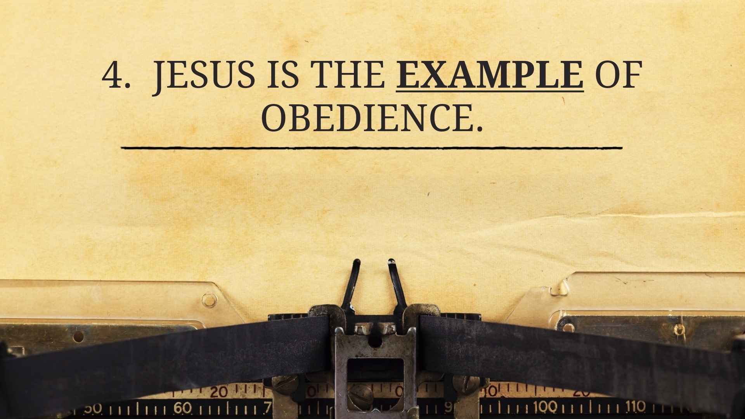

Slide 12
1 John 5:3 (NASB)
For this is the love of God, that we keep His commandments; and His commandments are not burdensome.

Slide 13
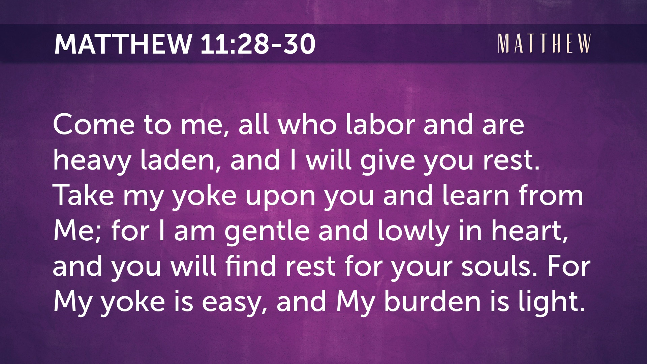

Slide 14


Slide 15
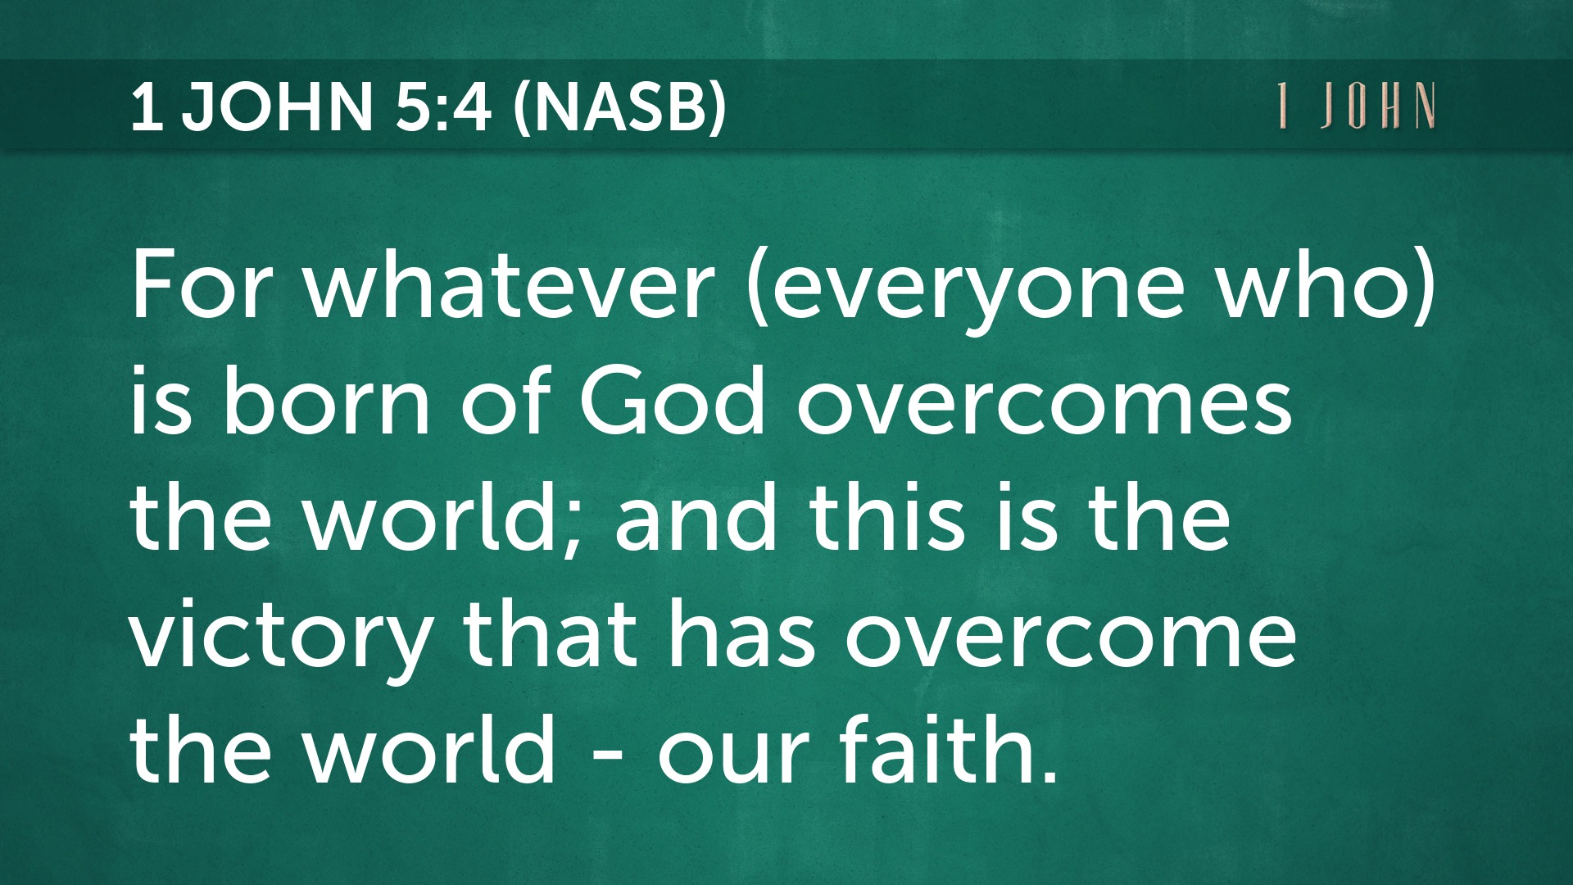

Slide 16
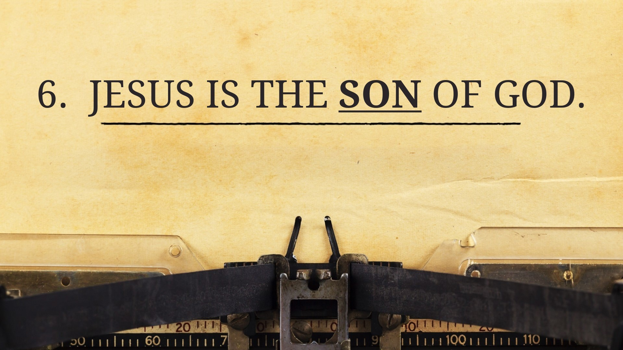

Slide 17
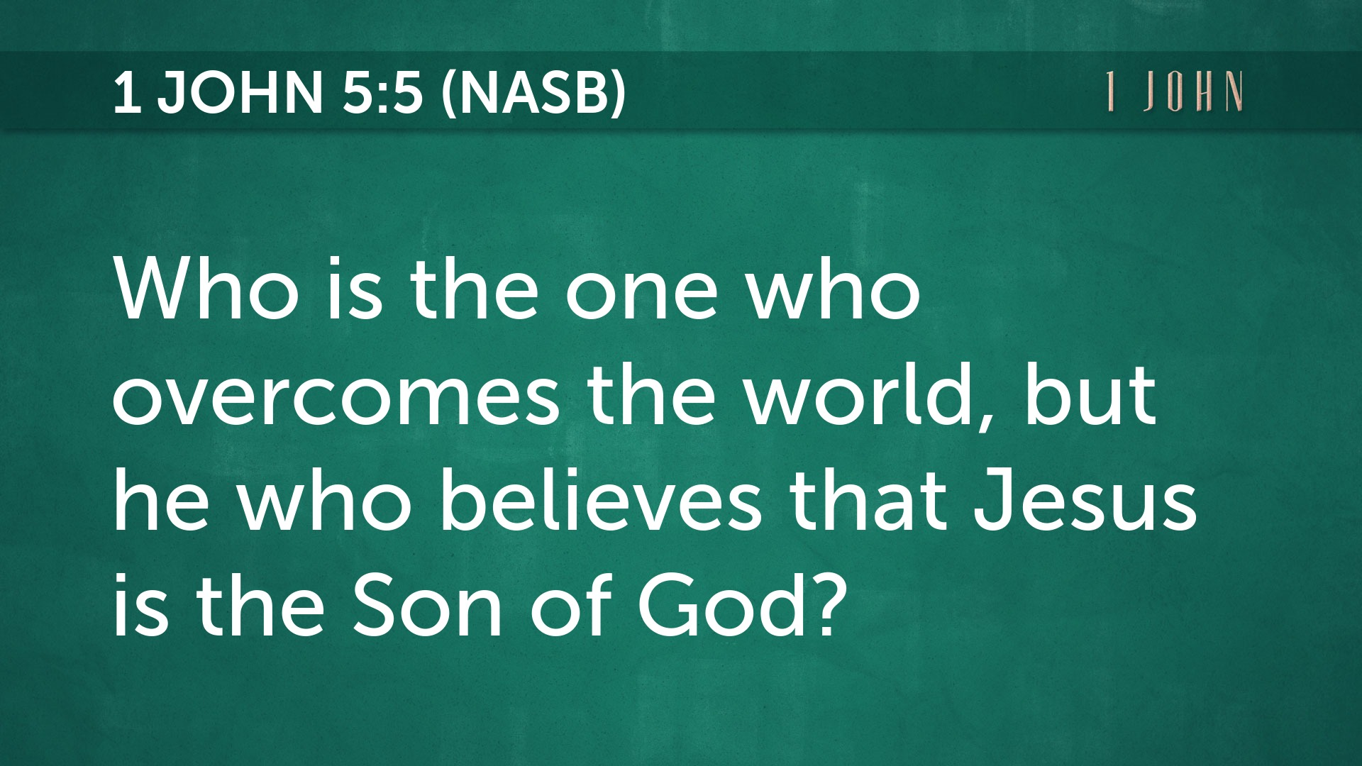

Slide 18


