Slide 1

Now That You Have Passed the Test, Make Your Testimony Sure
1 John 1:1-3 5:6-12

Slide 2
1 John 5:6 (nasb)
This is the One who came by water and blood, Jesus Christ; not with the water only, but with the water and with the blood. It is the Spirit who testifies, because the Spirit is the truth.

Slide 3
1 John 5:7-8 (nasb)
7 For there are three that testify:
8 the Spirit and the water and the blood; and the three are in agreement.

Slide 4
1 John 5:9 (nasb)
If we receive the testimony of men, the testimony of God is greater; for the testimony of God is this, that He has testified concerning His Son.

Slide 5
1 John 5:10 (nasb)
The one who believes in the Son of God has the testimony in himself; the one who does not believe God has made Him a liar, because he has not believed in the testimony that God has given concerning His Son.

Slide 6
1 John 5:11-12 (nasb)
11 And the testimony is this, that God has given us eternal life, and this life is in His Son.
12 He who has the Son has the life; he who does not have the Son of God does not have the life.

Slide 7
There are Four Indisputable Testimonies:
The Apostle John
The Holy Spirit
God the Father
The believer
Testimonies about Jesus in John 5:31-46:
John the Baptist, the works of Jesus, God the Father,
the Scriptures, and Moses.

Slide 8

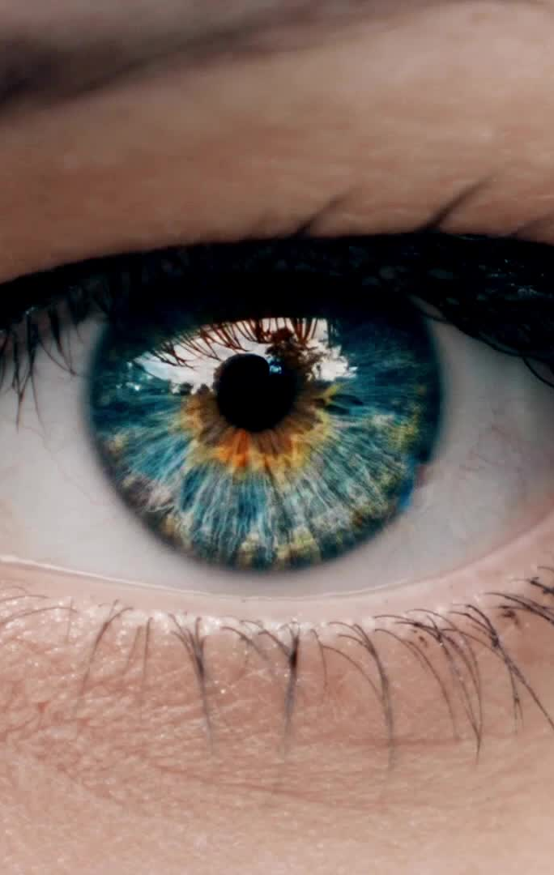
Four Indisputable Testimonies:
The eye-witness of John (1:1-3)

Slide 9
1 John 1:1
What was from the beginning, what we have heard, what we have seen with our eyes, what we have looked at and touched with our hands, concerning the Word of Life –

Slide 10
1 John 1:2
and the life was manifested, and we have seen and testify and proclaim to you the eternal life, which was with the Father and was manifested to us –

Slide 11
1 John 1:3
what we have seen and heard we proclaim to you also, so that you too may have fellowship with us; and indeed our fellowship is with the Father, and with His Son Jesus Christ.

Slide 12
Four Indisputable Testimonies:
The eye-witness of John (1:1-3)
The Spirit’s testimony to the Alpha and Omega (vv. 6-8)

Slide 13
Four Indisputable Testimonies:
The eye-witness of John (1:1-3)
The Spirit’s testimony to the Alpha and Omega (vv. 6-8)
God’s testimony to His Son (vv. 9, 10b)

Slide 14
Four Indisputable Testimonies:
The eye-witness of John (1:1-3)
The Spirit’s testimony to the Alpha and Omega (vv. 6-8)
God’s testimony to His Son (vv. 9, 10b)
The personal testimony of belief in Jesus (v. 10)

Slide 15
Four Indisputable Testimonies:
The eye-witness of John (1:1-3)
The Spirit’s testimony to the Alpha and Omega (vv. 6-8)
God’s testimony to His Son (vv. 9, 10b)
The personal testimony of belief in Jesus (v. 10)
The testimony of eternal life defined (vv. 11-12)

