Slide 1

The Worried Warrior Turned Worshiper
A Study of Gideon – Judges 6-8 (summarized)

Slide 2
Gideon – The Warrior
6:12

Slide 3
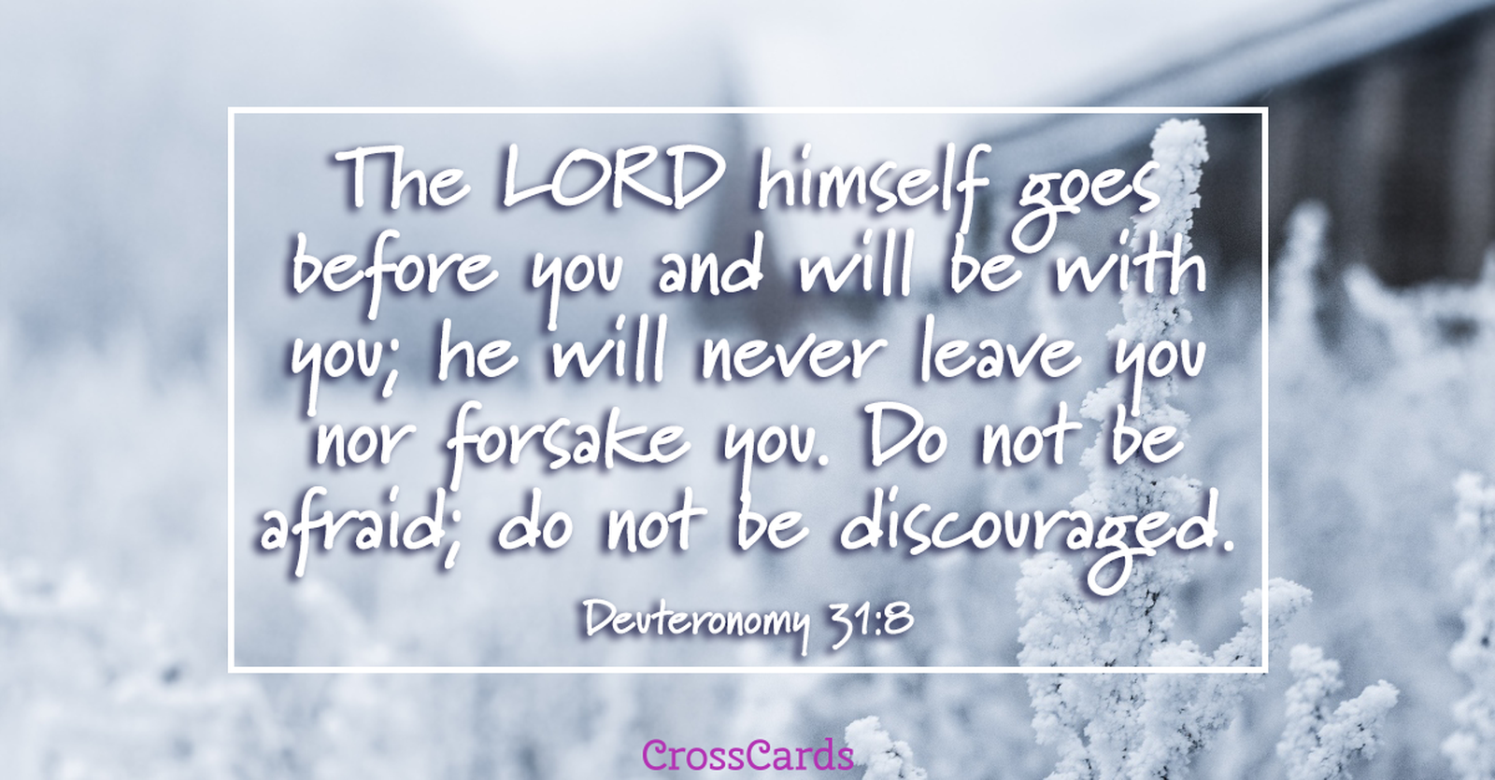

Slide 4
Gideon – The Worrier
Stay here … fleece …

Slide 5
Gideon – The Worshiper
7:15

Slide 6
But He said to me, “My grace is sufficient for you, for my power is made perfect in weakness.” 2 Cor 12:9 (ESV)

