Slide 1

“Ambassadors Behind Enemy Lines –
Our Dual Citizenship in a Foreign Land”
A look at the misapplied prayer of 2 Chronicles 7:14 and a misguided view of 1 Peter 2:9-12.

Slide 2

2 Chronicles 7:14 –
The Old Command & the CHARACTER of God

Slide 3
Four synonyms for repentance or aspects of repentance appear in this verse:
1. Humble themselves
2. Pray
3. Seek My face
4. Turn

Slide 4
Three Promises from God to ISRAEL:
1. Hear
From heaven
2. Forgive
Their sins
3. Heal
Their land

Slide 5
1 Peter 2:9-12 –
The New Command and the MISSION of God

Slide 6

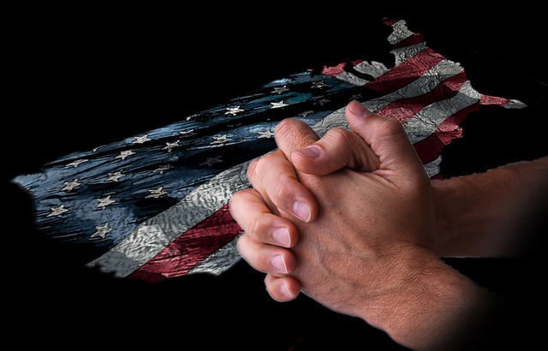
Complacency has led to a lack of urgency.
We are failing to reach the next generation.
“As Christians, we should not celebrate America as a great nation, rather, we should mourn America for its apostasy (the abandonment or renunciation of a religious belief). Don’t pray for God to heal our land, but that He would replace hearts of stone!”
– Pastor David

