Slide 1

Big Gulp from 7-11
1 John 2:7-11

Slide 2

“The Walk of a True Believer”
1 John 2:7-11

Slide 3
A True Believer . . .
Walks in the Truth (7-8)

Slide 4
A True Believer . . .
Walks in the Truth (7-8)
Walks in the Light (9)

Slide 5
A True Believer . . .
Walks in the Truth (7-8)
Walks in the Light (9)
Walks in the Love (10)

Slide 6

Diving DEEP into 1 John 2:10

Slide 7
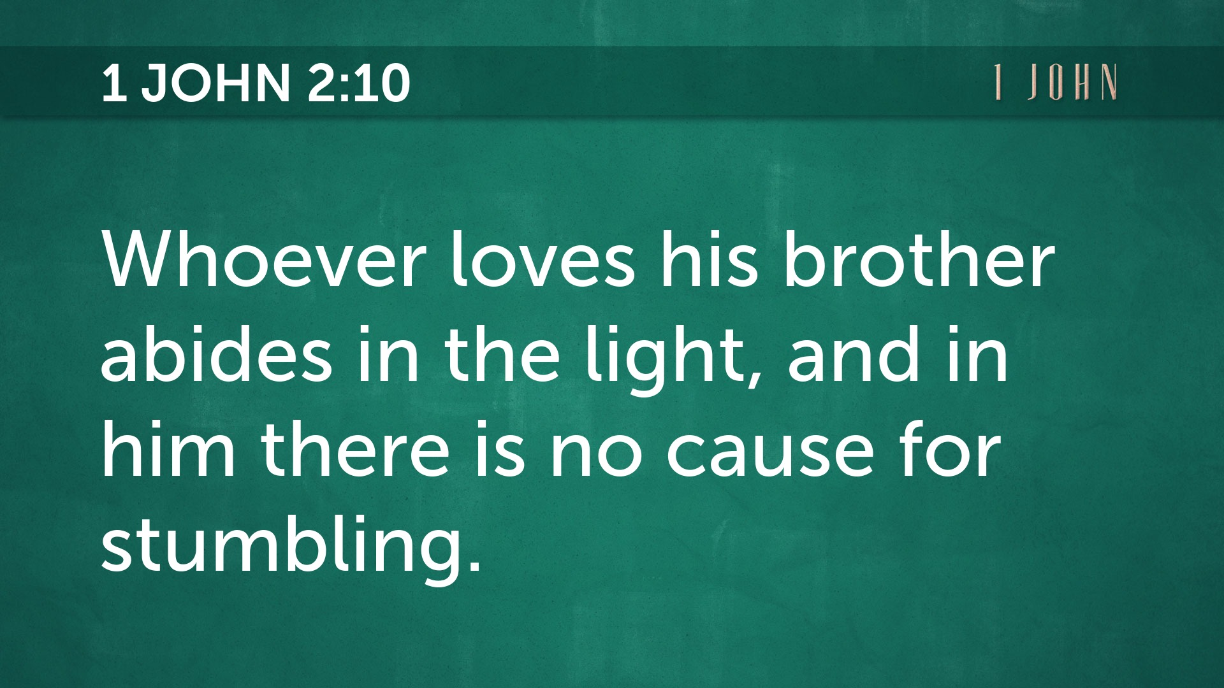

Slide 8


Slide 9
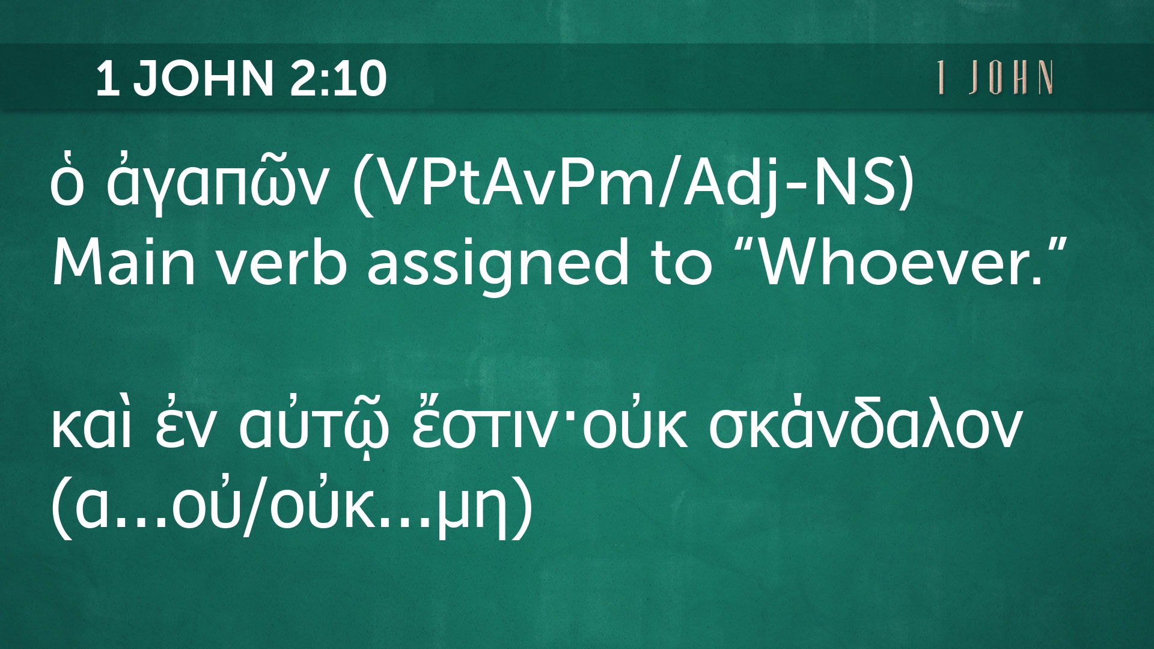

Slide 10
A True Believer . . .
Walks in the Truth (7-8)
Walks in the Light (9)
Walks in the Love (10)
Shows others the Way (11)

