Slide 1

“Growing in Christ Means Living the Life”
1 John 2:12-14

Slide 2

Three Spirit Led Groups –
Spoon Fed … Scripturally Wed … Never Dead
1. The Reclaimed Group is Spirit Led (all believers) – v. 12
2. The Regurgitated Group is Spoon Fed (babes in Christ) – v. 13c
3. The Reformed Group is Scripturally Wed (growing and conquering) – vv. 13b, 14b
4. The Reverent Group is Never Dead (mature believers, still fighting the good fight) – vv. 13a, 14a
Living Life Together - “Red and yellow,
Black and white”

Slide 3
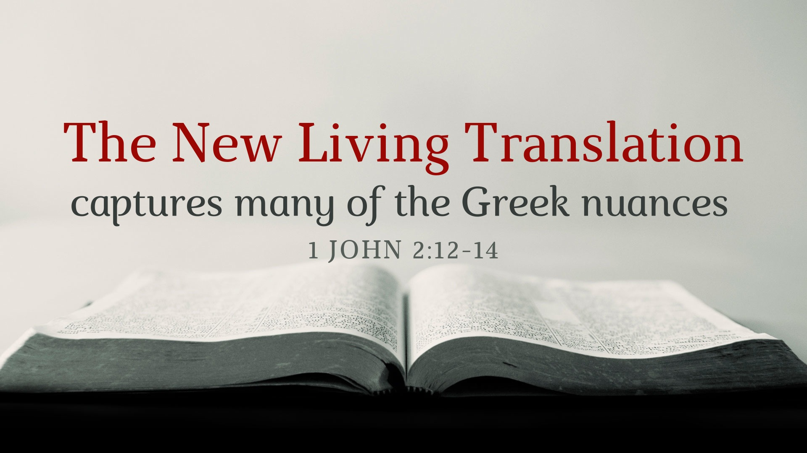

Slide 4
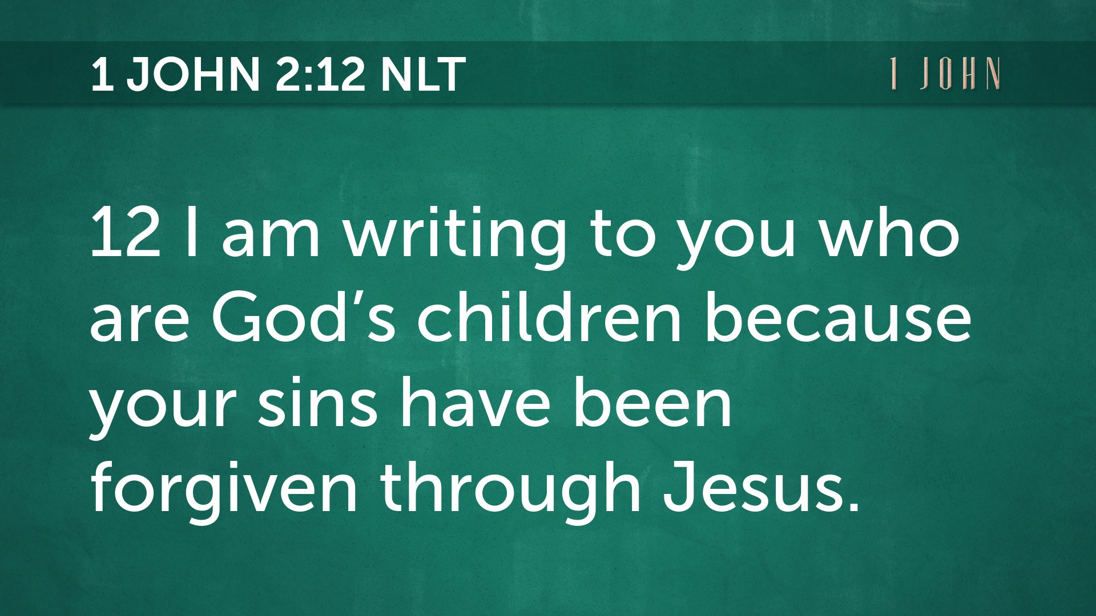

Slide 5
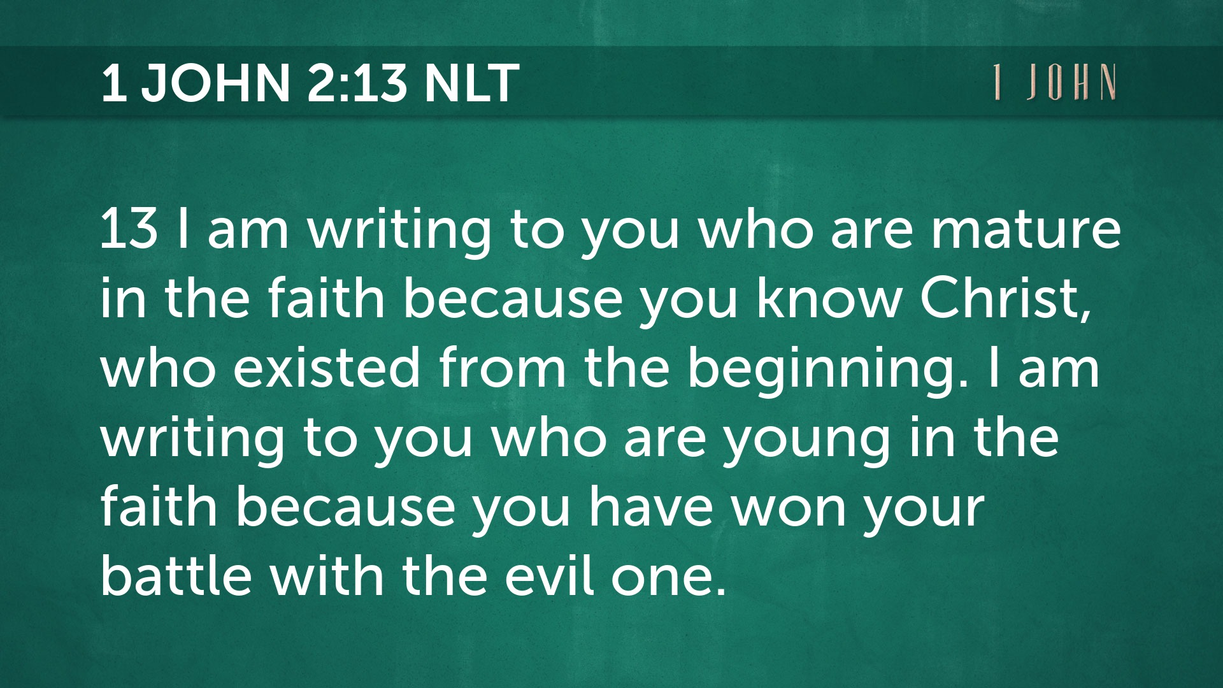

Slide 6
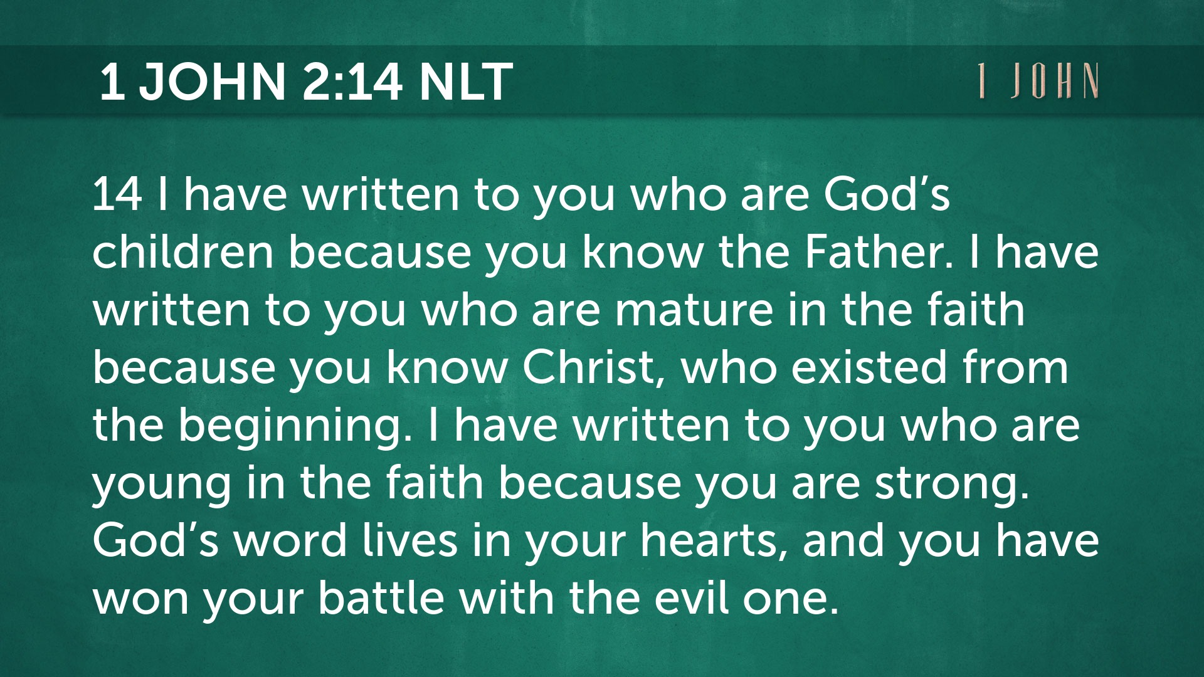

Slide 7
1. The Reclaimed Group
… is Spirit led
1 John 2:12

Slide 8
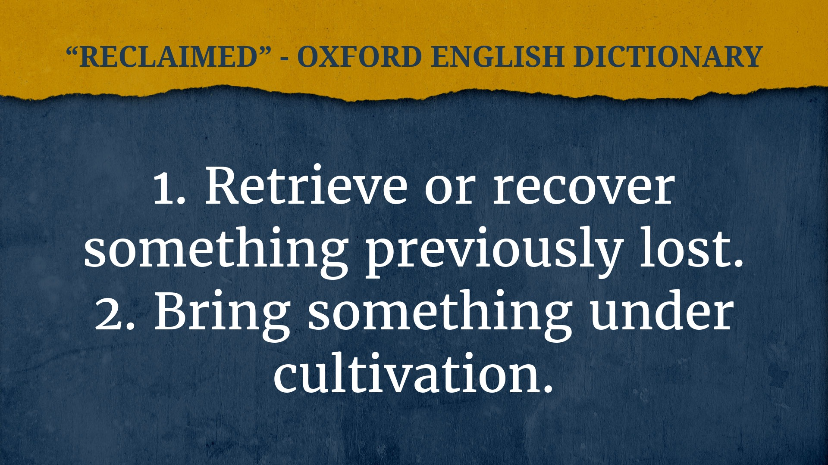

Slide 9
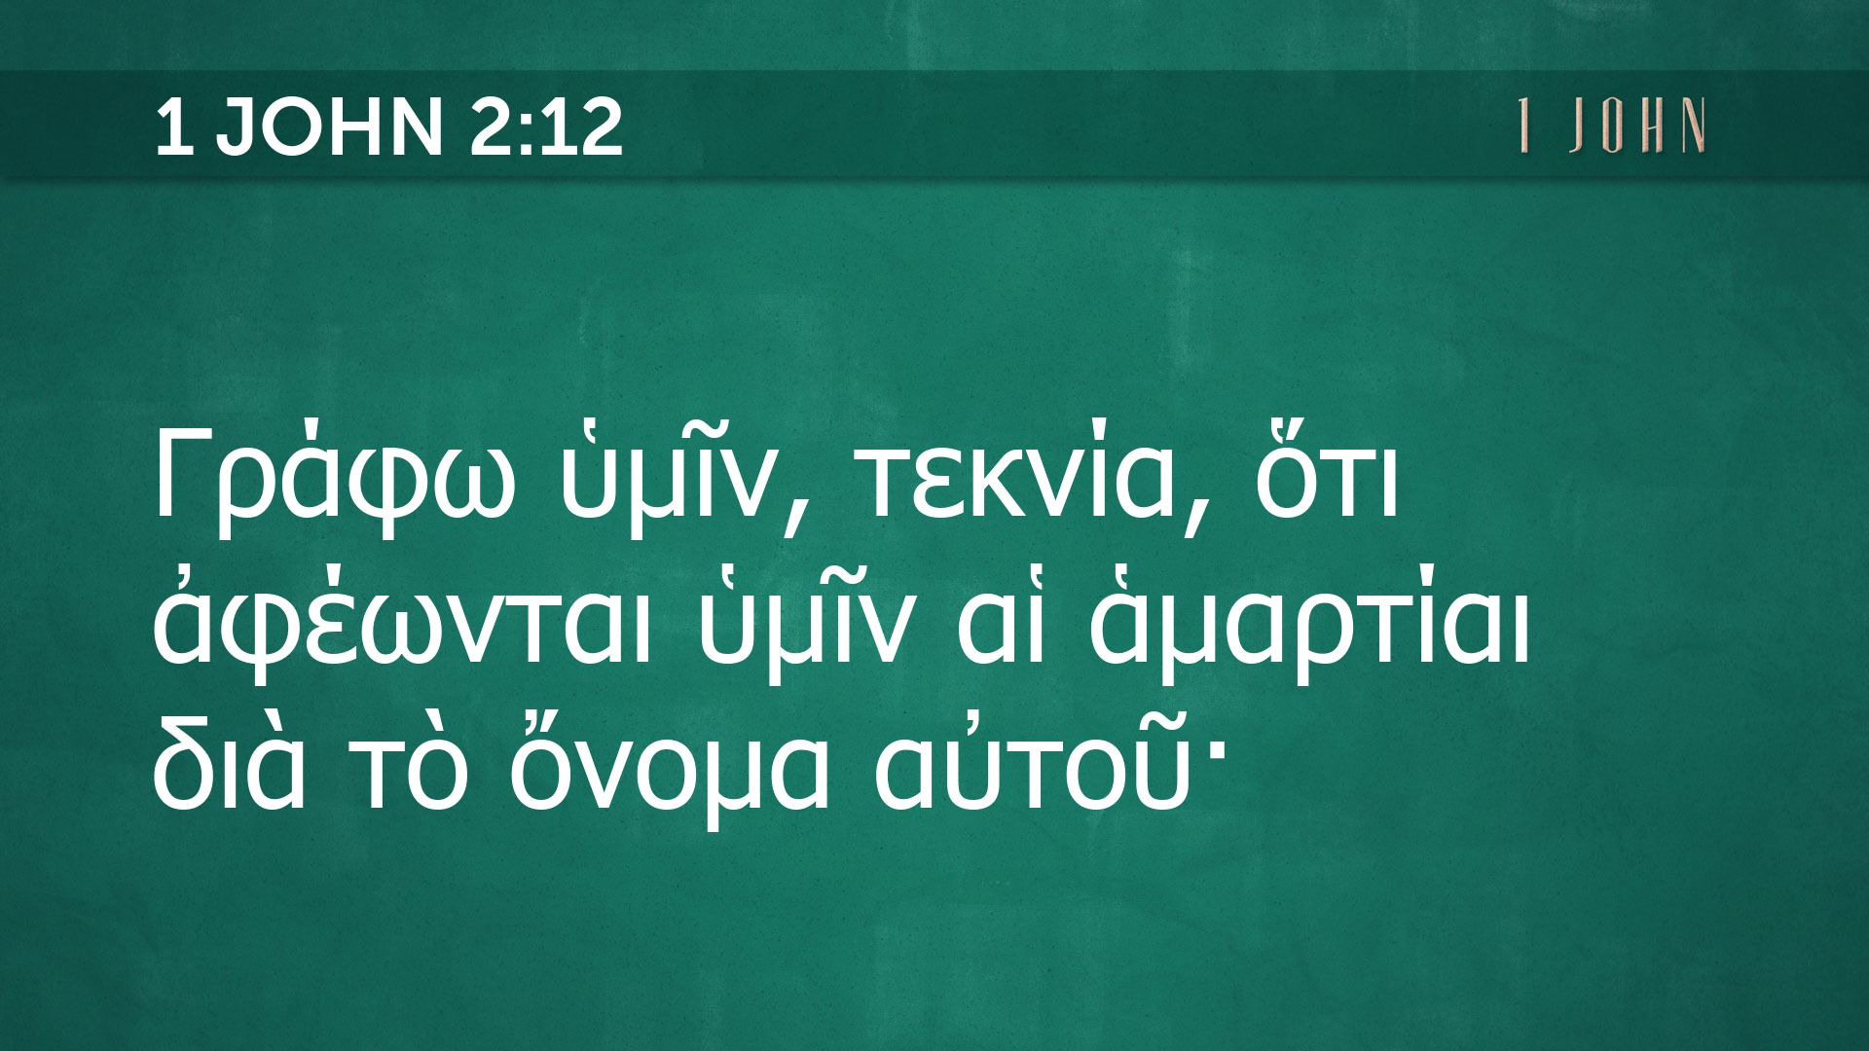

Slide 10
Verse 12 ENGLISH
Sentence Diagramming
Γράφω ὑμῖν – “I write (Γράφω) to you (ὑμῖν).”
“I” (subj)
“write” (verb)
“(to) you” (D.O.)

Slide 11
Verse 12 GREEK
Sentence Diagramming
Γράφω ὑμῖν, τεκνία, ὅτι ἀφέωνται ὑμῖν αἱ ἁμαρτίαι διὰ τὸ ὄνομα αὐτοῦ·
^{Subject = nom. or voc.}
“Sins” (ἁμαρτίαι) is in the nominative (noun) while “Children/little ones” (τεκνία) is vocative (direct address).
The subject would then be “You children who sin,” but stated with endearment.
Not “sinful” children, for ἁμαρτίαι is not an adjective.

Slide 12
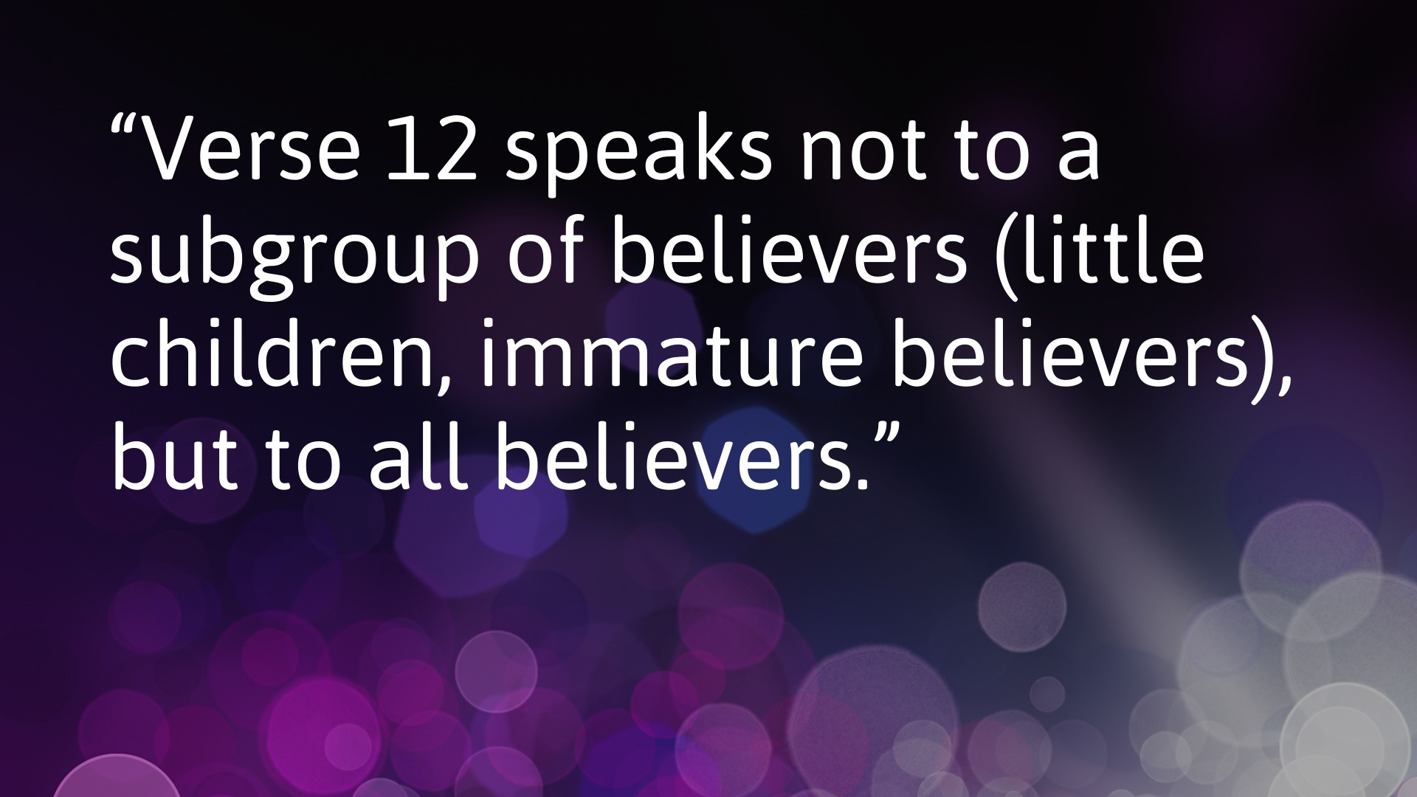

Slide 13
τεκνία (12) vs. παιδία (13)
Each group is mentioned twice (children – 12, 13c) (young men – 13b, 14b) (fathers – 13a, 14a), but the first mention of “children” is not the same as the second mention of children.
Τεκνία is a term of endearment, “little children” – see John 13:33.
Παιδία means “childish” or “without having matured” – see 1 Cor 3:2; 1 Pet 2:2; Heb 5:12-13.

Slide 14
Article that points a finger directly at a group. YOUR sins are forgiven. Contrasted to the Gnostics or outsiders.
Clarifies 1 Jn 2:2, the offer is for everyone, but forgiveness applies to believers only.

Slide 16
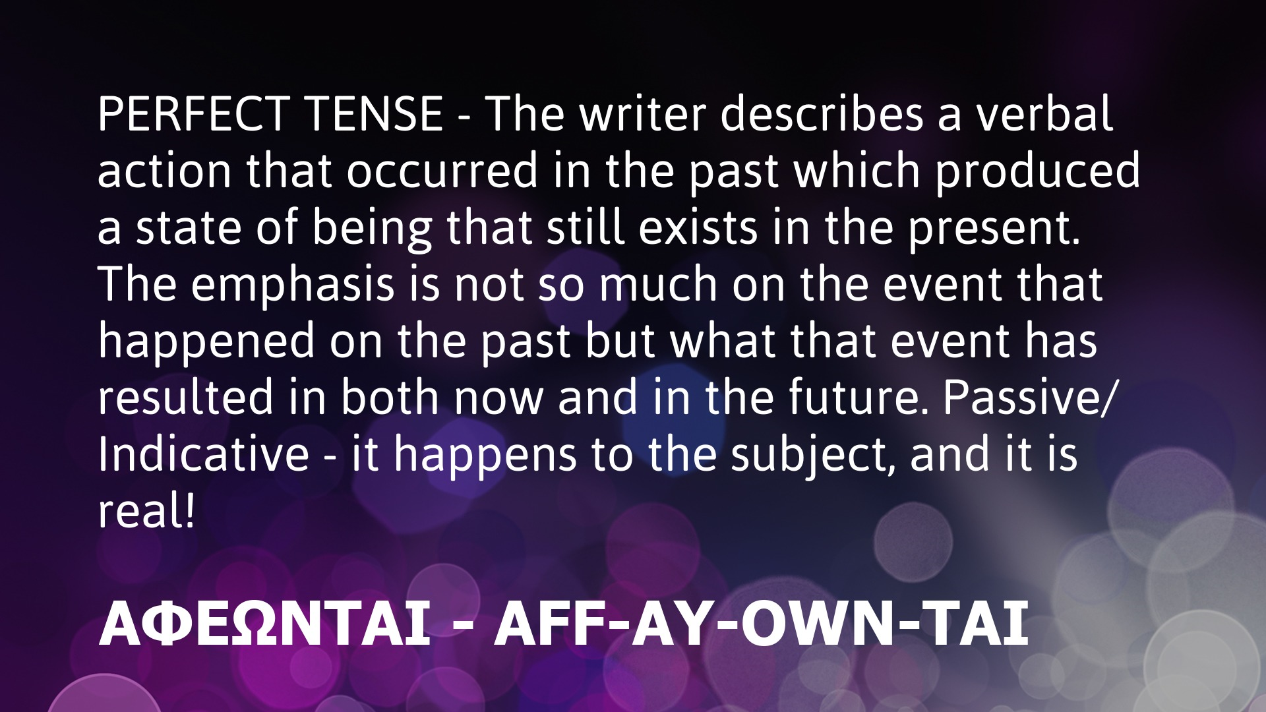

Slide 17
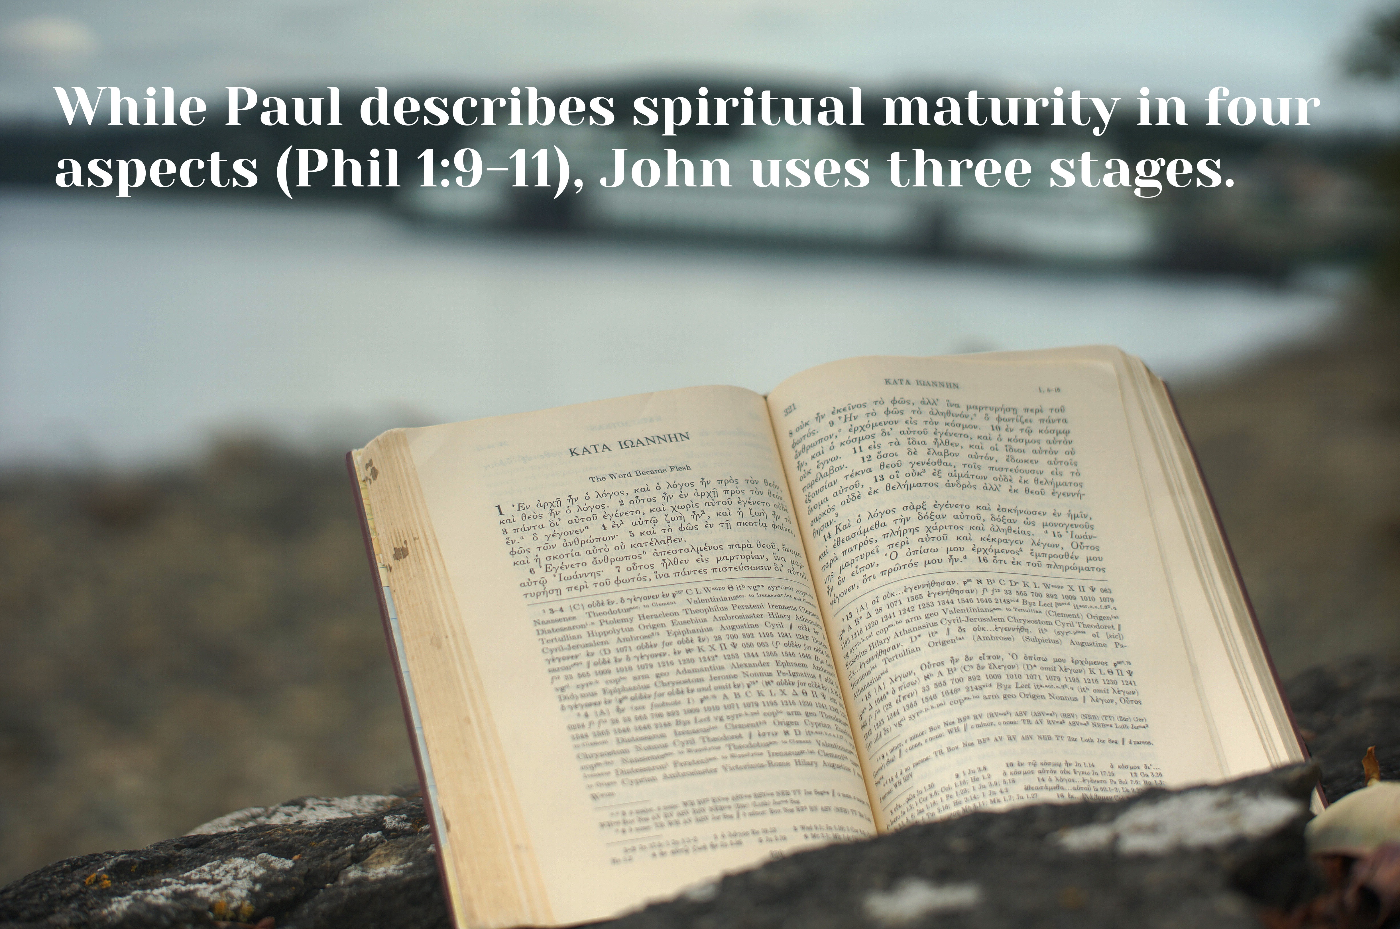

Slide 18
2. The Regurgitated Group
… is spoon fed
1 John 2:13c

Slide 19
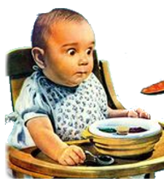
Regurgitate:
“Bring (swallowed food) up again to the mouth.”
As Christians, we are to be discipled and mentored by those who have gone before us.
“Repeat (information) without analyzing or comprehending it.”
This is where we need to change the definition for our situation, for we need to analyze and comprehend it!
This Photo by Unknown Author is licensed under CC BY-NC-ND

Slide 20
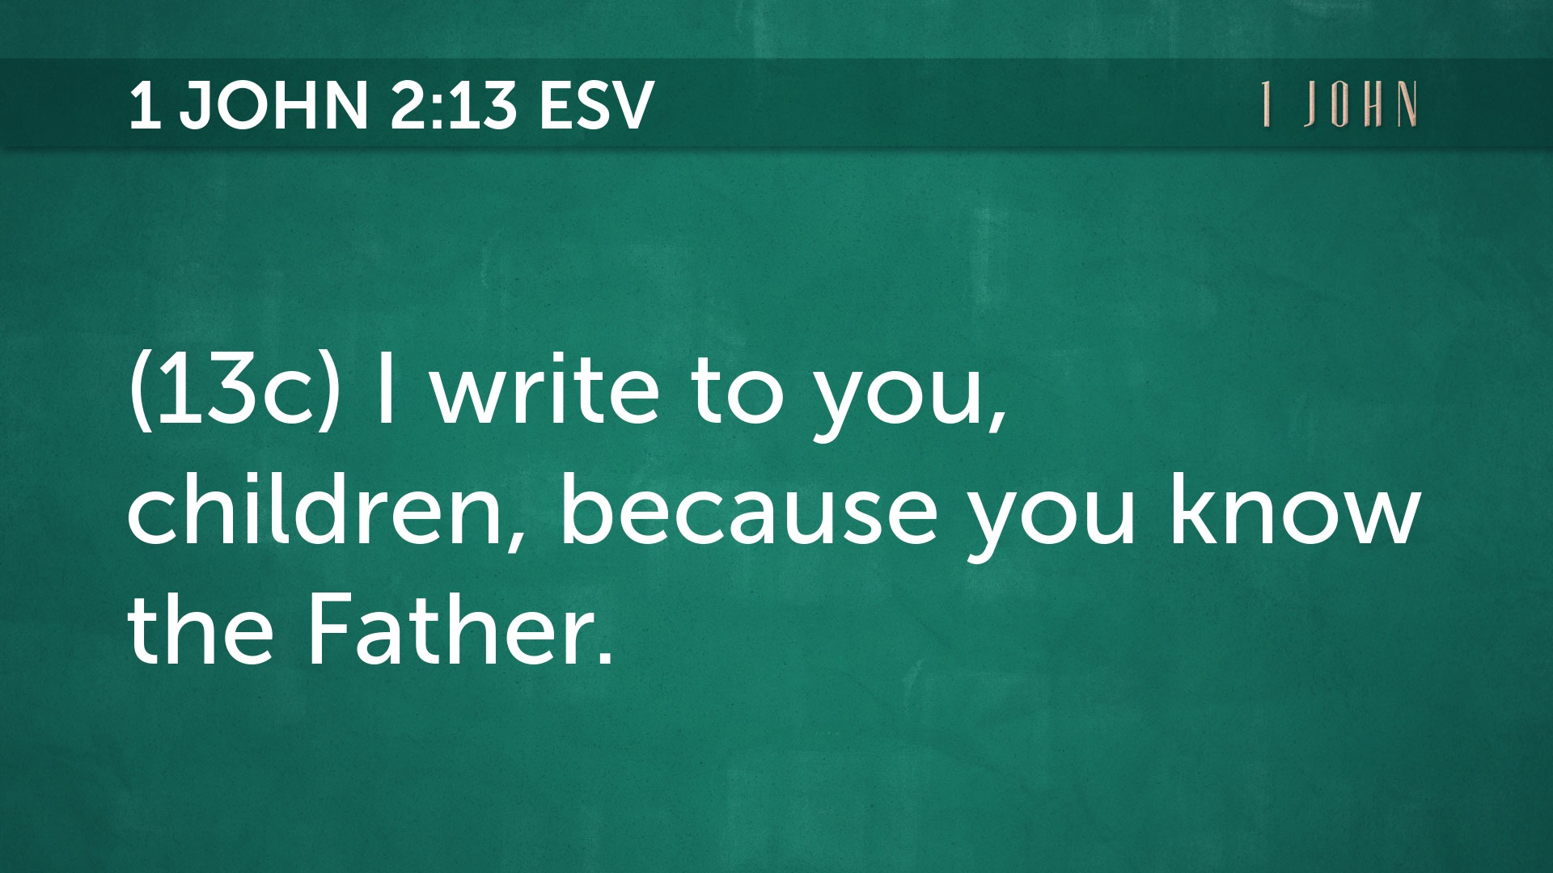

Slide 21
3. The Reformed Group
… is spiritual wed
1 John 2:13b, 14b

Slide 22
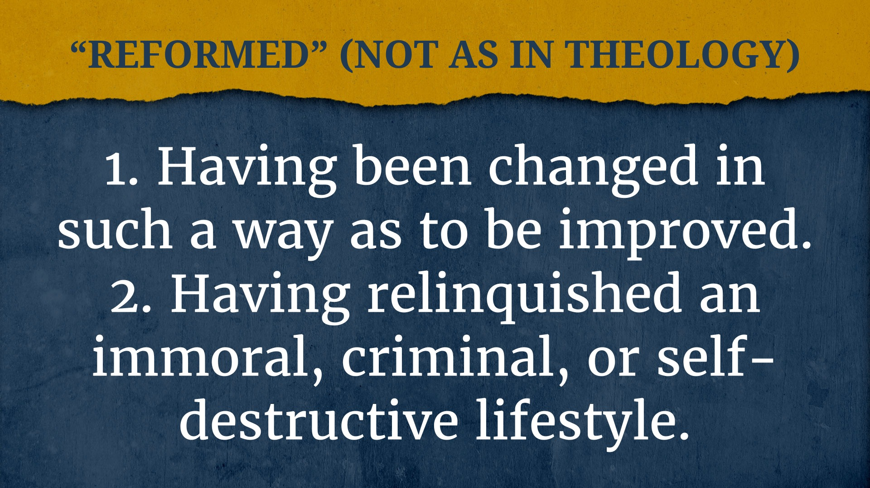

Slide 23
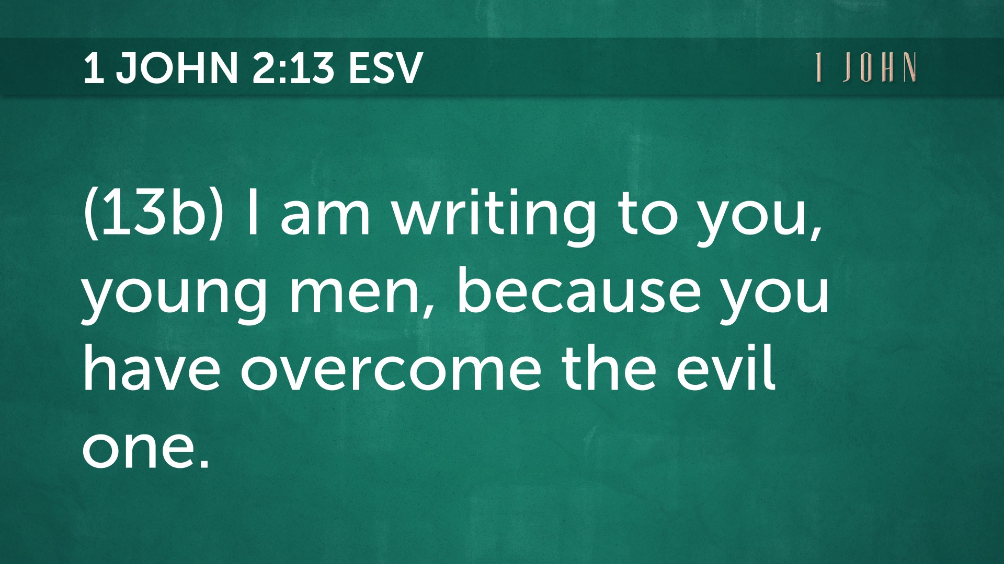

Slide 24
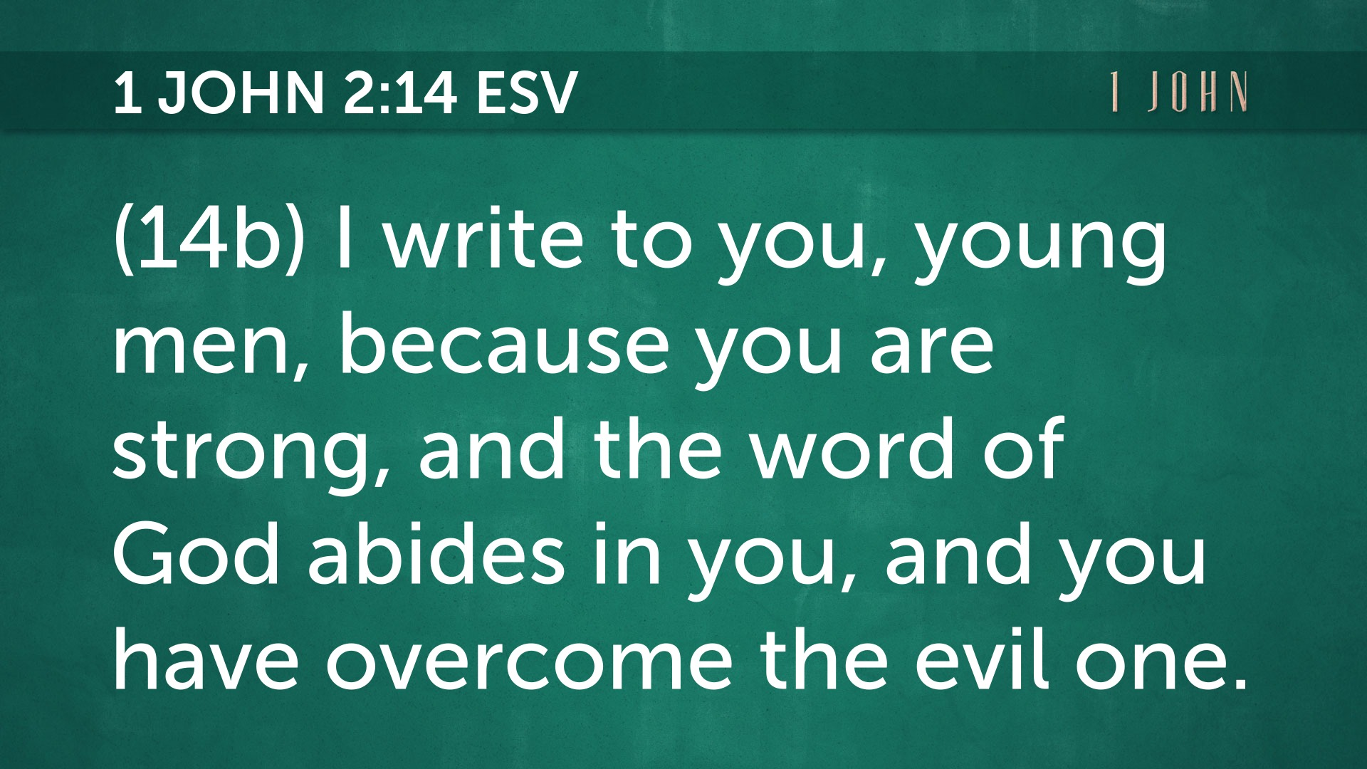

Slide 25
4. The Reverent Group
… is never dead
1 John 2:13a, 14a

Slide 26
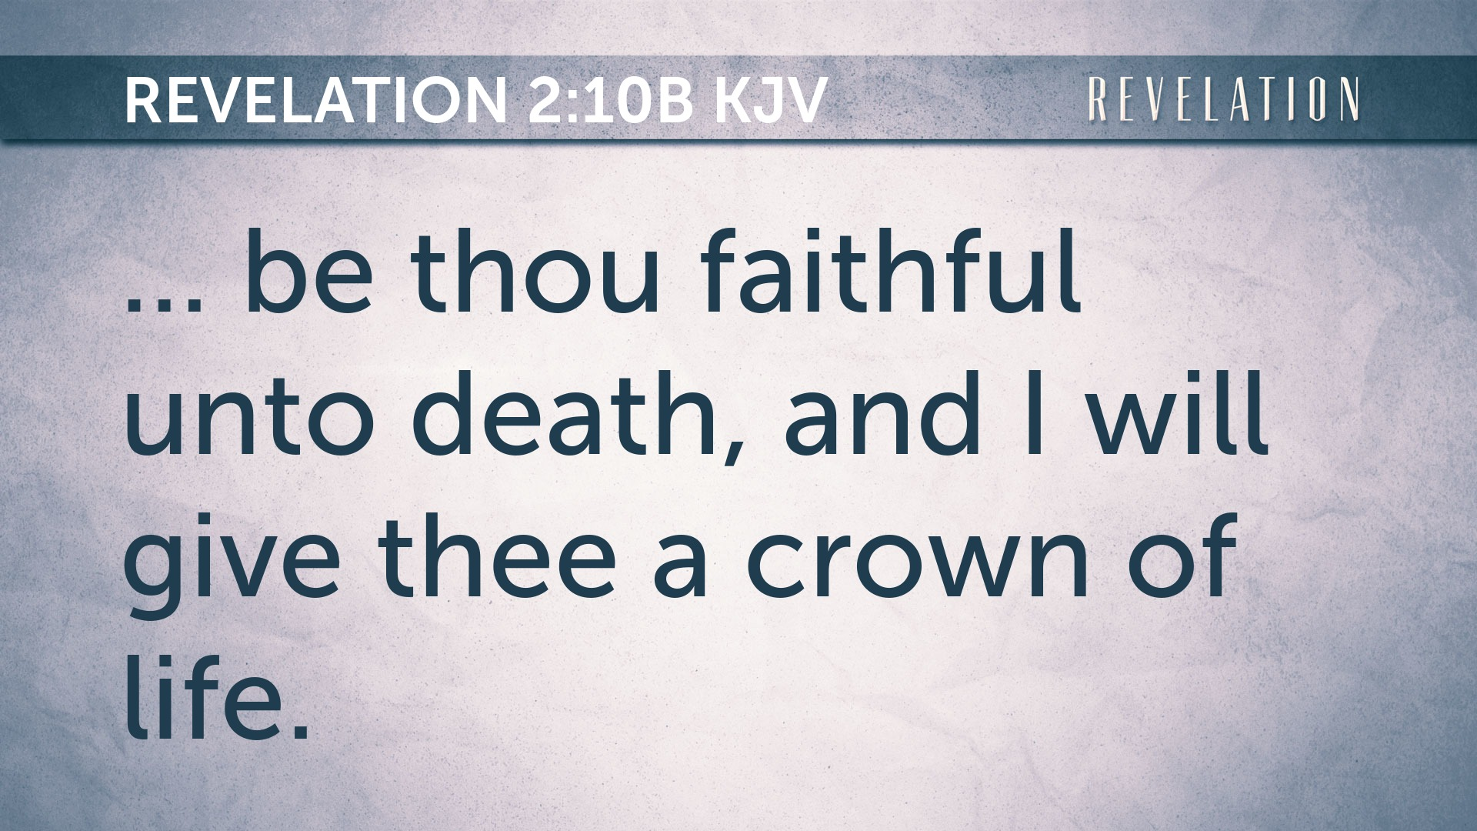
Per John … Paul also covers this in 2 Tim 4:7-8.

Slide 27
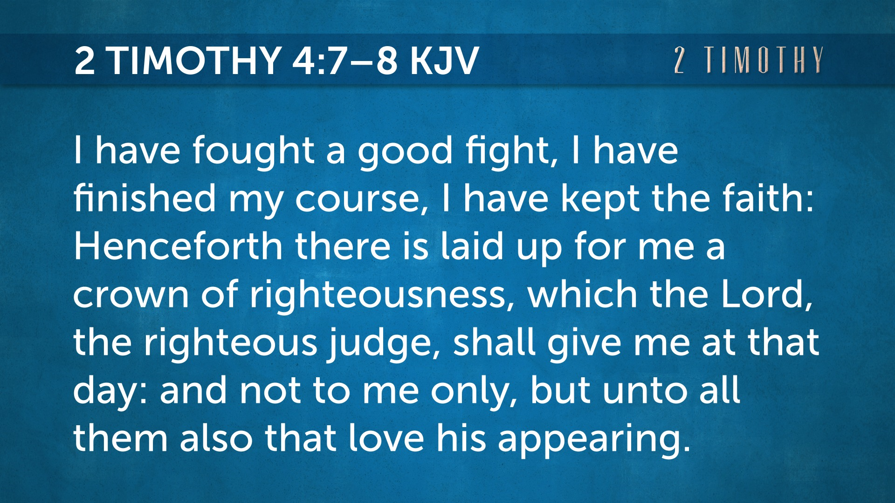

Slide 28
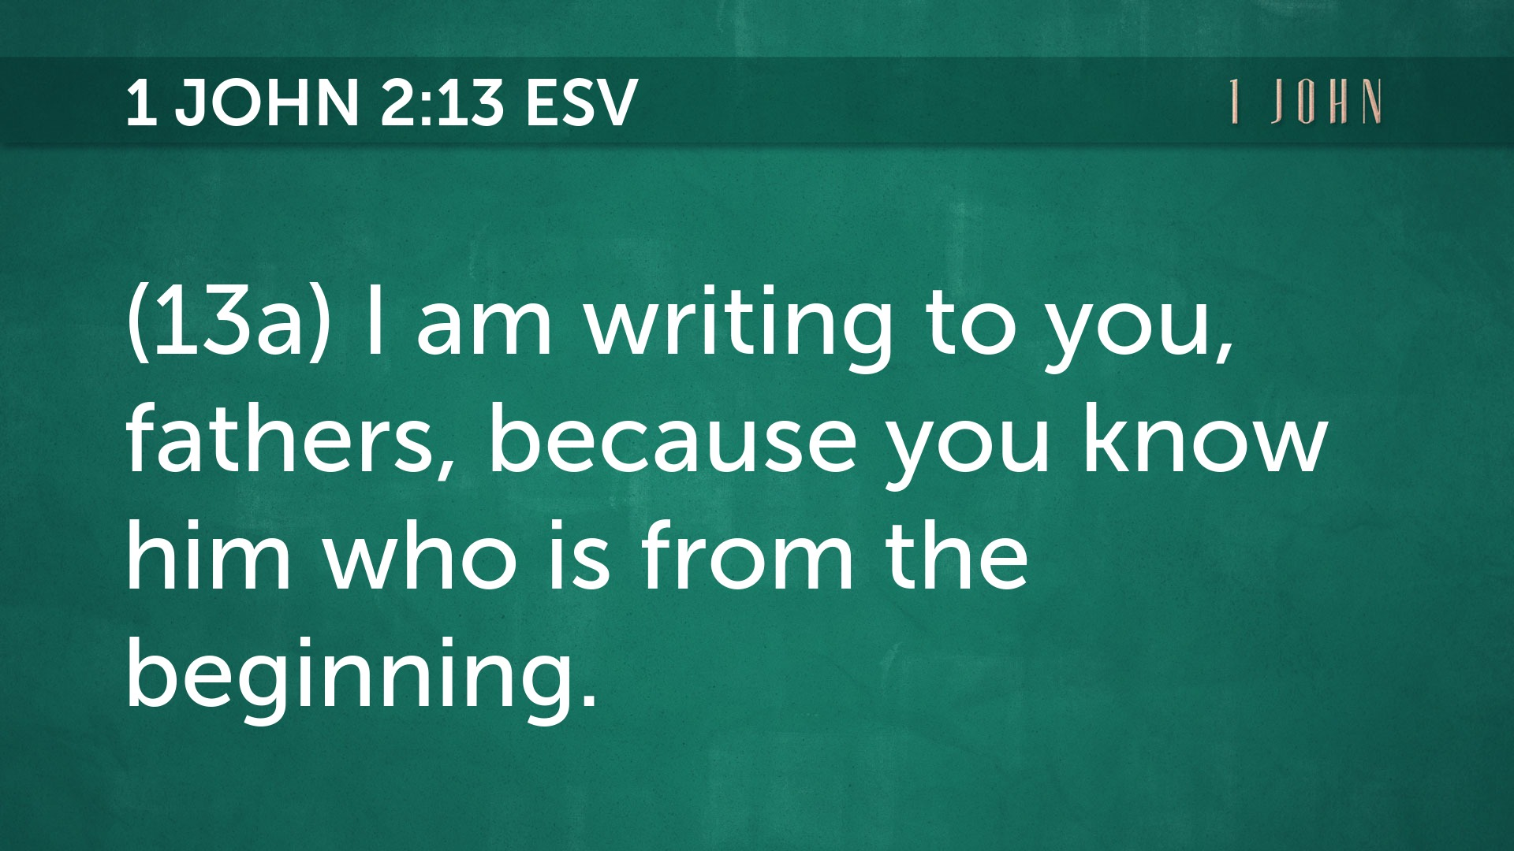

Slide 29

QUESTION –
“Who is HIM in 13a and 14a?”
God the Father?
Jesus His Son?

Slide 31
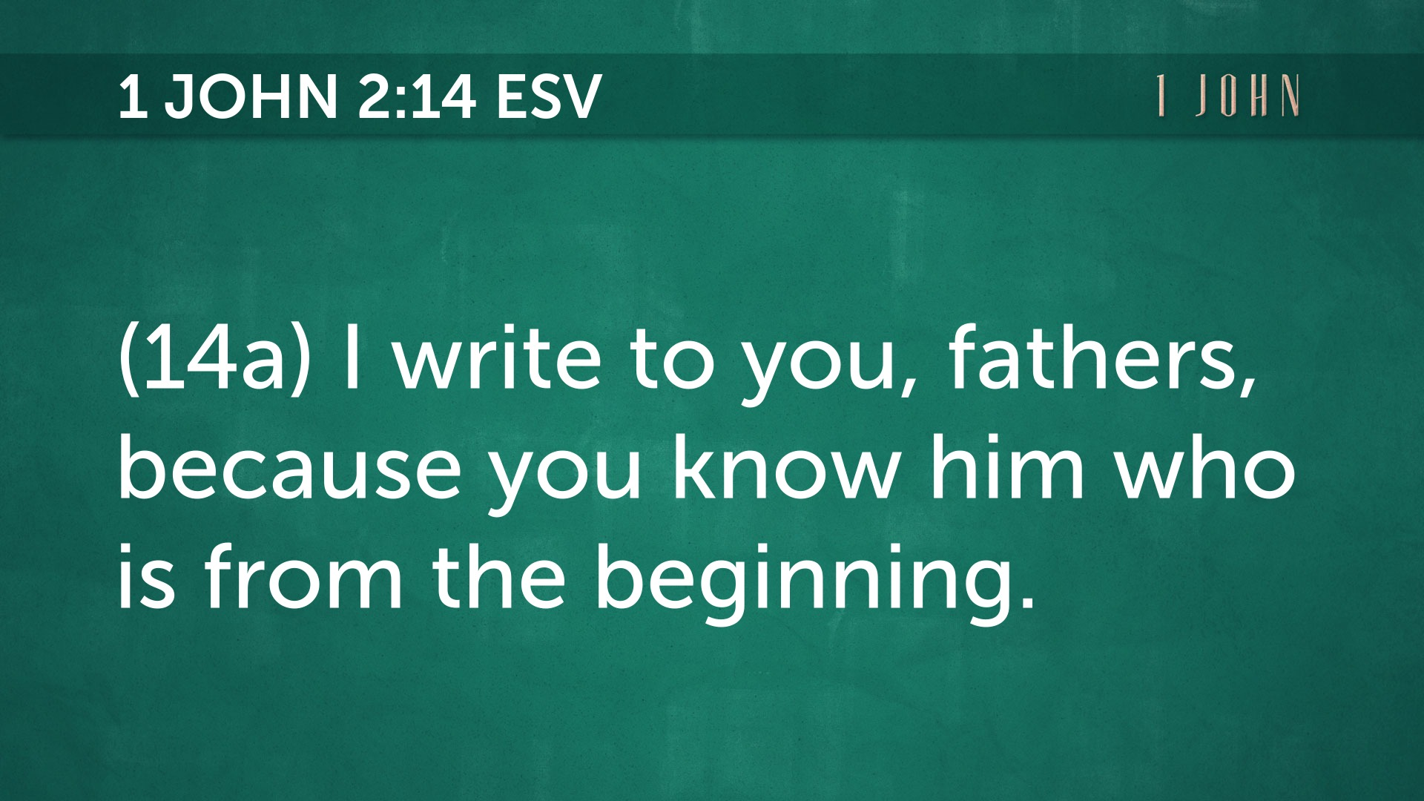

Slide 32
QUESTION –
“Why does John repeat himself?”
Does it matter?
If so, how do you apply it?

Slide 33
“Growing in Christ Means
Living the Life”
1. The Reclaimed Group is Spirit Led
2. The Regurgitated Group is Spoon Fed
3. The Reformed Group is Scripturally Wed
4. The Reverent Group is Never Dead
1 John 2:12-14

