Slide 1
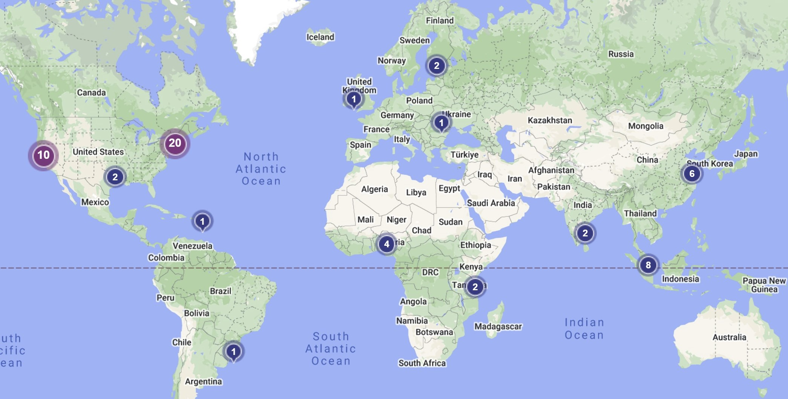
FBC’s Story is Impacting the World!

Slide 2

“Hamartiology: The Doctrine of Sin” - According to John
1 John 1:7, 9; 2:1-2

Slide 3

Teach the Text (verse-by-verse)
Central Idea of the Text (C.I.T.) – “So that you will not sin.”

Slide 4
“So that you will not sin.”
The Cleansing Blood (1:7)
The Confessing Band (1:9)
The Common Battle (2:1)
The Christ Believed (2:2)

Slide 5
“So that you will not sin.”
The Cleansing Blood (1:7)
The Confessing Band (1:9)
The Common Battle (2:1)
The Christ Believed (2:2)

Slide 6
“So that you will not sin.”
The Cleansing Blood (1:7)
The Confessing Band (1:9)
The Common Battle (2:1)
The Christ Believed (2:2)

Slide 7
“So that you will not sin.”
The Cleansing Blood (1:7)
The Confessing Band (1:9)
The Common Battle (2:1)
The Christ Believed (2:2)

Slide 8
Key Words and Concepts: Propitiation, Expiation, Paraklete, Atonement

Slide 9
Hamartiology – The Doctrine of Sin

Slide 10
Bonus Material
The Consequences of Sin
The Punishments of Sin
The Forgiveness of Sin
The Prevention of Sin

Slide 11
Bonus Material
The Consequences of Sin
The Punishments of Sin
The Forgiveness of Sin
The Prevention of Sin

Slide 12
Bonus Material
The Consequences of Sin
The Punishments of Sin
The Forgiveness of Sin
The Prevention of Sin

Slide 13
Bonus Material
The Consequences of Sin
The Punishments of Sin
The Forgiveness of Sin
The Prevention of Sin

