Slide 1



Slide 2
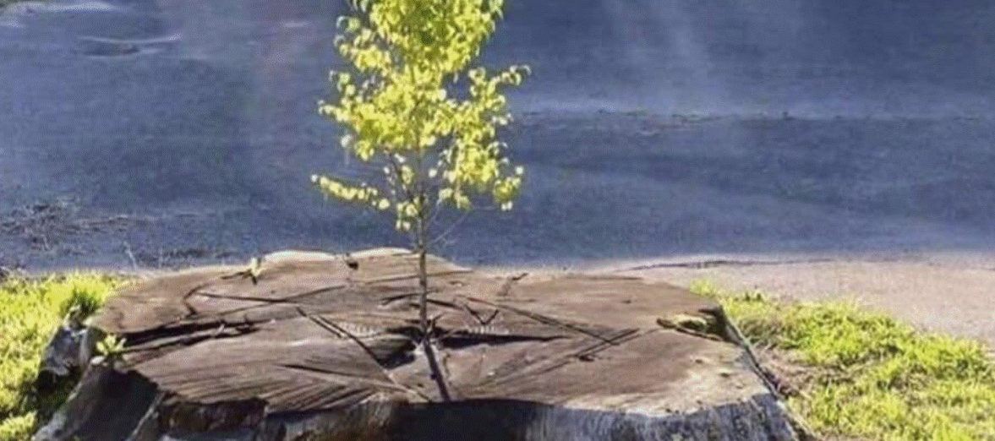
Main Idea – God offers 2nd chances.

Slide 3
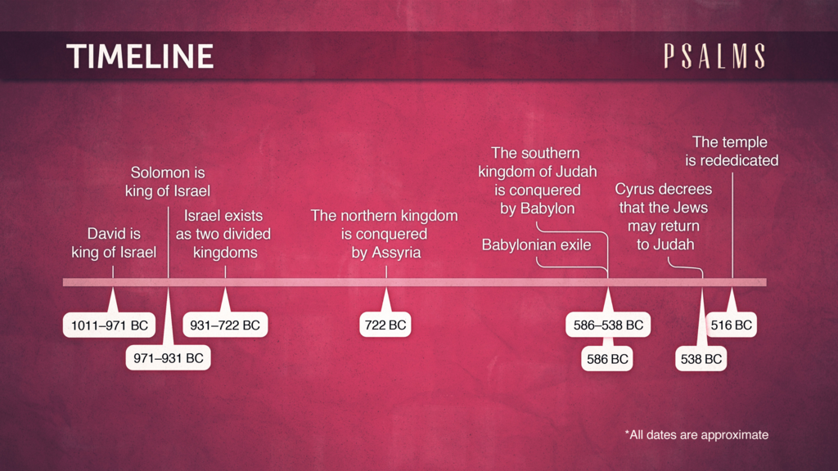
X
King David lived from 1040 BC - 970 BC

Slide 4

“The Benefits of Belief”
According to Psalm 103
vv. 1-5, 8-13

Slide 5
Blessed Benefit #1
1. God sanctifies your soul (1-2)

Slide 6
Blessed Benefit #2
God sanctifies your soul (1-2)
God supplies your needs (3-4)

Slide 7
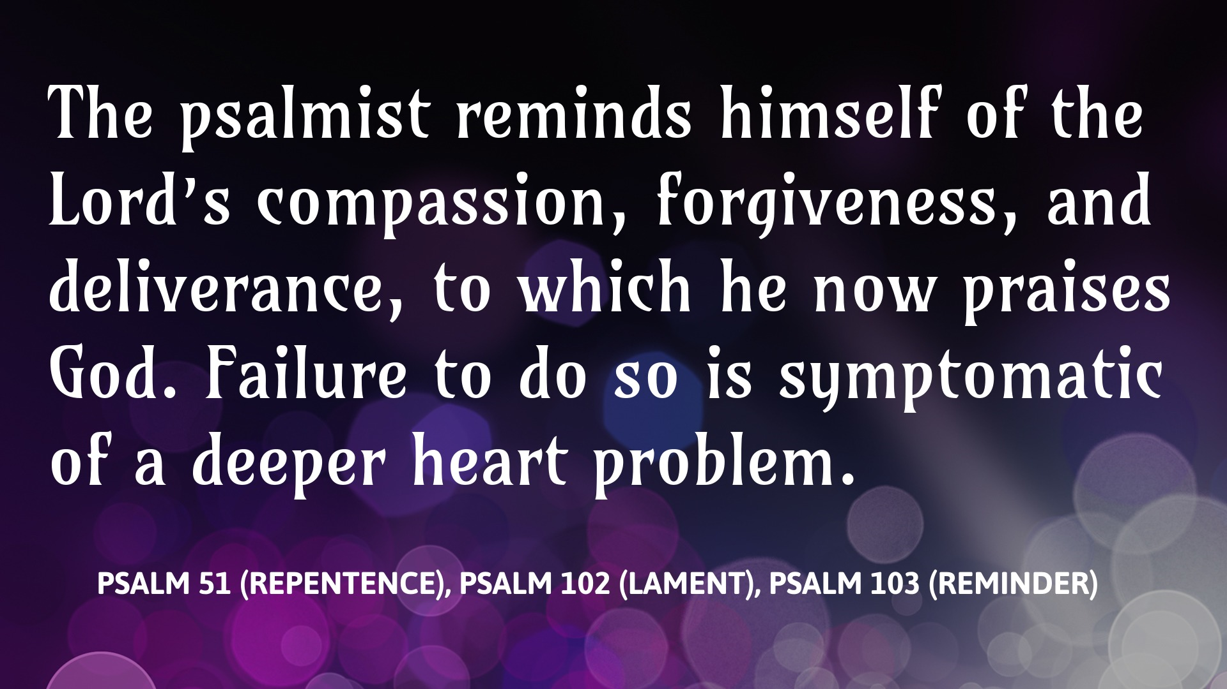

Slide 8
Blessed Benefit #3
God sanctifies your soul (1-2)
God supplies your needs (3-4)
God satisfies your desires (5)

Slide 9
Blessed Benefit #4
God sanctifies your soul (1-2)
God supplies your needs (3-4)
God satisfies your desires (5)
God slows His wrath (8-10)

Slide 10
Blessed Benefit #5
God sanctifies your soul (1-2)
God supplies your needs (3-4)
God satisfies your desires (5)
God slows His wrath (8-10)
God settles your account (11-13)

Slide 11
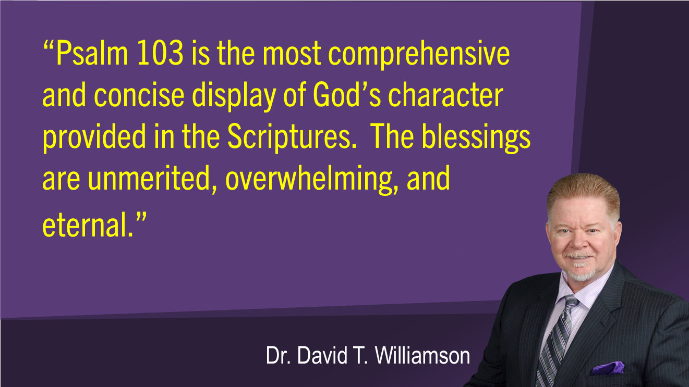

Slide 12
