Slide 1

Belief is Quite Vital Because the Grave is Not Final!
John 11:1- 44
This is the last of the Seven Manifestations
of Jesus as the Messiah

Slide 2
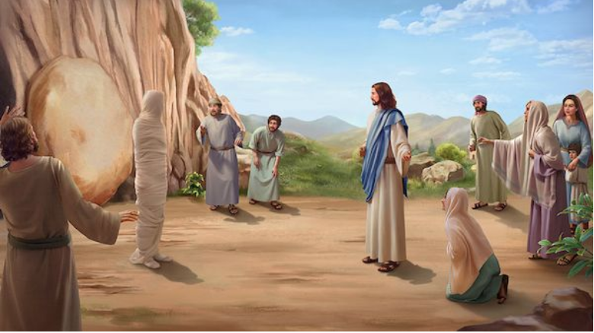

Slide 3
I. Flow of the Story:
The Dilemma (vv. 1-5)

Slide 4
I. Flow of the Story:
The Dilemma (vv. 1-5)
The Delay (vv. 6-10)

Slide 5
I. Flow of the Story:
The Dilemma (vv. 1-5)
The Delay (vv. 6-10)
The Death (vv. 11-16)

Slide 6
I. Flow of the Story:
The Dilemma (vv. 1-5)
The Delay (vv. 6-10)
The Death (vv. 11-16)
The Declaration (vv. 17-27)

Slide 7
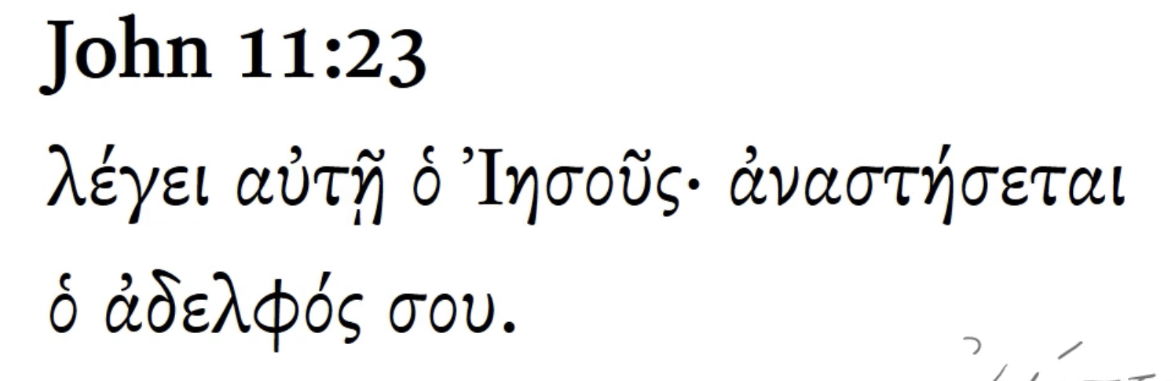
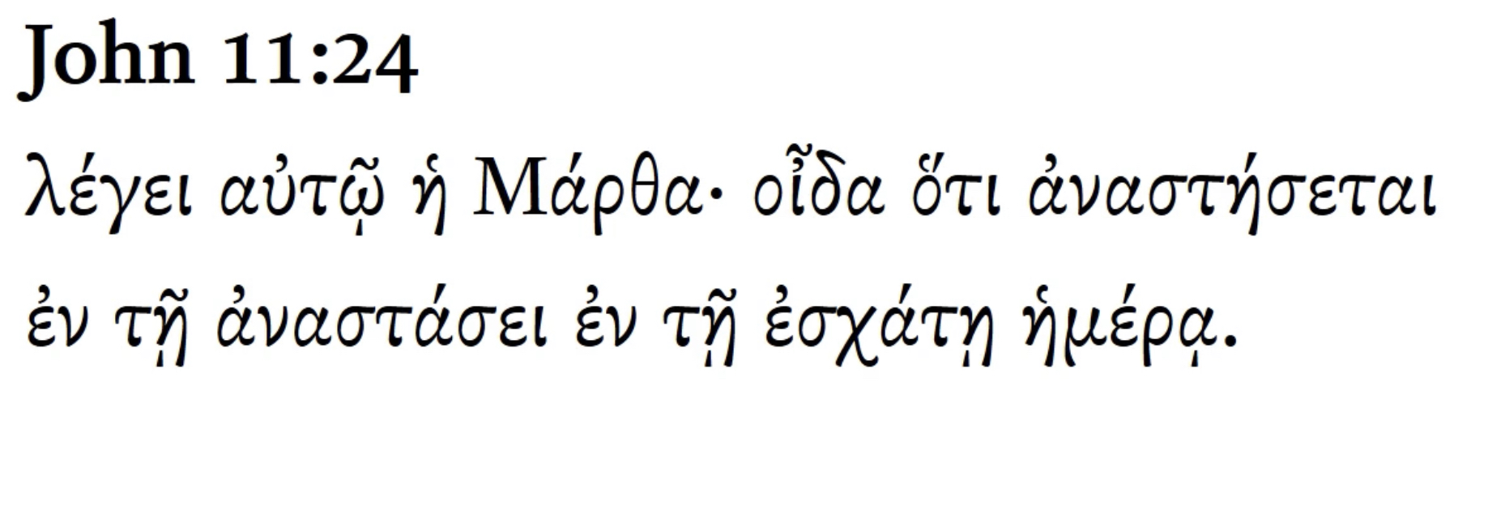
Again?
“Thought by thought”
Future-has not yet occurred.
Middle – subj both causes & is concerned w/the action.
Indicative–statement of fact.

Slide 8
I. Flow of the Story:
The Dilemma (vv. 1-5)
The Delay (vv. 6-10)
The Death (vv. 11-16)
The Declaration (vv. 17-27)
The Despair (vv. 28-37)

Slide 9
I. Flow of the Story:
The Dilemma (vv. 1-5)
The Delay (vv. 6-10)
The Death (vv. 11-16)
The Declaration (vv. 17-27)
The Despair (vv. 28-37)
The Deliverance (vv. 38-44)

Slide 11
II. Focus on the Savior:
His Names
* Jesus (16x)
* Lord (8x)
* God’s Son (v. 4)
* Rabbi (v. 8)
* Friend (v. 11)
* Resurrection and Life (v. 26)
* Messiah and Son of God (v. 27)
* Teacher (v. 28)

Slide 12
II. Focus on the Savior:
His
Names
Our Needs

Slide 13
II. Focus on the Savior:
His
Names
Our Needs
Belief, Forgiveness, Hope – Jesus!

Slide 15

III. Faith for the Future:
Jesus is the Resurrection and the Life.

Slide 16
III. Faith for the Future:
Jesus is the Resurrection and the Life.
Looking to the future and forgetting the past.

