Slide 1

COURAGE UNDER FIRE
Sighting in to have . . .
John 9:1-41

Slide 2
Jesus – “The Man”
Progressive Realization #1
John 9:11

Slide 3
Jesus – “The Healer”
Progressive Realization #2
John 9:15

Slide 4
Jesus – “a prophet”
Progressive Realization #3
John 9:17

Slide 5
Jesus – “The Son of Man”
Progressive Realization #4
John 9:35

Slide 6
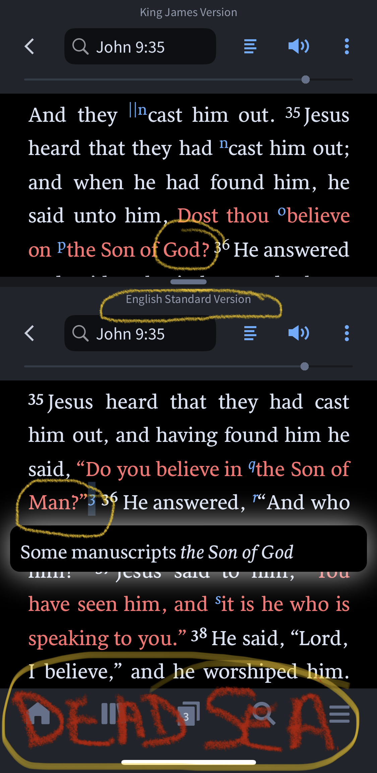
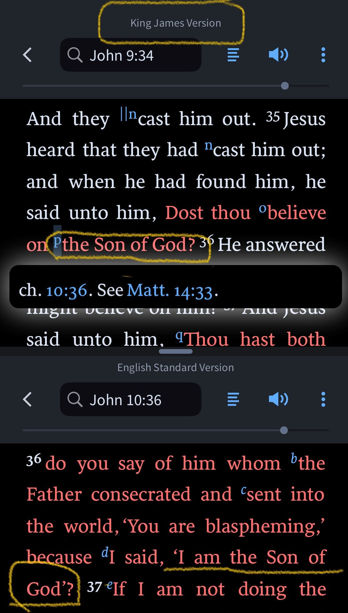
Son of Man or Son of God?
Byzantine Greek Manuscripts
SBLGNT - NA27
Dead Sea Scrolls
KJV/NKJV - Jn 10:36 (Son of God)

Slide 7
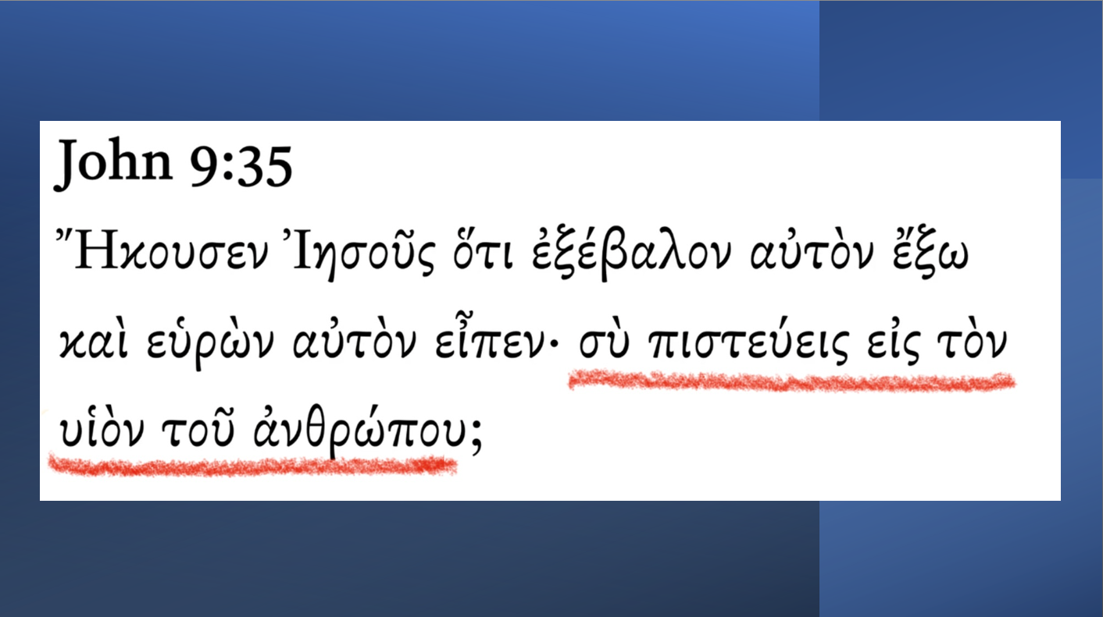

Slide 8
Jesus – “My Lord and Savior”
Progressive Realization #5
Pharisees said, “Give glory to God.” He did, by worshiping Jesus!
John 9:38

