Slide 1
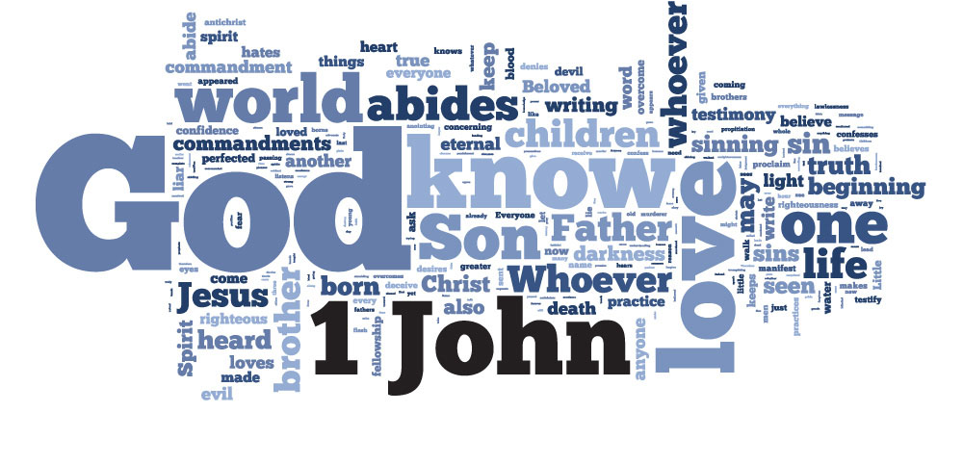
There is SO MUCH to unpack in these five chapters!

Slide 2

“The Johannine Prologue”
“No Greater Witness”
“A Firsthand Experience”
“The Hypostatic Proof”
“A Generational Dilemma”
“Come to Your Senses”
“Truth or Consequences”
“Embrace the Word; Experience the Life!”
“Not On My Watch”
Sermon
Titles

Slide 3

“The Word of Life”
Certain key words characterize the writings of the NT authors:
For Paul, it was “faith,” and “joy.”
For James, it was “works.”
For Peter, it was “hope.”
For John, it was threefold: “believe,” “love” and “life.”

Slide 4
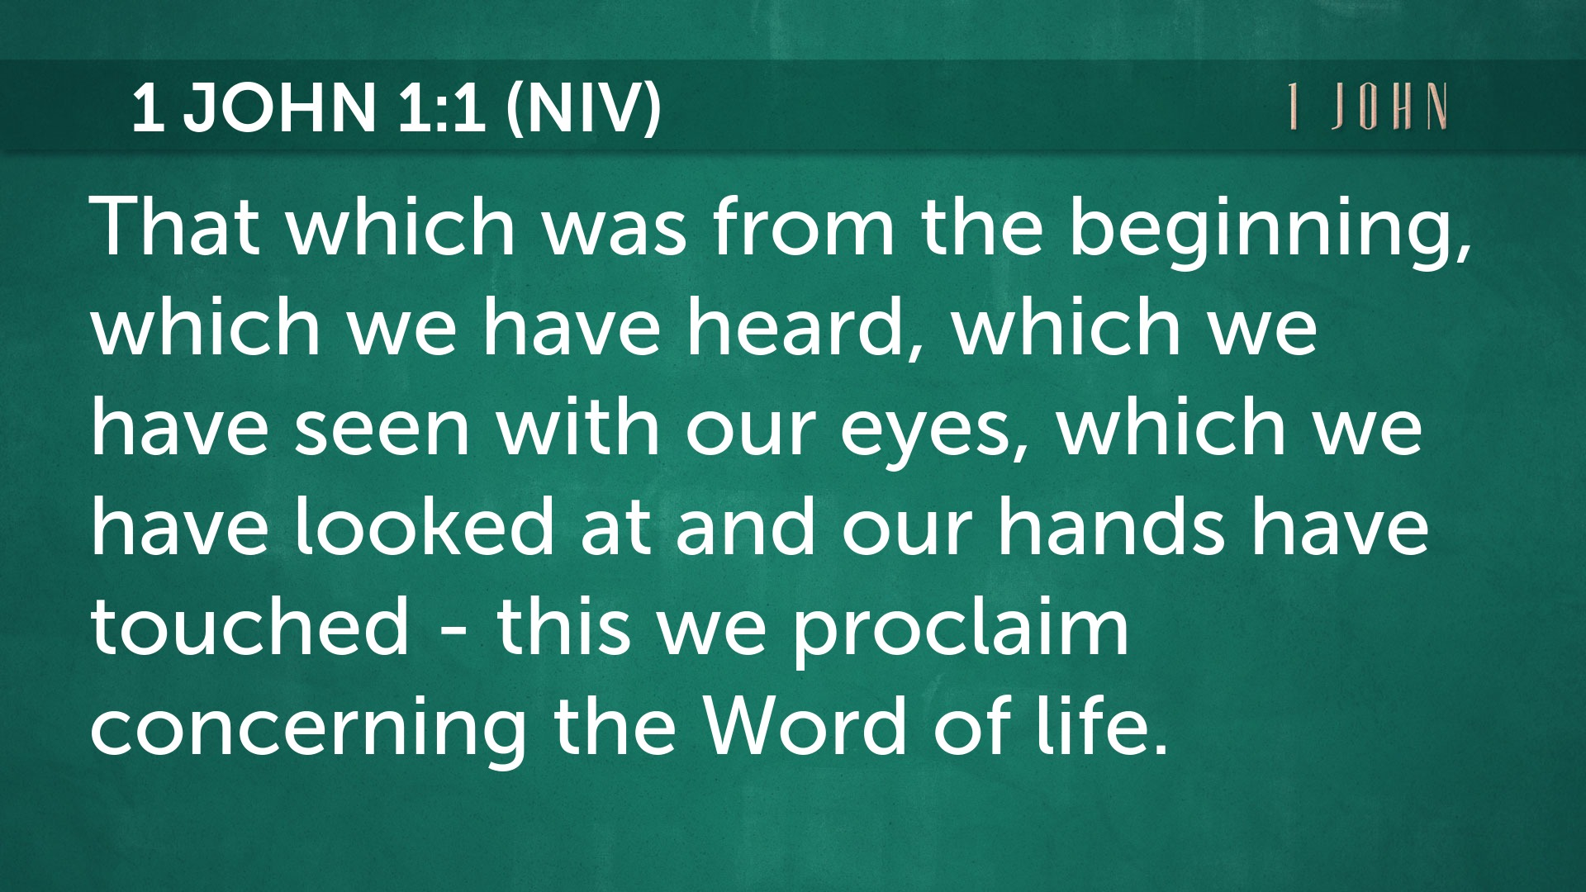

Slide 5
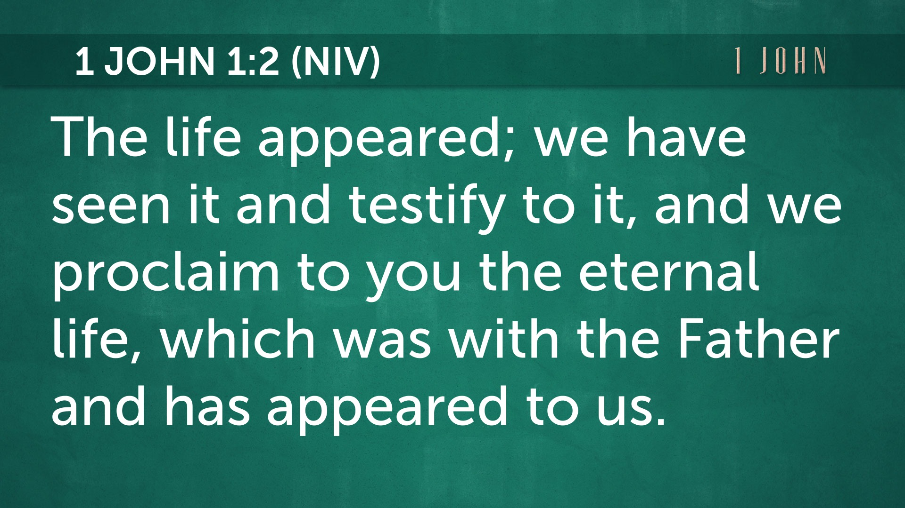

Slide 6
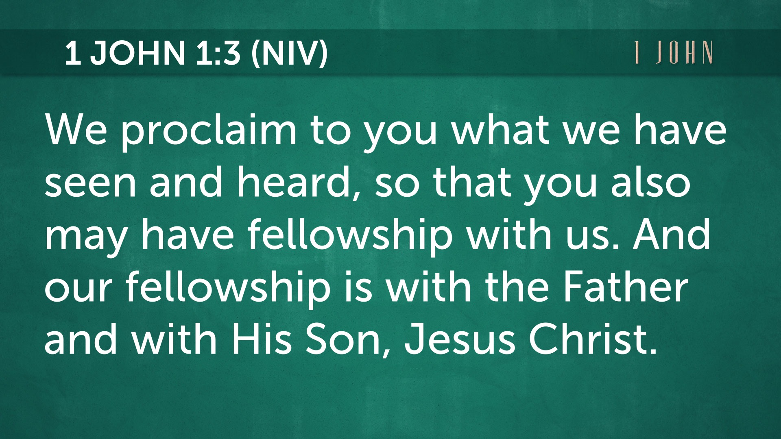

Slide 7
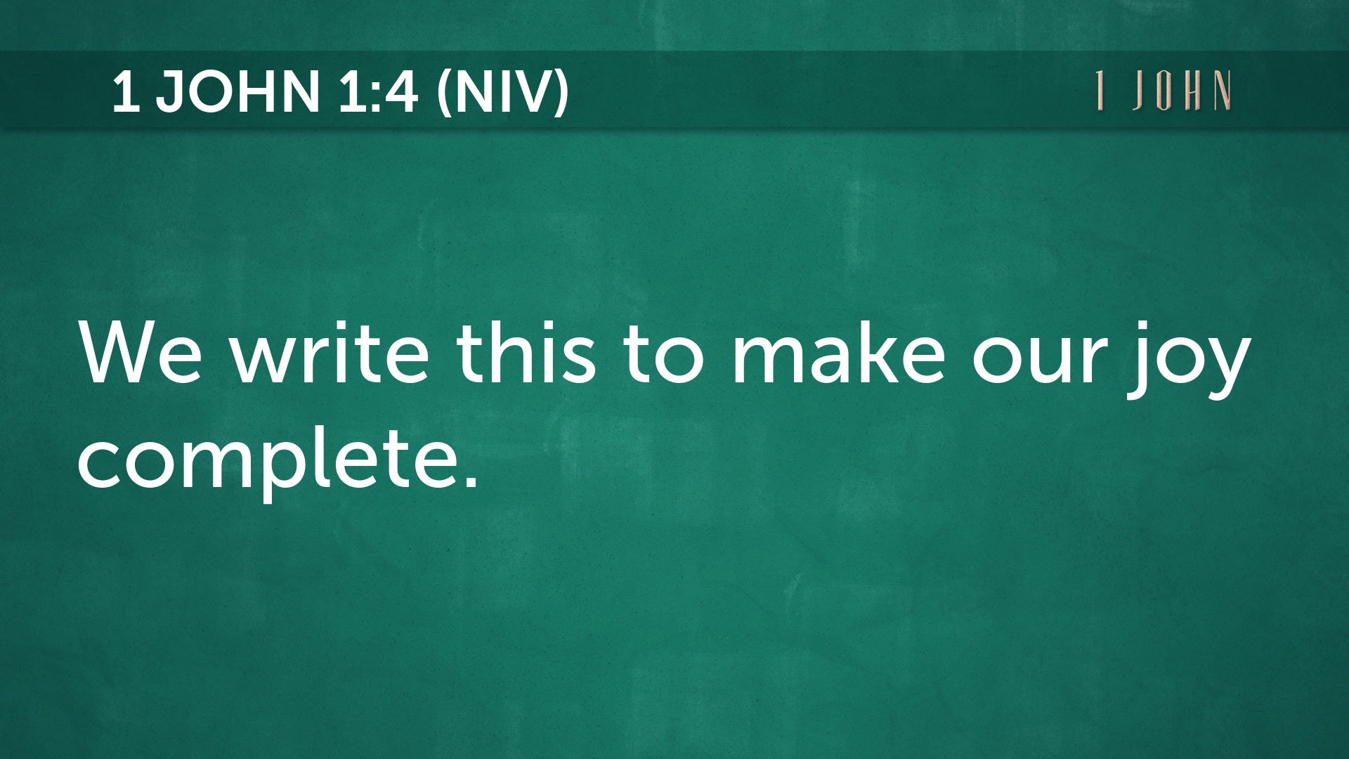

Slide 8
1 John
Background and Context

Slide 9
Jesus, the Word of Life is…
1.
Eternal
(1a)

Slide 11
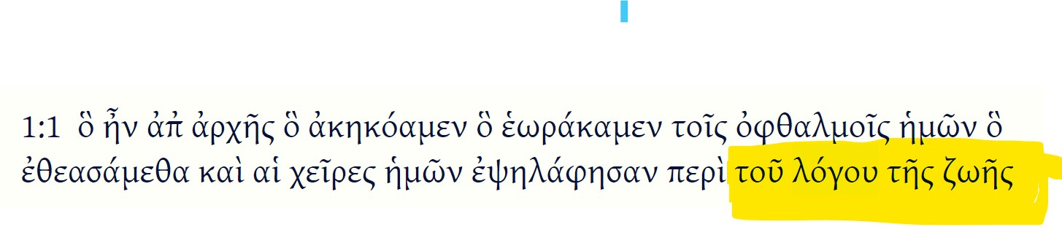

“The Word of Life”
Both nouns, “Word” and “Life” are in the Genitive case, which shows ownership. Jesus, the Word, owns (your) life.

Slide 12
“Jesus is the ____ of life” (71x)
Breath | Fountain | Covenant
Giver | Book | Word
Tree | Way | Bread
Assurance | Power | Author
Light | Enjoyment | Promise
Path | Days | GOD !

Slide 13
Jesus, the Word of Life is…
1.
Eternal
(1a)
2. Explained
(1b-2)

Slide 15
Jesus, the Word of Life is…
1.
Eternal
(1a)
2. Explained
(1b-2)
3. Experienced
(3)

Slide 17
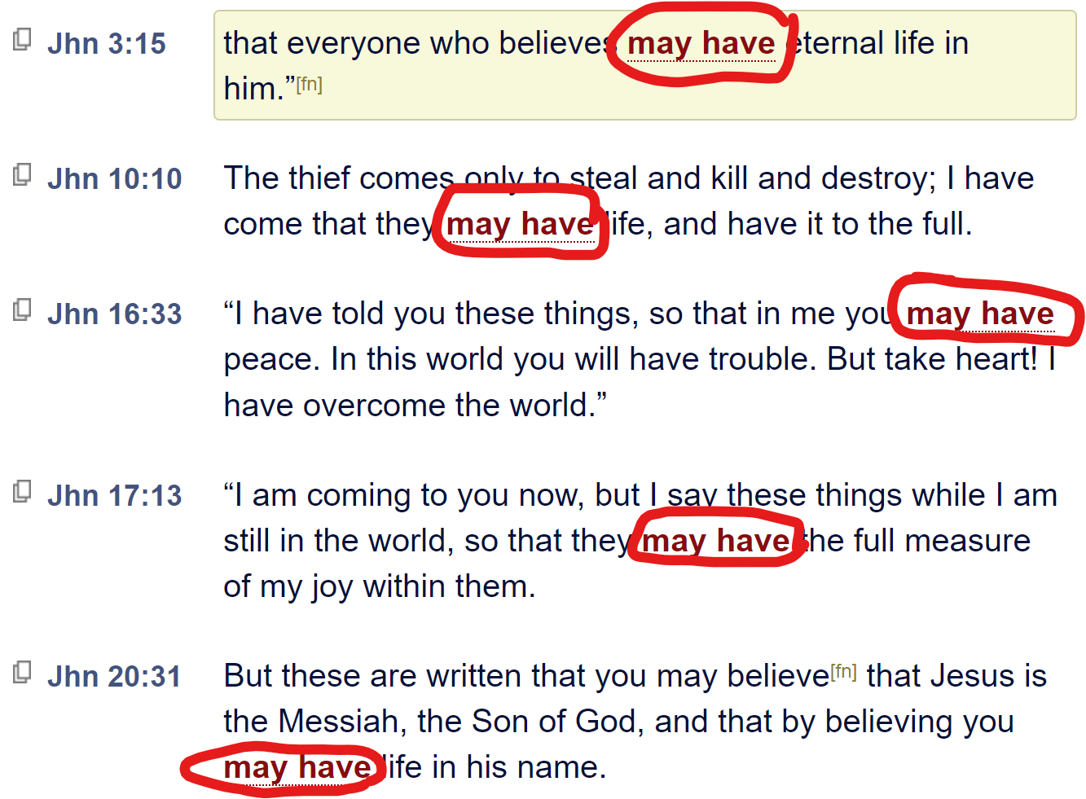
1 John 1:3 – so that you also MAY HAVE fellowship with us.
ἔχητε (εχω) – “may have”
Verb, present, active, subjunctive
This is a “final subjunctive” which expresses PURPOSE.
Not “maybe, might, perhaps if,” but “may” as in permission granted due to previous requirements being met.

Slide 18
Jesus, the Word of Life is…
1.
Eternal
(1a)
2. Explained
(1b-2)
3. Experienced
(3)
4.
Enjoyed
(4)

Slide 20
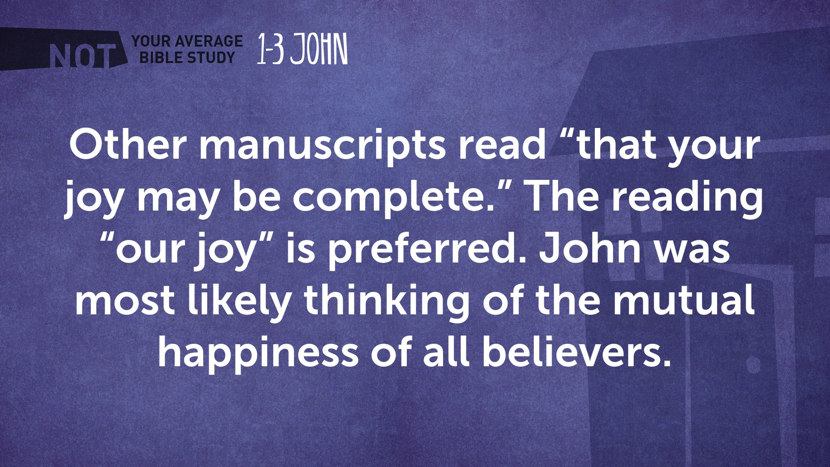
ἡμῶν
1 John 1:4

Slide 21
“The Johannine Prologue”
“No Greater Witness”
“A Firsthand Experience”
“The Hypostatic Proof”
“A Generational Dilemma”
“Come to Your Senses”
“Truth or Consequences”
“Embrace the Word; Experience the Life!”
“Not On My Watch”
Sermon
Titles

Slide 22
“Central Idea of the Text”
Listen to the right voice and live like your life
depends on it.

Slide 23
Modern Day –
Satan is still attacking!
Heresies
Gnosticism
Modalism
Docetism

