Slide 1
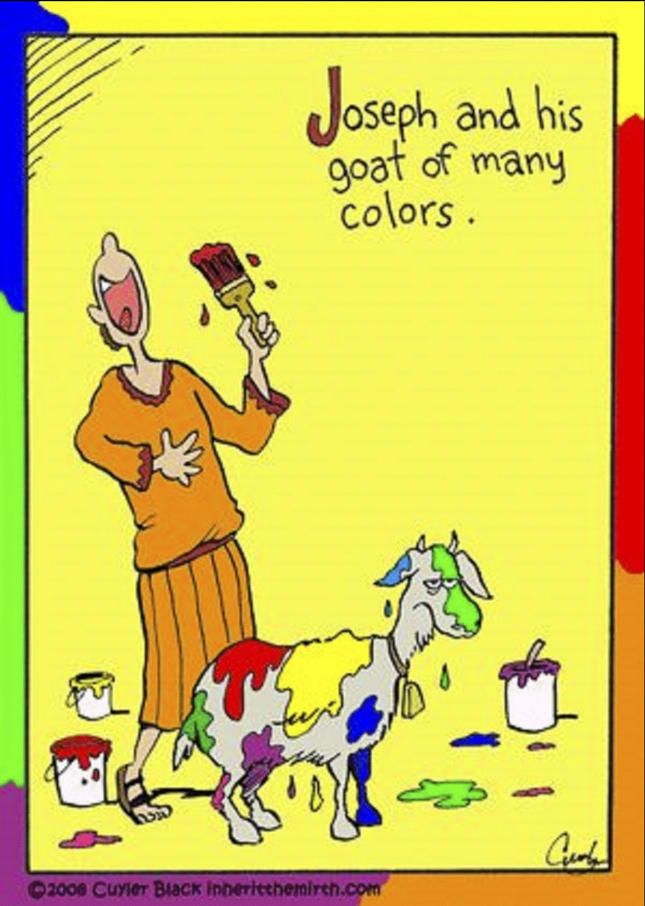
Joseph and his GOAT
of many colors.

Slide 2

“The Clapper,
The Dimmer, and
The Matchstick”
Which one
are you?
John 8:12, 9:4-5 (and others)

Slide 3
1. The Intimate Setting
Lampstands and Bowls
(Zech 4:1-3)
Feast of Tabernacles
Living Intently for the Harvest
Old Testament

Slide 4
2. The Illuminated Saying
The Bread of Life (Jn 6)
The Living Water (Jn 7)
The Light of the World (Jn 8)
I AM…

Slide 5
3. The Included Sending
A sense of …
* Inclusivity (we)
* Urgency (must)
* Duty (do)
It’s a decision, not a choice!

Slide 6
“Jesus is the Light
of the World”
- Six Stages of
Spiritual Sight
John 9:1-41
IN 2 WEEKS ...

Slide 7
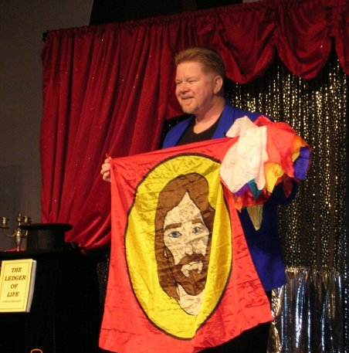
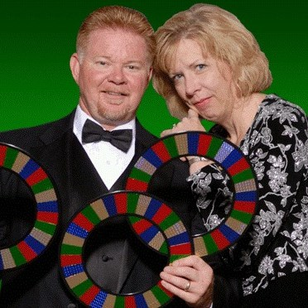
The Gospel Message through Illusion

