Slide 1

“The Misunderstood King and His Empty Promises”
…from Entrance to Exit

Slide 2
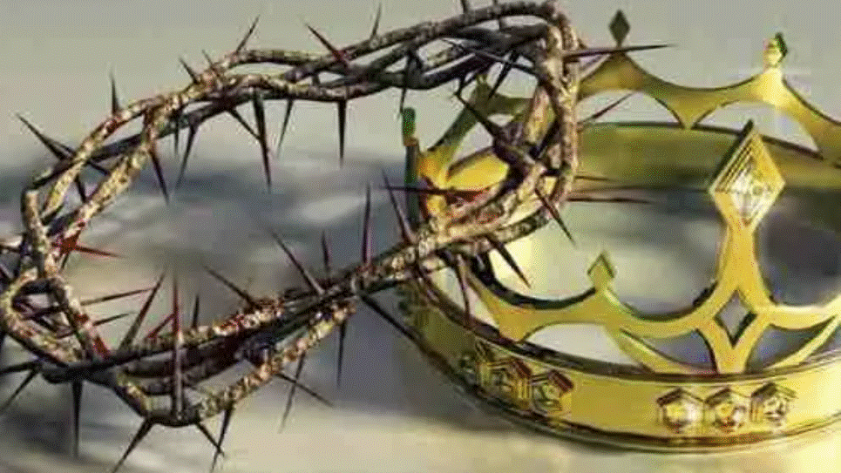
A Story of Two Crowns
Entrance: Palm Sunday (Mt. 21:1-11)
Exit: Easter Sunday (Mt. 28:1-10)
The greatest riches to rags to riches story ever told.

Slide 3
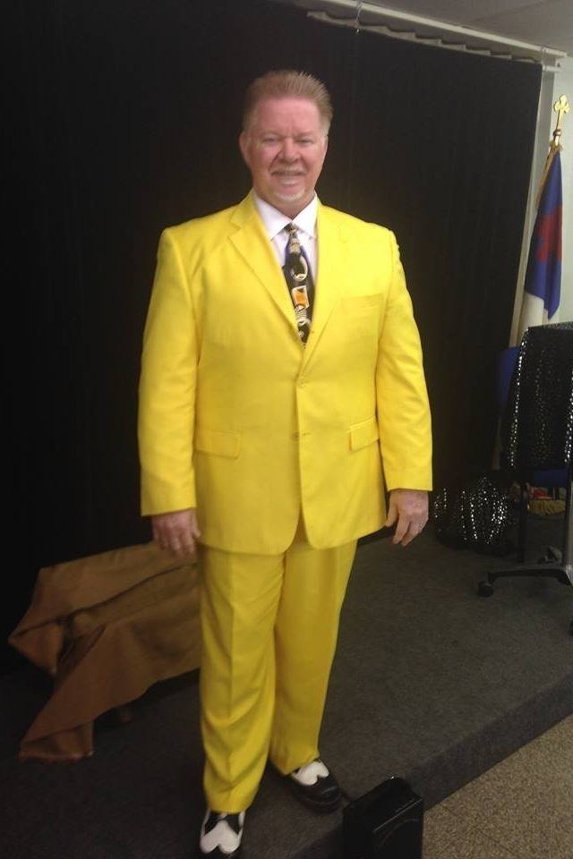

Don’t laugh – it’s paid for.

Slide 4
The Last Week of Public Ministry in Jerusalem
Sunday – A Day of Presentation (Palm Sunday)
Monday – A Day of Cursing and Cleansing (Fig Tree/Temple)
Tuesday – A Day of Confrontation (Pharisees, then Olivet Discourse)
Wednesday – A Day of Conspiracy & Consolation (Feet-LS-HS)
Thursday – A Day of Conviction & Crucifixion (Trials, Thieves, 7)
Fri-Sat – A Day of Completion & Conquering (Death. But Hell?)
Sunday – A Day of VICTORY!

Slide 5
From Palm Sunday to Final Ascension
133
“Jesus did many other things as well. If every one of them were written down, I suppose that even the whole world would not have room for the books that would be written.” - John 21:25

Slide 6
1. Came in peace.
The King . . .
Palm Sunday
Matthew 21:1-11

Slide 7
1. Came in peace. 2. Confirmed by people.
The King . . .
Palm Sunday
Matthew 21:1-11

Slide 8
1. Came in peace. 2. Confirmed by people. 3. Crowned with praise.
The King . . .
Palm Sunday
Matthew 21:1-11

Slide 9
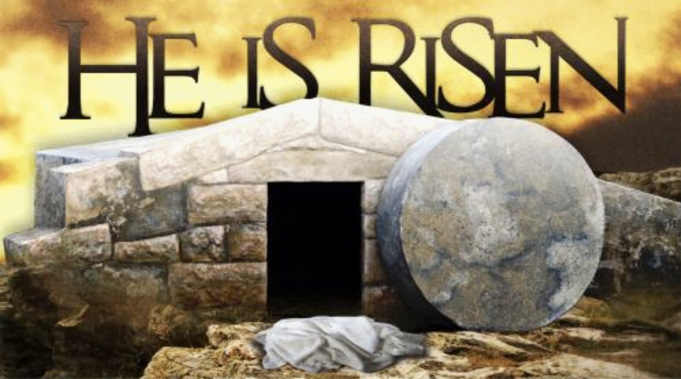
The 3 “Empty Promises” of Easter - Matthew 28:1-10

Slide 10
#1 – The Empty Cross
The 3 “Empty Promises” of Easter - Matthew 28:1-10

Slide 11
#1 – The Empty Cross #2 – The Empty Tomb
The 3 “Empty Promises” of Easter - Matthew 28:1-10

Slide 12
#1 – The Empty Cross #2 – The Empty Tomb #3 – The Empty Clothes
The 3 “Empty Promises” of Easter - Matthew 28:1-10

Slide 13
But never an empty promise for eternity!
Salvation is found in no one else, for there is no other name under heaven given to mankind by which we must be saved. - Acts 4:12
For it is by grace that you have been saved, through faith – and this is not from yourselves, it is the gift of God, not by works, so that no one can boast. - Ephesians 2:8-9
John 14:6

Slide 14
The Misunderstood King – Came in peace, was confirmed by people, and was crowned with praise. And His Empty Promises - There was an empty cross, an empty tomb, and empty clothes, but… NEVER an empty promise for eternity!

