Slide 1


“A Lot to
Chew On”
John 6:1-14, 26-40
Signs, Sandwiches, and a Savory Salvation

Slide 2

A faith that believes:
* Philip had a pessimistic faith.

Slide 3
A faith that believes:
* Philip had a pessimistic faith.
* Andrew had an optimistic faith.

Slide 4
A faith that believes:
* Philip had a pessimistic faith.
* Andrew had an optimistic faith.
* Jesus displayed a perfect faith.

Slide 5
The crowds missed their chance at faith.
- Signs that lead to nowhere.

Slide 6
Four Stages to a True Faith:
Curious

Slide 7
Four Stages to a True Faith:
Curious
Convicted

Slide 8
Four Stages to a True Faith:
Curious
Convicted
Convinced

Slide 9
Four Stages to a True Faith:
Curious
Convicted
Convinced
Converted

Slide 10

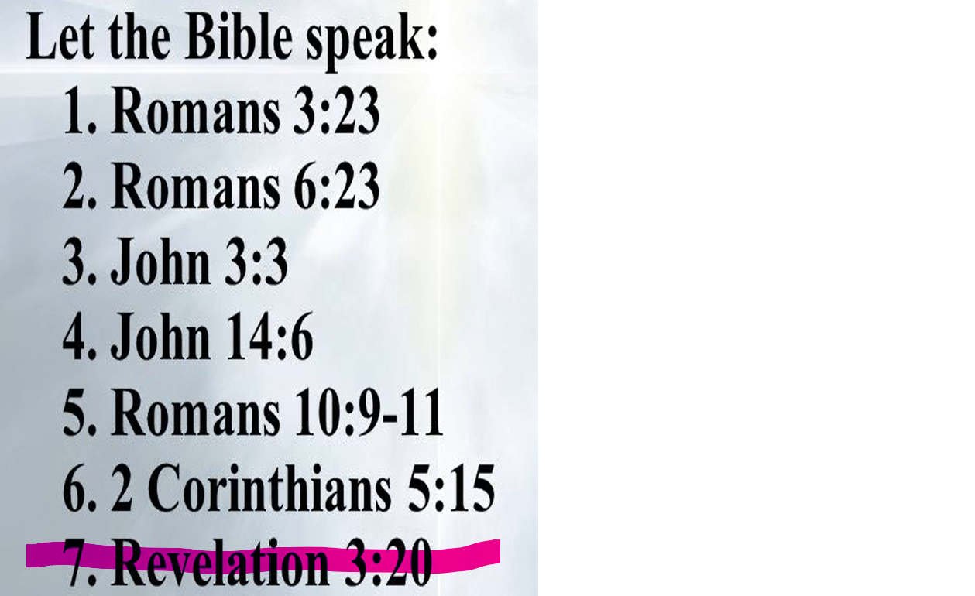
Equipping the Saints:
John 3:16; Rom. 8:1; 1 Jn 1:9

Slide 11

“Used by God,
for His purpose,
and to His glory.”
. . . and some to be pastors and teachers,
to prepare God’s people for works of service,
so that the body of Christ may be built up . . .
- Eph 4:11b-12, NIV

Slide 12

Next week is Palm Sunday and the kids will be performing here at FBC - Invite a friend!

