Slide 1
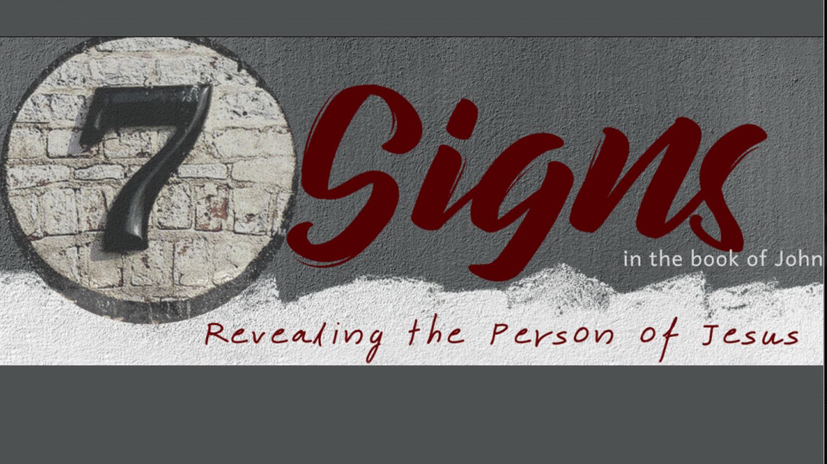

Slide 2
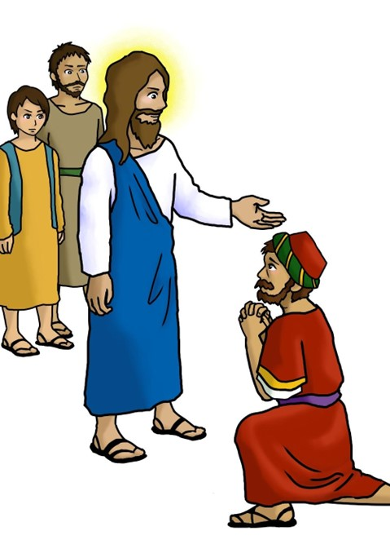

John 4:46-54
Manifestation #2 –
Jesus Heals the Official’s Son

Slide 3

What kind of faith do you have?
Keep this question in mind:

Slide 4
The man started with a CRISIS faith.
!
1.

Slide 5
John 4:47 (NASB)
“When he heard that Jesus had come out of Judea into Galilee …

Slide 6
John 4:47 (NASB)
“When he heard that Jesus had come out of Judea into Galilee, he went to Him and was imploring Him to come down and heal his son; for he was at the point of death.”
Asked, begged, pleaded … to interrogate, beseech, desire, I pray ye… of a sentry who challenges for a password. This word carries with it a sense of “demand.”

Slide 7
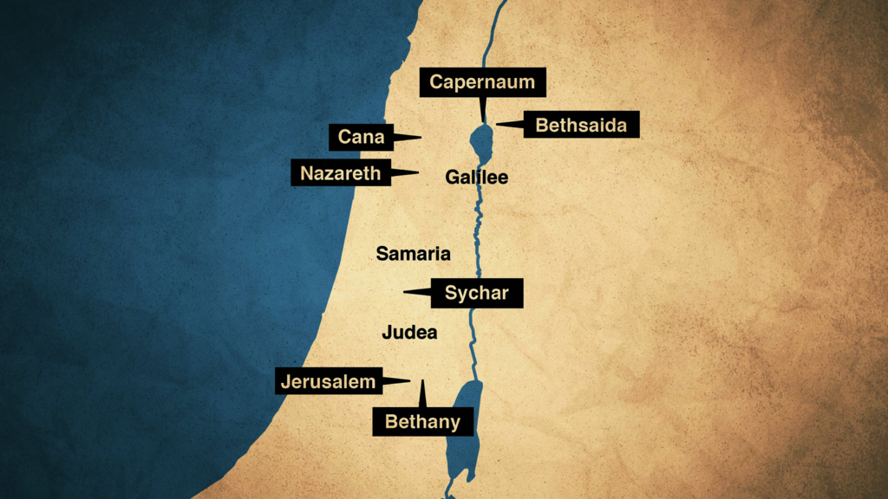

Slide 8

It grew into a CAUTIOUS faith.
2.

Slide 9
John 4:50 (NASB)
Jesus said to him, “Go; your son lives.” The man believed the word that Jesus spoke to him and started off.
Some might read this to be a CONFIDENT faith, but the royal official still holds a bit of caution in his belief/obedience.

Slide 10

It grew to be a CONFIRMED faith.
3.

Slide 11
John 4:51-52 (NASB)
As he was now going down, his slaves met him, saying that his son was living. So, he inquired of them the hour when he began to get better. Then they said to him, “Yesterday at the seventh hour the fever left him.”
Slave – bondservant … Roman Empire (1:2), served 7 yrs (freedom/pay)
    Jacob worked for Laban 7 years each (Leah, Rachel)

Slide 12

Finally, it grew into a CONTAGIOUS faith.
4.

Slide 13
John 4:53 (NASB)
So the father knew that it was at that hour in which Jesus said to him, “Your son lives”; and he himself believed and his whole household.
Household – this is a cultural difference.

Slide 14

A GROWING FAITH
A Crisis Faith
A Cautious Faith
A Confirmed Faith
A Contagious Faith

Slide 15

“Is their faith worth sharing?” – Dr. Lucien Fortier

Slide 16
Romans 3:23 - all
Romans 6:23 - wages
John 3:3 - born
John 14:6 - Way
Romans 10:9-10
2 Corinthians 5:15
Memory Verses
⁹ If you declare with your mouth, “Jesus is Lord,” and
believe in your heart that God raised him from the dead, you will be saved.
¹⁰ For it is with your heart that you believe and are justified,
and it is with your mouth that you profess your faith and are saved.

Slide 17

Baptism Next Sunday
Lord’s Supper and Potluck, too!

