Slide 1

Rejoice always, pray without ceasing, give thanks in all circumstances. 1 Thes 5:16-18

Slide 2


Slide 3
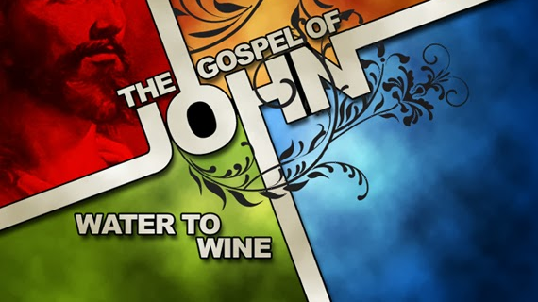
John 2:1-11

Slide 4
Cultural Confusions – Weddings and Wine, Then and Now.

Slide 5

1. The SETTING
The Place (v. 1)
B. The Participation (v. 2)

Slide 6
2. The SITUATION
The Problem (v. 3)
B. The Posturing (vv. 4-5)

Slide 7
3. The SYMBOLISM
The Purification (v. 6)
B. The “Punch” (vv. 7-8)

Slide 8
4. The STATEMENT
The Proclamation (vv. 9-10)
B. The Purpose (v. 11)

Slide 9
APPLICATION

