Slide 1

Growing Stronger through Ministry
Ephesians
4:11-16

Slide 2
Overview of Ephesians – UNITY IN CHRIST
Chapter 1 | We find spiritual blessings and rejoice in eternal promises | IN CHRIST
Chapter 2 | We have salvation by grace alone through faith alone | IN CHRIST
Chapter 3 | The mystery of God is revealed, we have salvation | IN CHRIST
Chapter 4 | While serving w/diff gifts and in diff offices, we are unified | IN CHRIST
Chapter 5 | Family life is focused on holy living as we share our love | IN CHRIST
Chapter 6 | Spiritual warfare is fought while wearing the armor of God and standing firm | IN CHRIST

Slide 3
Ephesians 4:11-16

Slide 4
4.11 - And He gave some as apostles, and some as prophets, and some as evangelists, and some as pastors and teachers,

Slide 5
1. WHO God gave – a.) Jesus b.) A-P-E-P/T

Slide 6
Apostles

Slide 7

Prophets

Slide 8
Evangelists

Slide 9
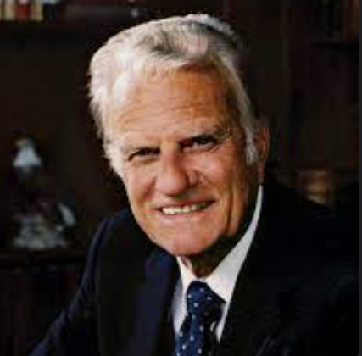
Billy Graham
1918-2018

Slide 10
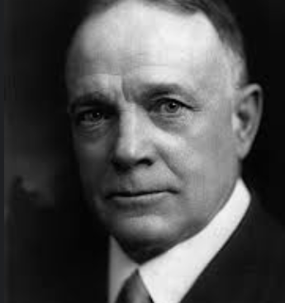
Billy Sunday
1862-1935

Slide 11
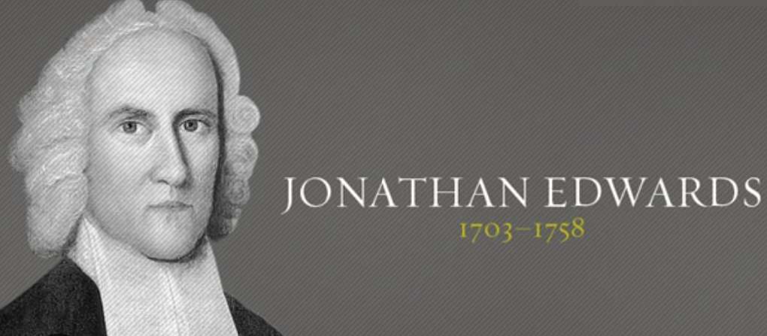

Slide 12
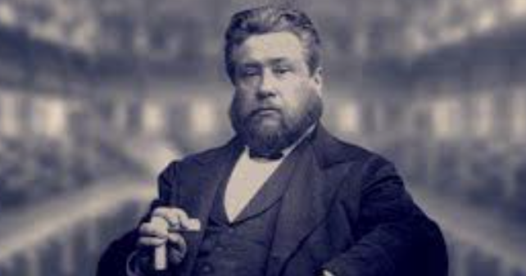
Charles Spurgeon 1834-1892

Slide 13
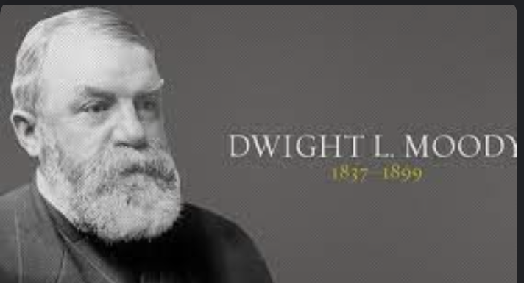

Slide 14
Pastors / Teachers

Slide 15
4:12 – to equip the saints for the work of ministry, for building up the body of Christ.

Slide 16
2. WHY were they given– a.) Equip the saints b.) Work of ministry c.) Build up the body

Slide 17
3. Reason? Build up the a.) unity of the faith b.) knowledge of the Son c.) growth in sp. maturity

Slide 18
4:13 – until we all attain to the unity of the faith and of the knowledge of the Son of God, to mature manhood, to the measure of the stature of the fullness of Christ…

Slide 19
4:14 – so that we may no longer be children, tossed to and fro by the waves and carried about by every wind of doctrine, by human cunning, by craftiness in deceitful schemes.

Slide 20

Judaizers
Syncretism
Docetism
Gnosticism

Slide 21
4:15 – Rather, speaking the truth in love we are to grow up in every way into Him who is the head, into Christ.

Slide 22
4:16 – from whom the whole body, joined and held together by every joint with which it is equipped, when each part is working properly, makes the body grow so that it builds itself up in love.

Slide 23
The RECAP – Growing Stronger through Ministry
A.) The Foundation of the church
B.) The Extension of the church
C.) The Continuance of the church
D.) The Ministry of the church

