Slide 1
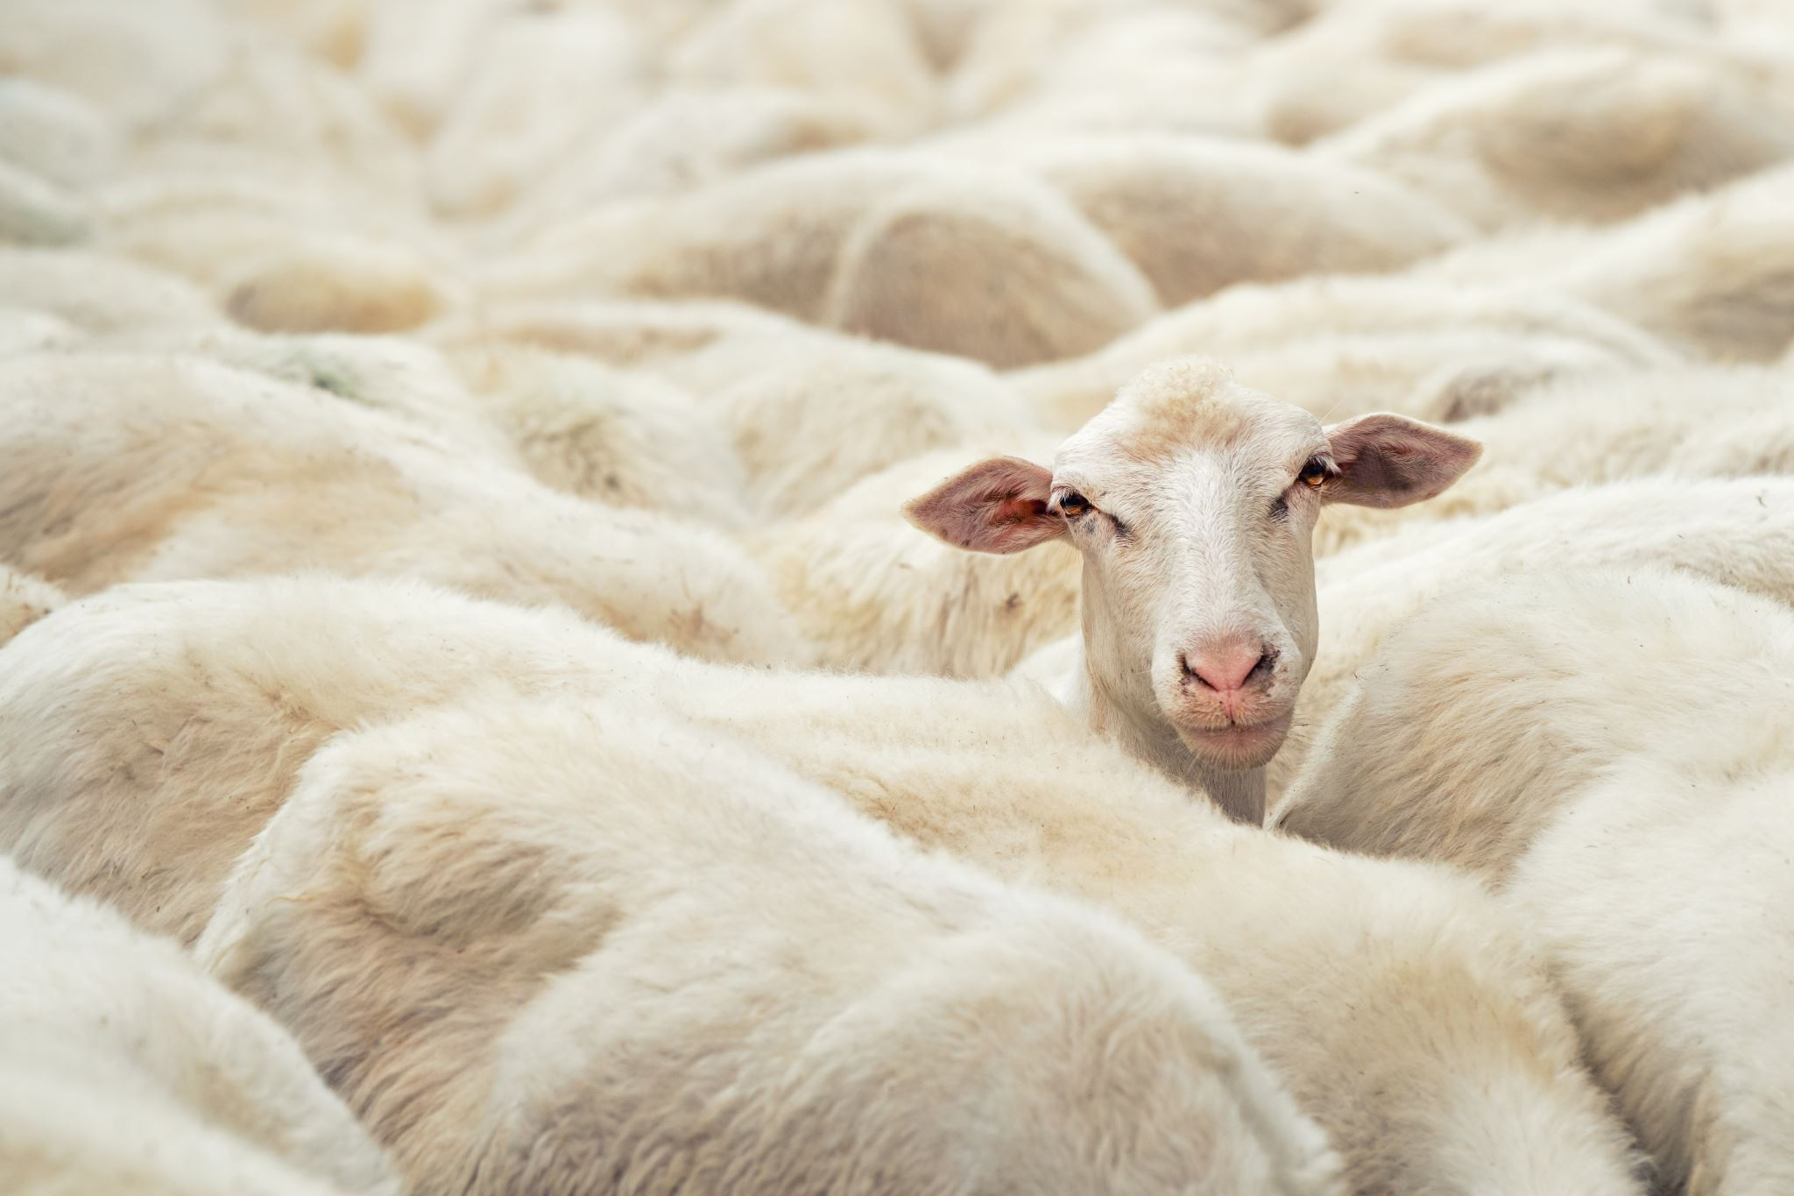
Are you a disciple, too?

Slide 2
God’s design for discipleship
Disciple – following
Discipleship – maturing
Disciple making – obeying
Matt. 4:19
Phil. 1:9-11
Matt. 28:19-20

Slide 3


Growing deeper through Discipleship:
Spiritual Disciplines

Slide 4
Spiritual Disciplines
(from Week 1, DTC)
Bible intake – hear, read, study, memorize
Prayer – (A.C.T.S.) (Lord’s) (exchange) (Word-promise)
Worship – focus, response, good/bad, truth (?)
Evangelism – expected, empowered, pursued, gift (?)
Serving – (motivated by obedience, gratitude, humility
Stewardship – time/talent/treasure, eternity, ownership
Fellowship/discipleship – participate, contribute, mandatory

Slide 5
Growing deeper through Discipleship:
Spiritual gifts

Slide 6
1 Cor. 12:4-6, 7-11
Rom. 12:6-8 Eph. 4:11
χαρισματα
χαρισμα

Slide 7
Spiritual gifts
Romans 12:6-8 | 1 Corinthians 12:4-6, 7-11 | Ephesians 4:11
Prophesy Serving Teaching Encouraging Giving Leading Mercy | Wisdom Knowledge Faith Healing Miracles Prophesy Discernment of spirits Tongues Interpretation of Tongues | Apostles Prophets Evangelists Pastors and Teachers
…LOVE must be sincere (v.9) | 12- LOVE-14 | 1 Cor. 12:31- Desire the “greater gifts”

Slide 8
Discipleship – serving the body with your spiritual gifts
Gifts are not … talents, offices, ministries, fruit
Speaking gifts … those that deal with preaching, teaching, evangelism
Serving gifts … body gifts - helps, hosp, admin, mercy, giving, service
Signifying gifts … these are the controversial gifts (cessation?)
Discovering and using your gifts - SHAPE

Slide 9
Teach the Text –
Charisma

Slide 10
Cessationalist
Charismatic vs. Conservative
γλωσσα – γλωσσων – γλωσσαις
Books …

Slide 11
Gifts - How do you know?
S*H*A*P*E
Know – Grow – Show - Go

Slide 12
Next week:
Growing stronger through ministries

