Slide 1


Growing deeper through discipleship
Acts 2:42 – They were continually devoting themselves to the apostles’ teaching and to fellowship, to the breaking of bread and to prayer.

Slide 2



1. Description of discipleship a.) The call (Mt. 4:19) b.) The confusion (Jn. 6:66-69) c.) The command (Mt. 28:18-20)

Slide 3
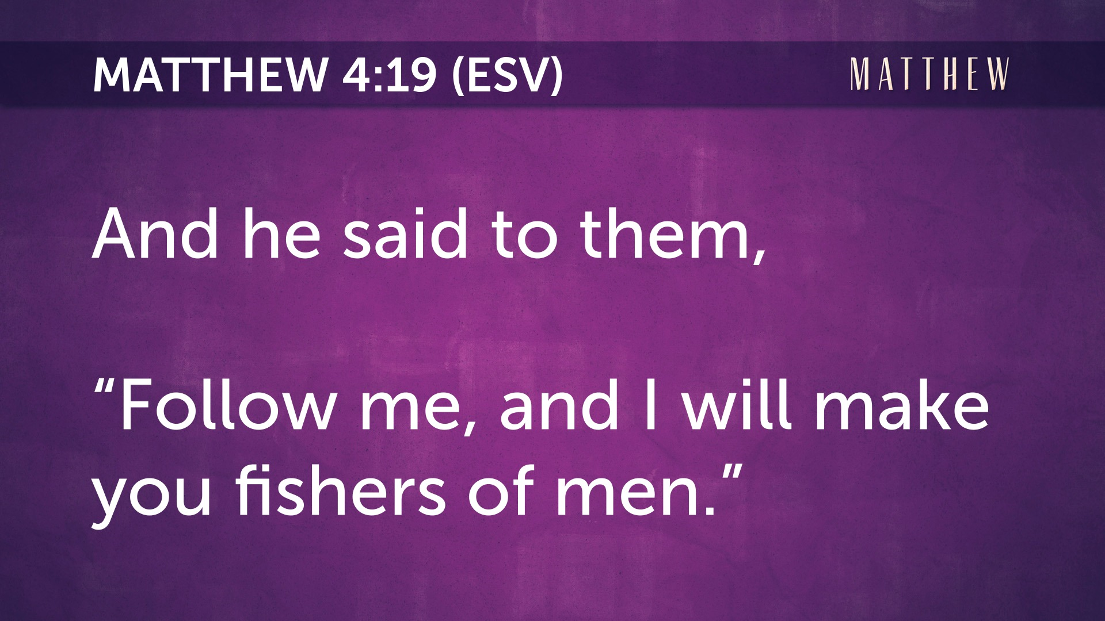

Slide 4

Caleb & Joshua – Num 14:24; 32:12

Slide 5
b.) The confusion (Jn. 6:66-69) Background text: John 6:41-44, 47-58, 64-65

Slide 6
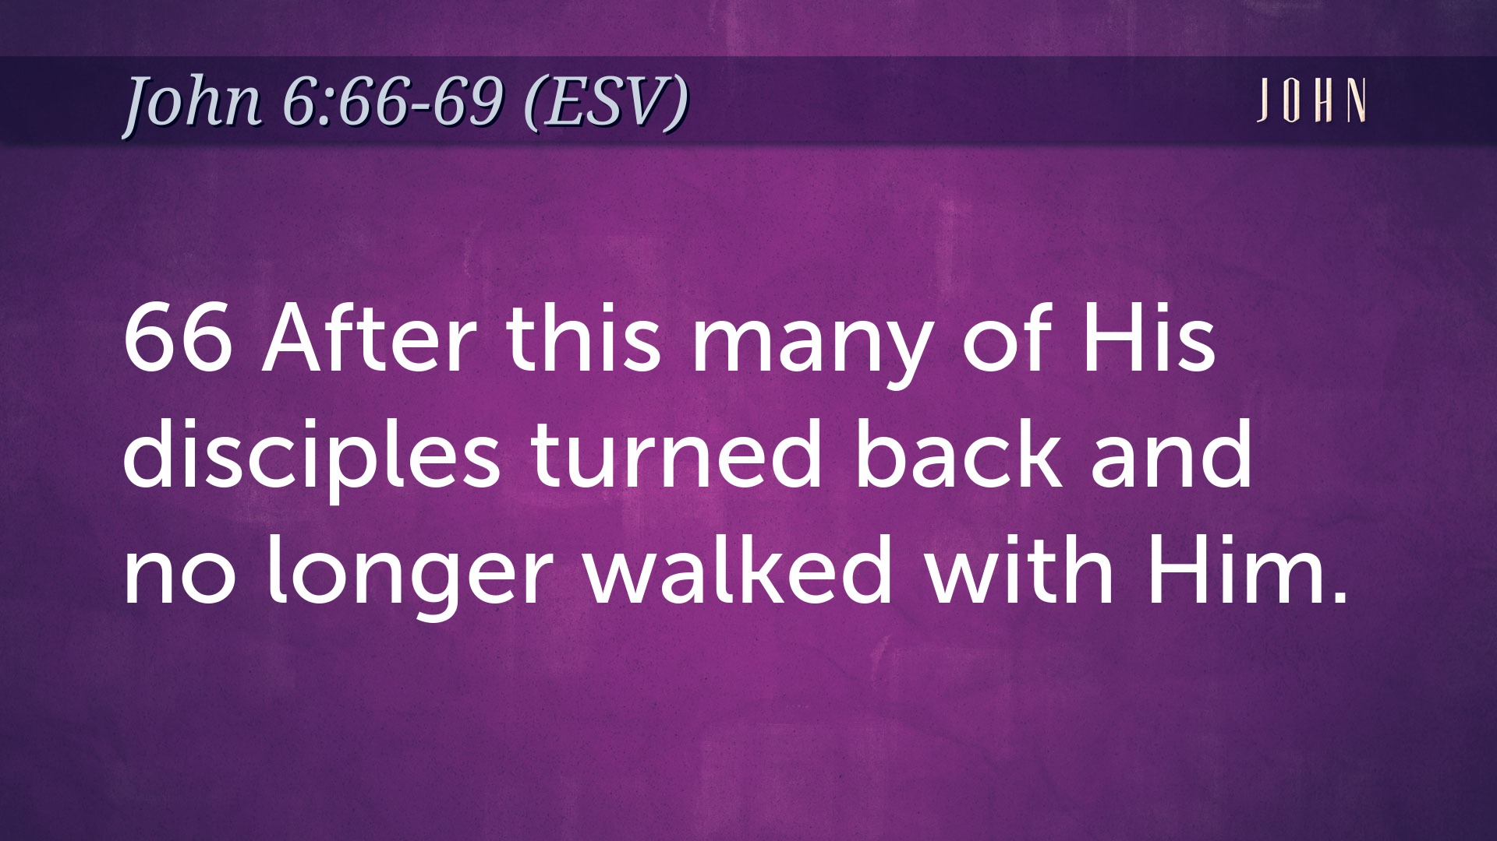

Slide 7
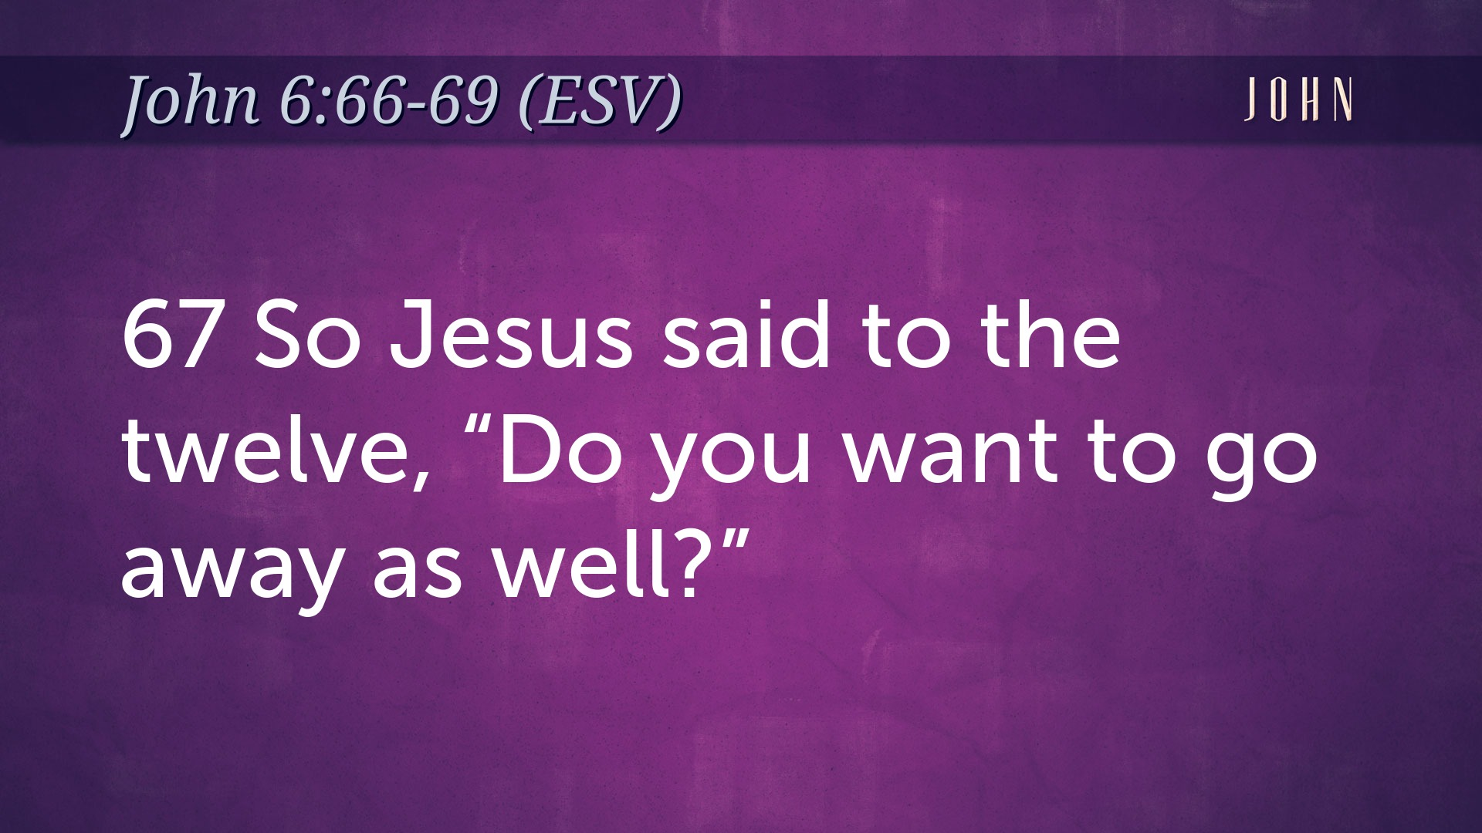

Slide 8
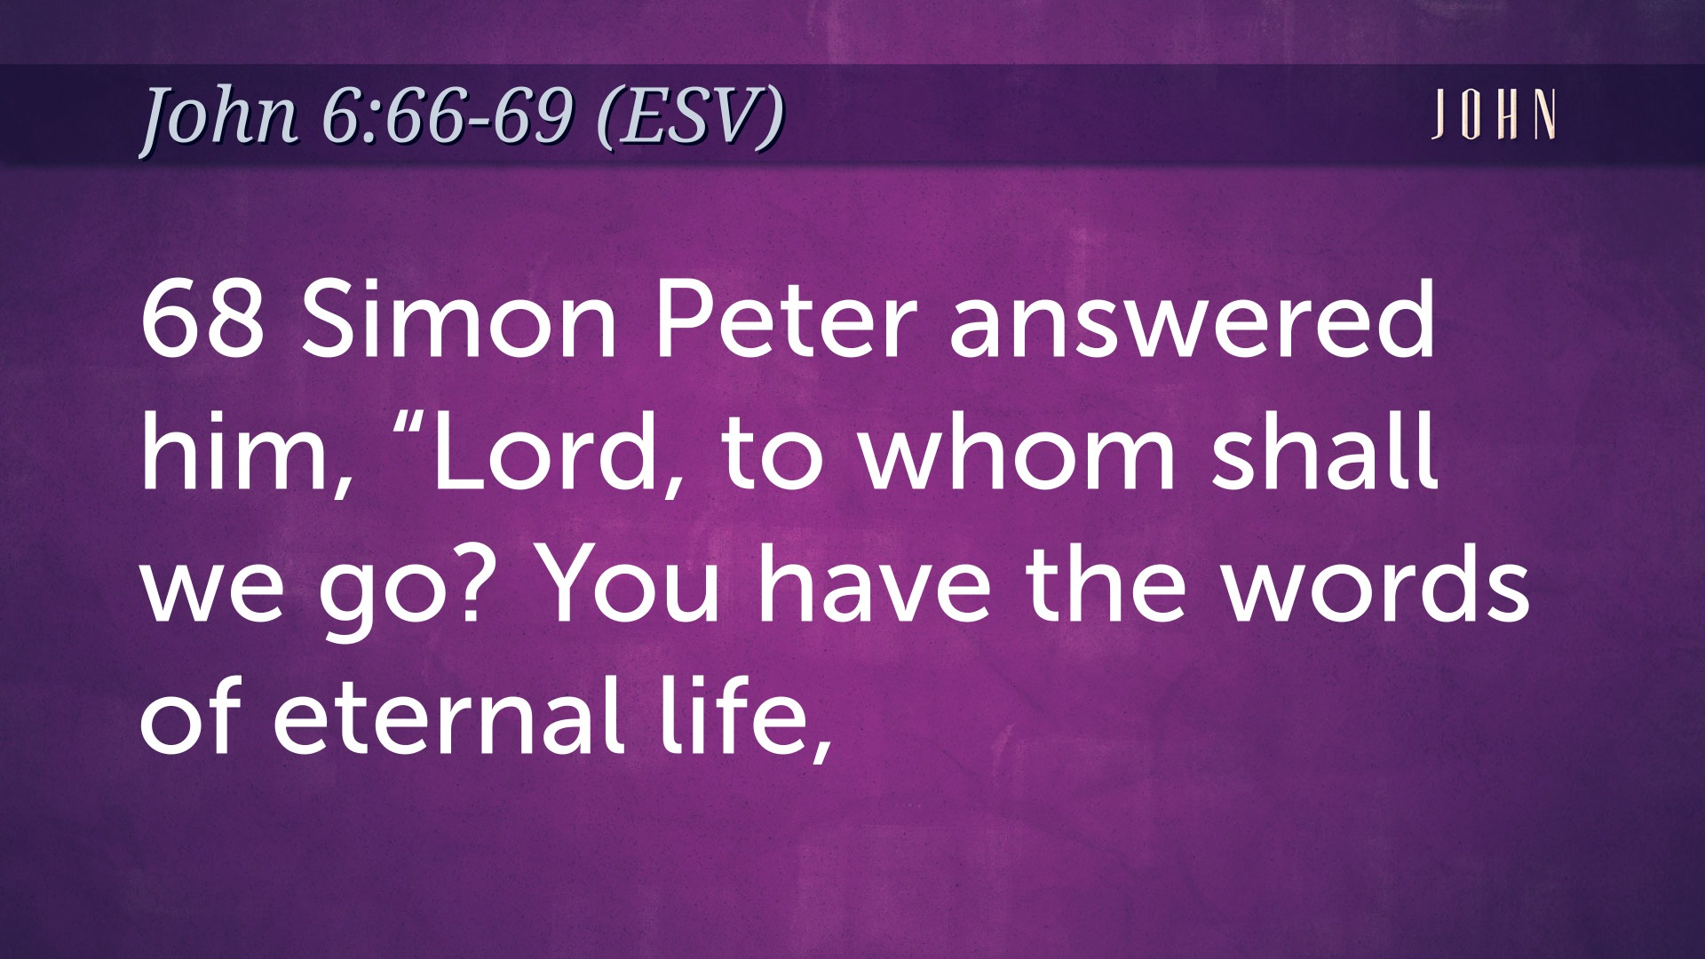

Slide 9
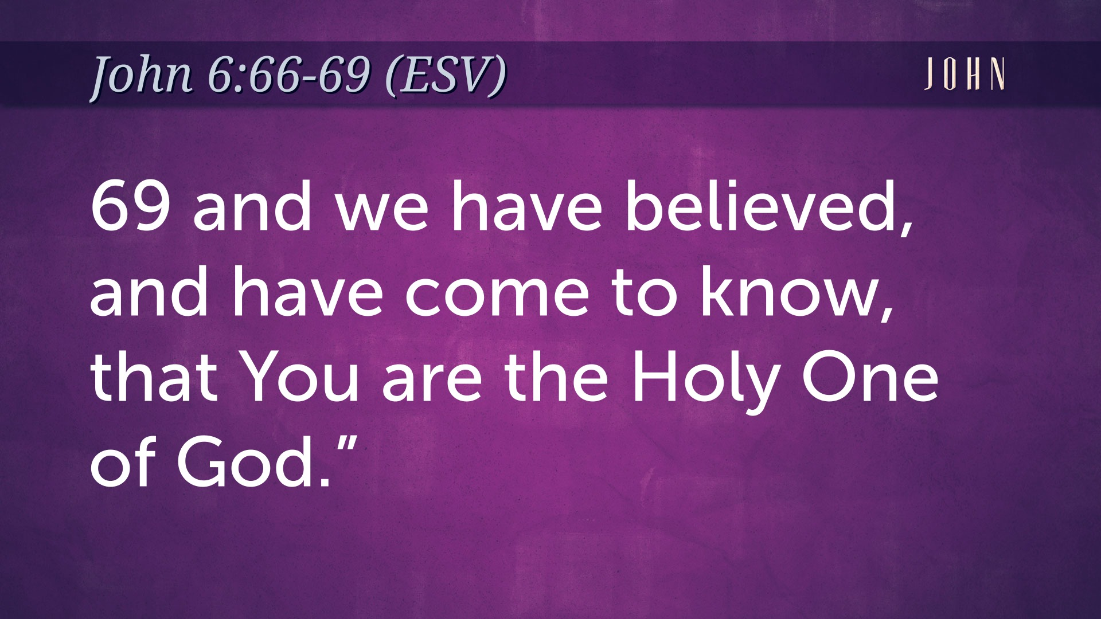

Slide 10
b.) The command (Matt. 28:18-20) all authority… held accountable: Heb. 13:17 Rom. 14:12

Slide 11
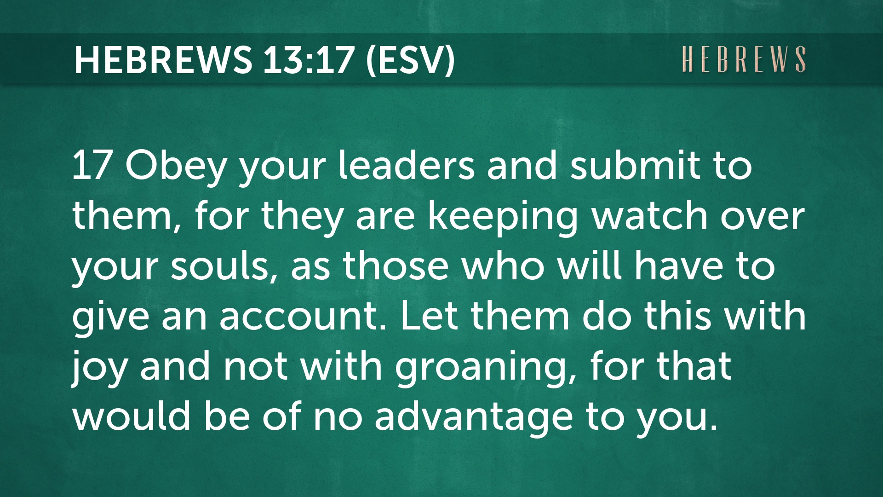

Slide 12
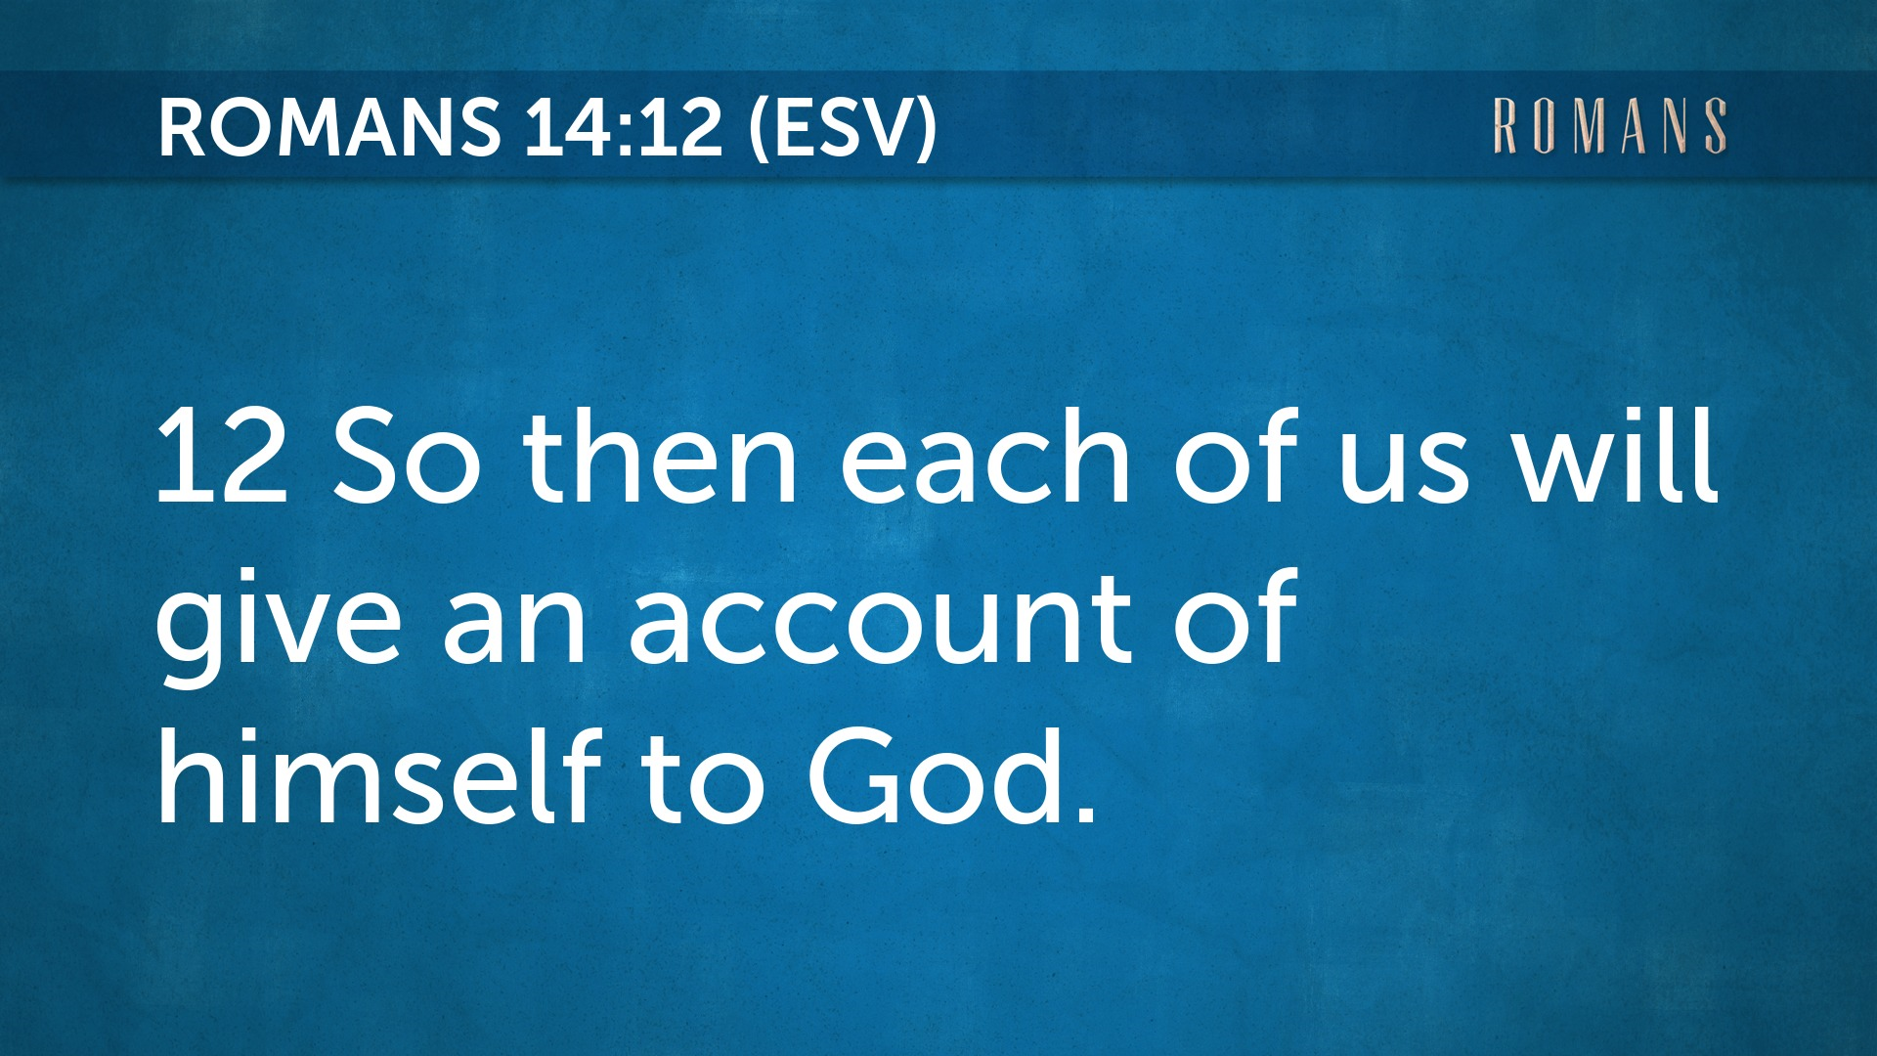

Slide 13
2. Definition of discipleship a.) What is a disciple? b.) Who are Jesus’ disciples? c.) Have you been discipled?

Slide 14
μαθητής – pupil, learner, student Matthew – 72 Mark – 46 Luke – 37 John – 78 Acts - 28 261
Paul never referred to himself as a disciple.

Slide 15
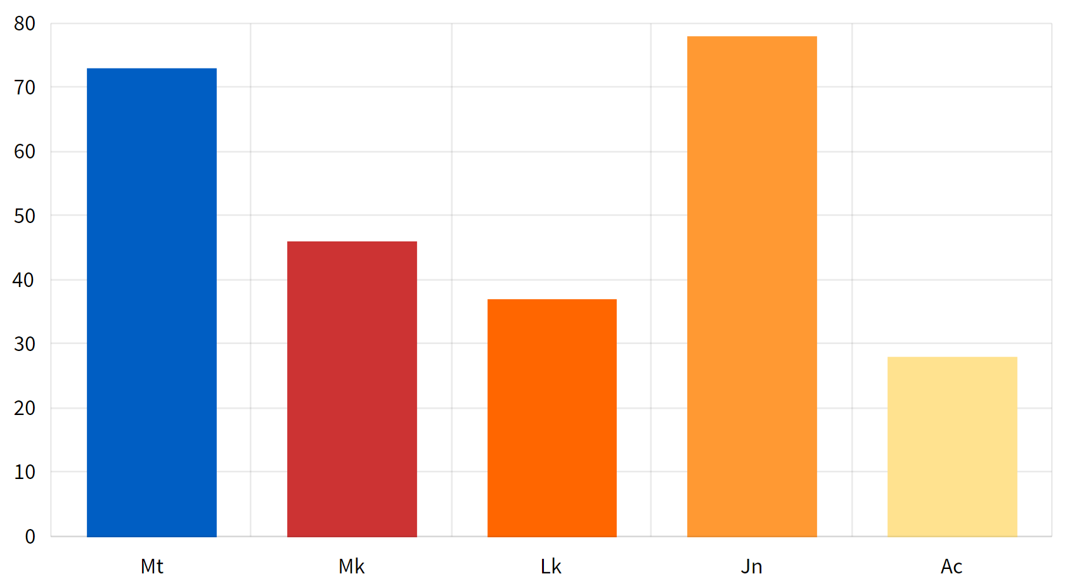

Slide 16
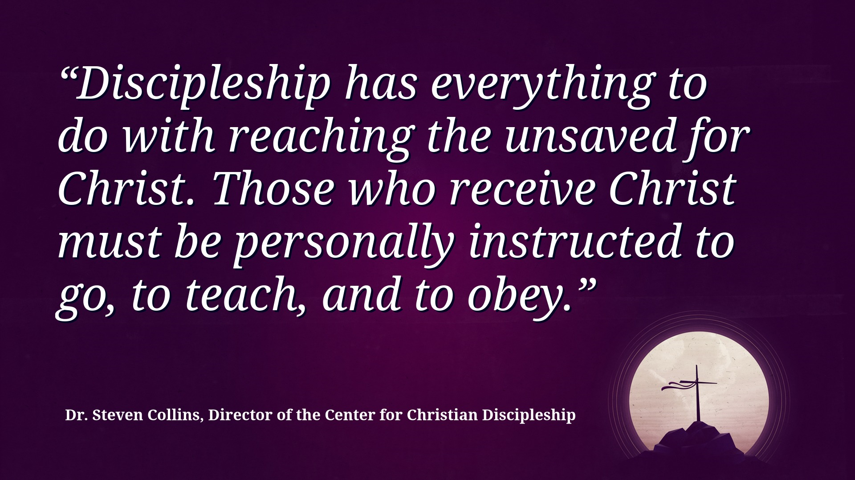

Slide 17
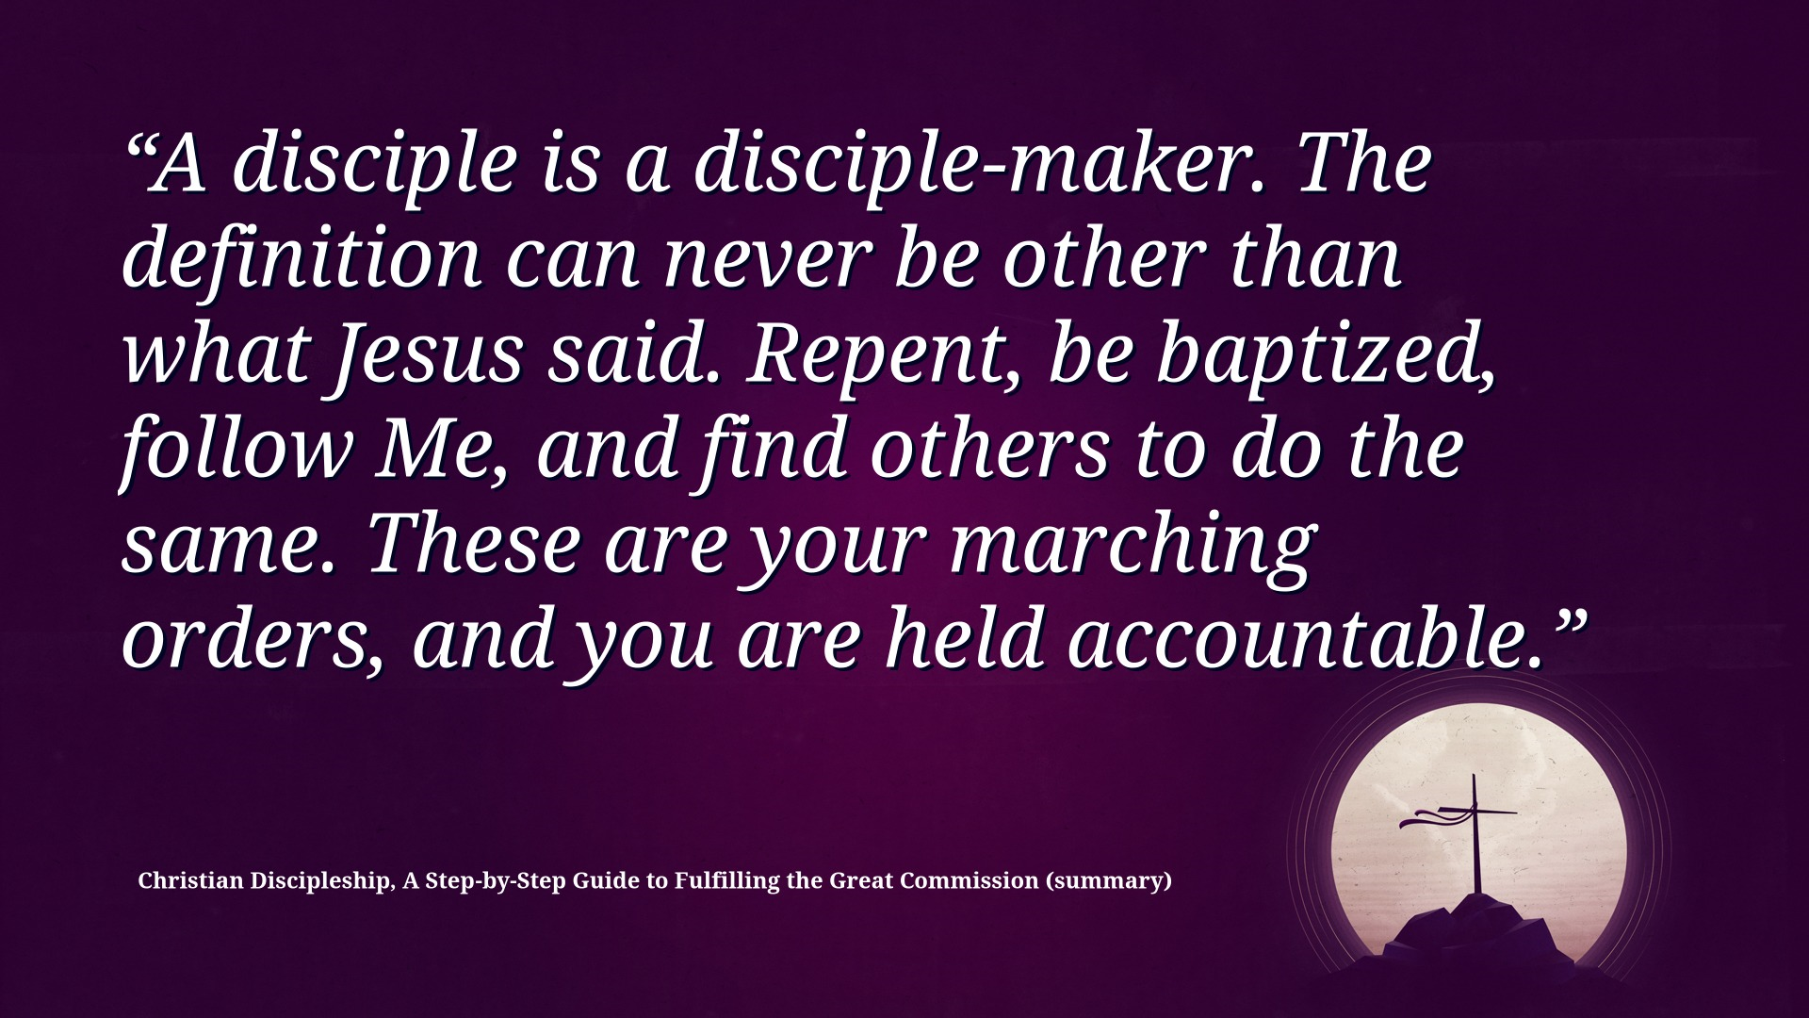

Slide 18
2. Definition of discipleship a.) What b.) Who c.) Have you been discipled and are you a disciple-maker?

Slide 19
3. Dynamics of discipleship a.) Jesus as our LORD b.) Jesus as our BROTHER c.) Jesus as our SAVIOR

Slide 20
4. Details of discipleship a.) FBC and the DTC (Phil 1:9-11) b.) FBC and CR FOUNDATIONS c.) FBC and the FUTURE

Slide 21
Growing deeper through discipleship
- Application?

Slide 22
Next Two Weeks … Discipleship 101 * Spiritual Disciplines * Spiritual Gifts * Know and grow as a disciple-maker

