Slide 1



Slide 2





Slide 3

Grow Warmer Through Fellowship
Acts 2:42-47

Slide 4
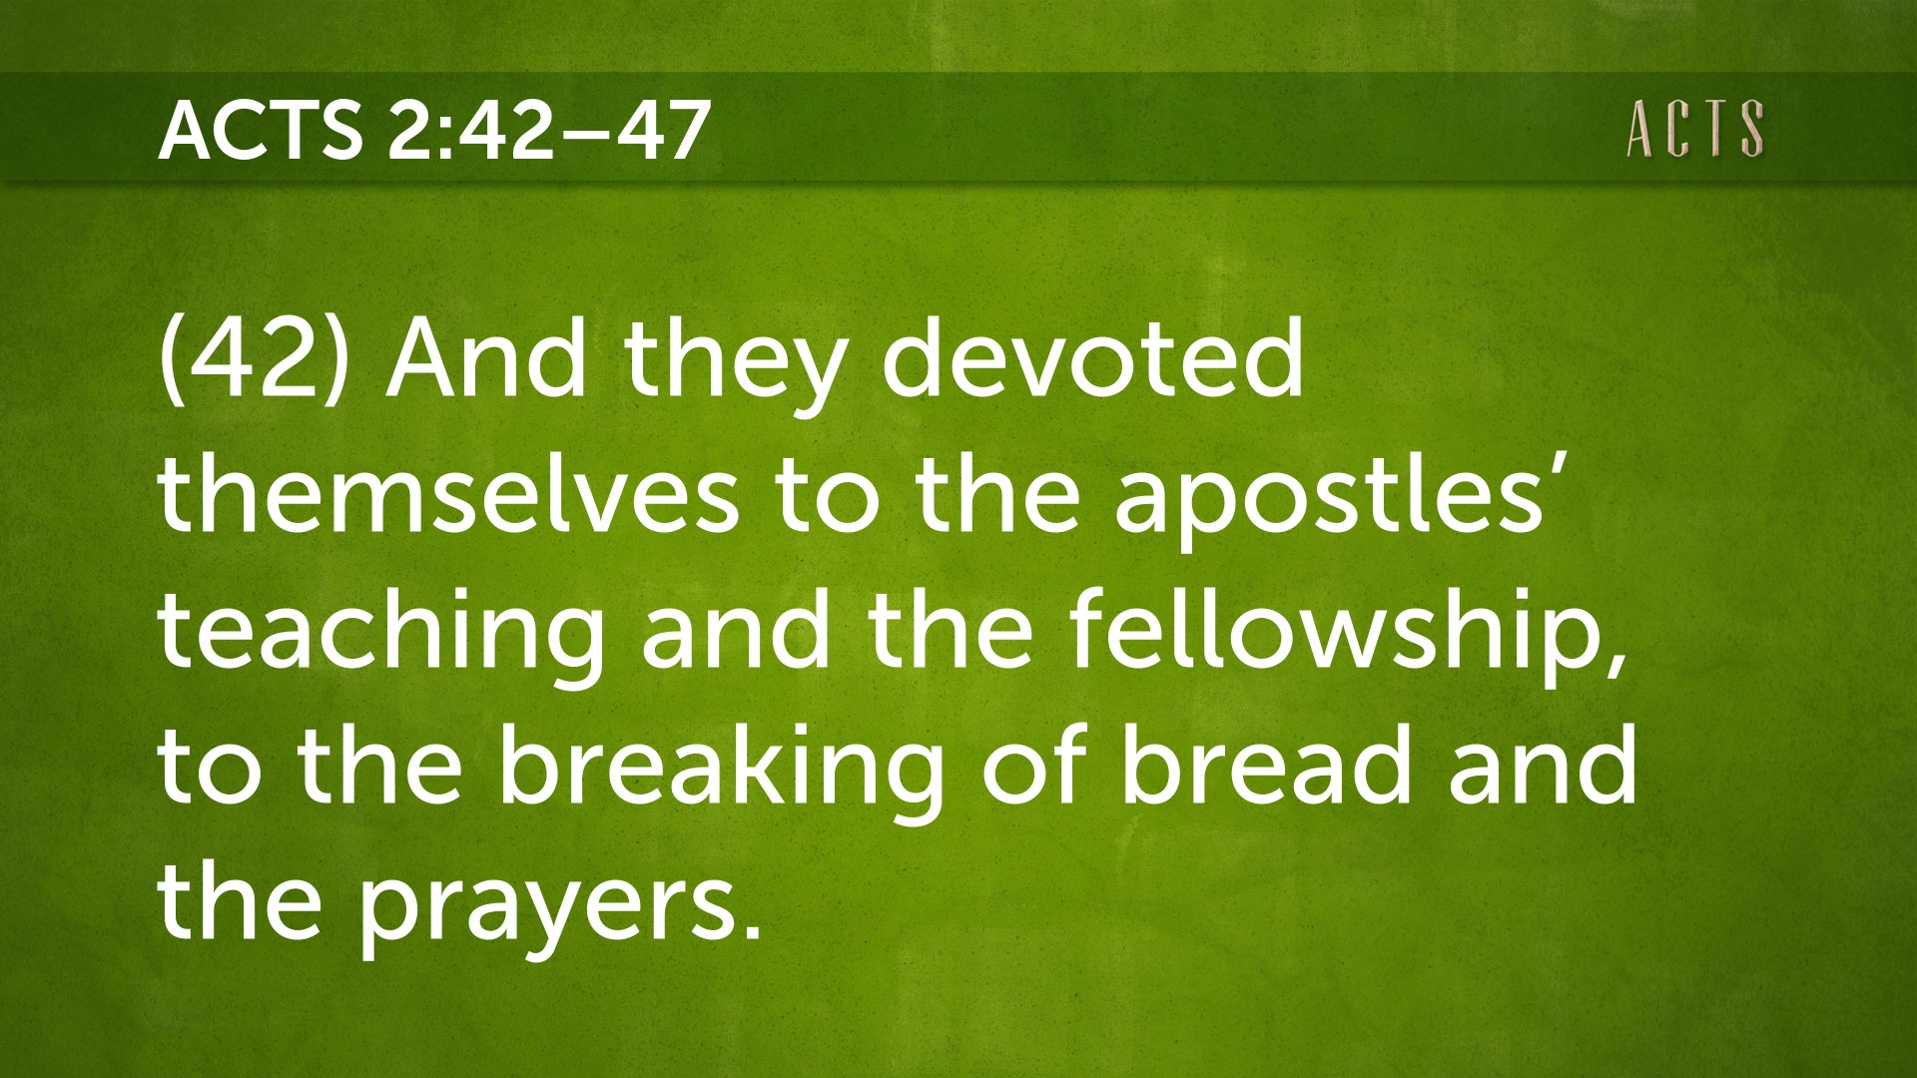

Slide 5
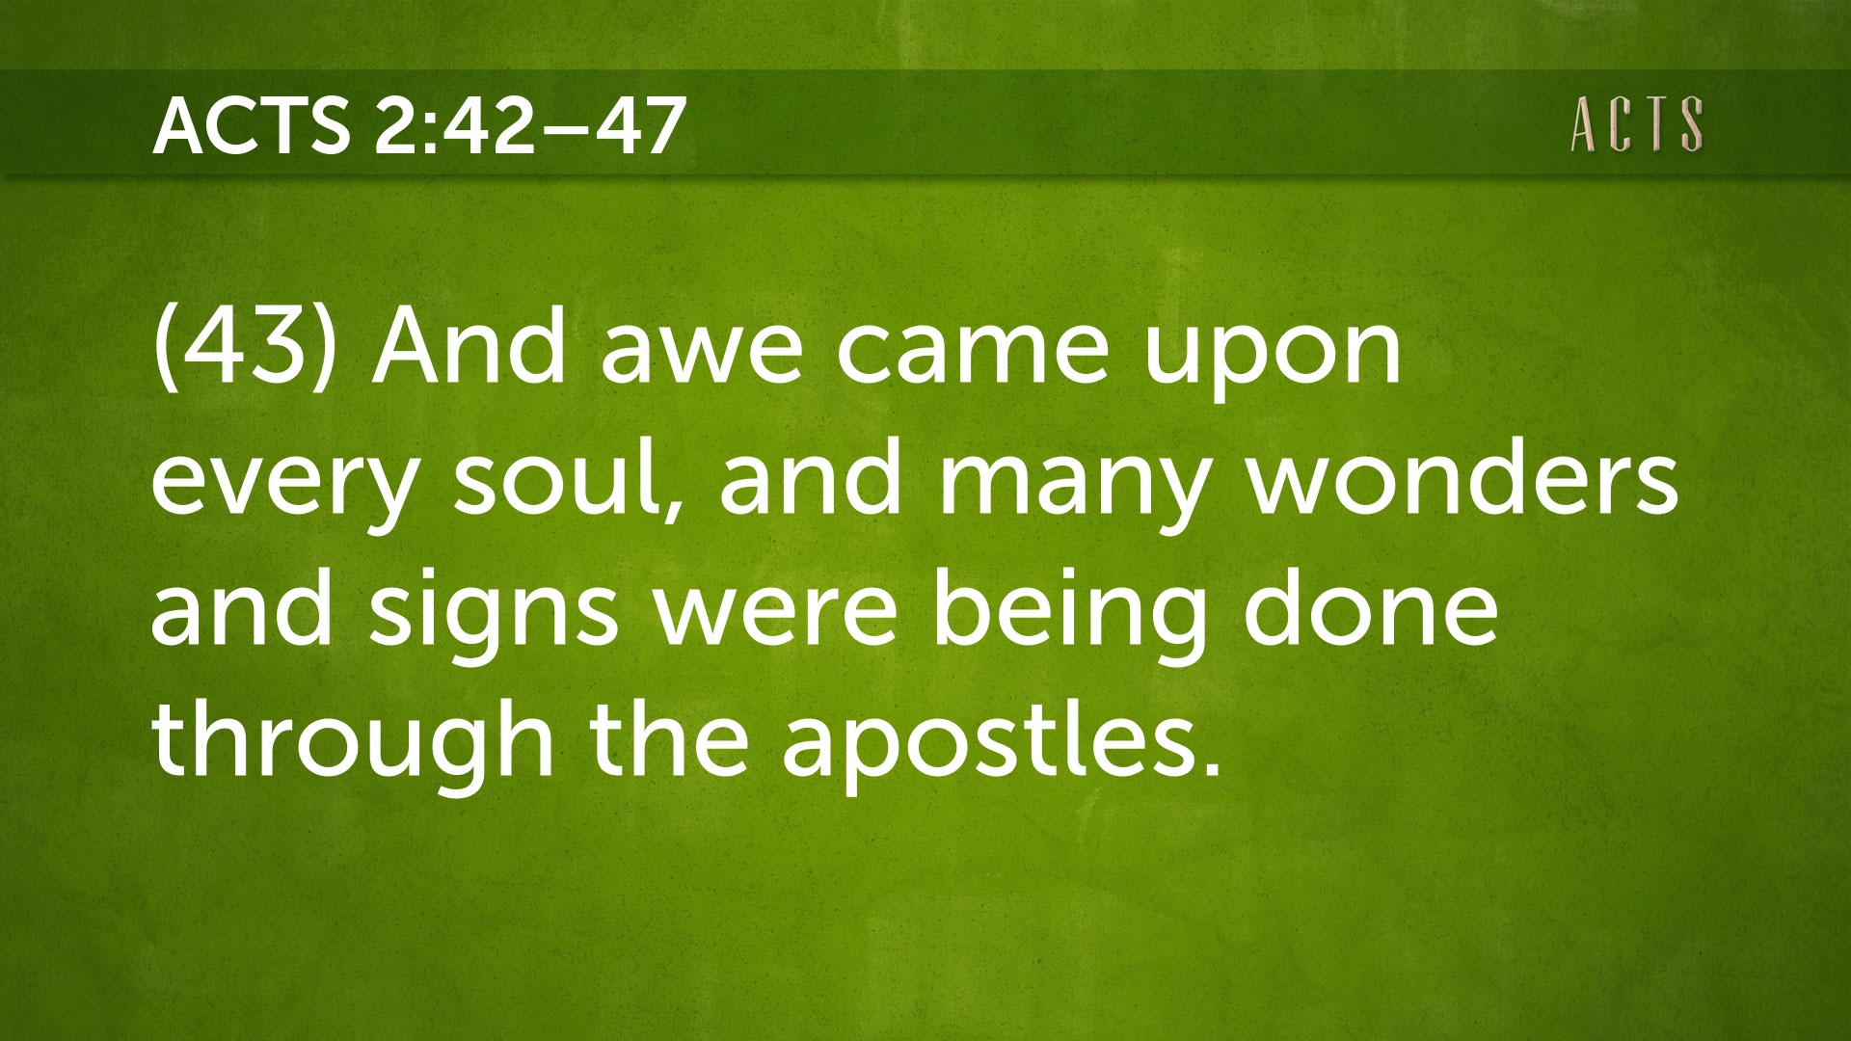

Slide 6
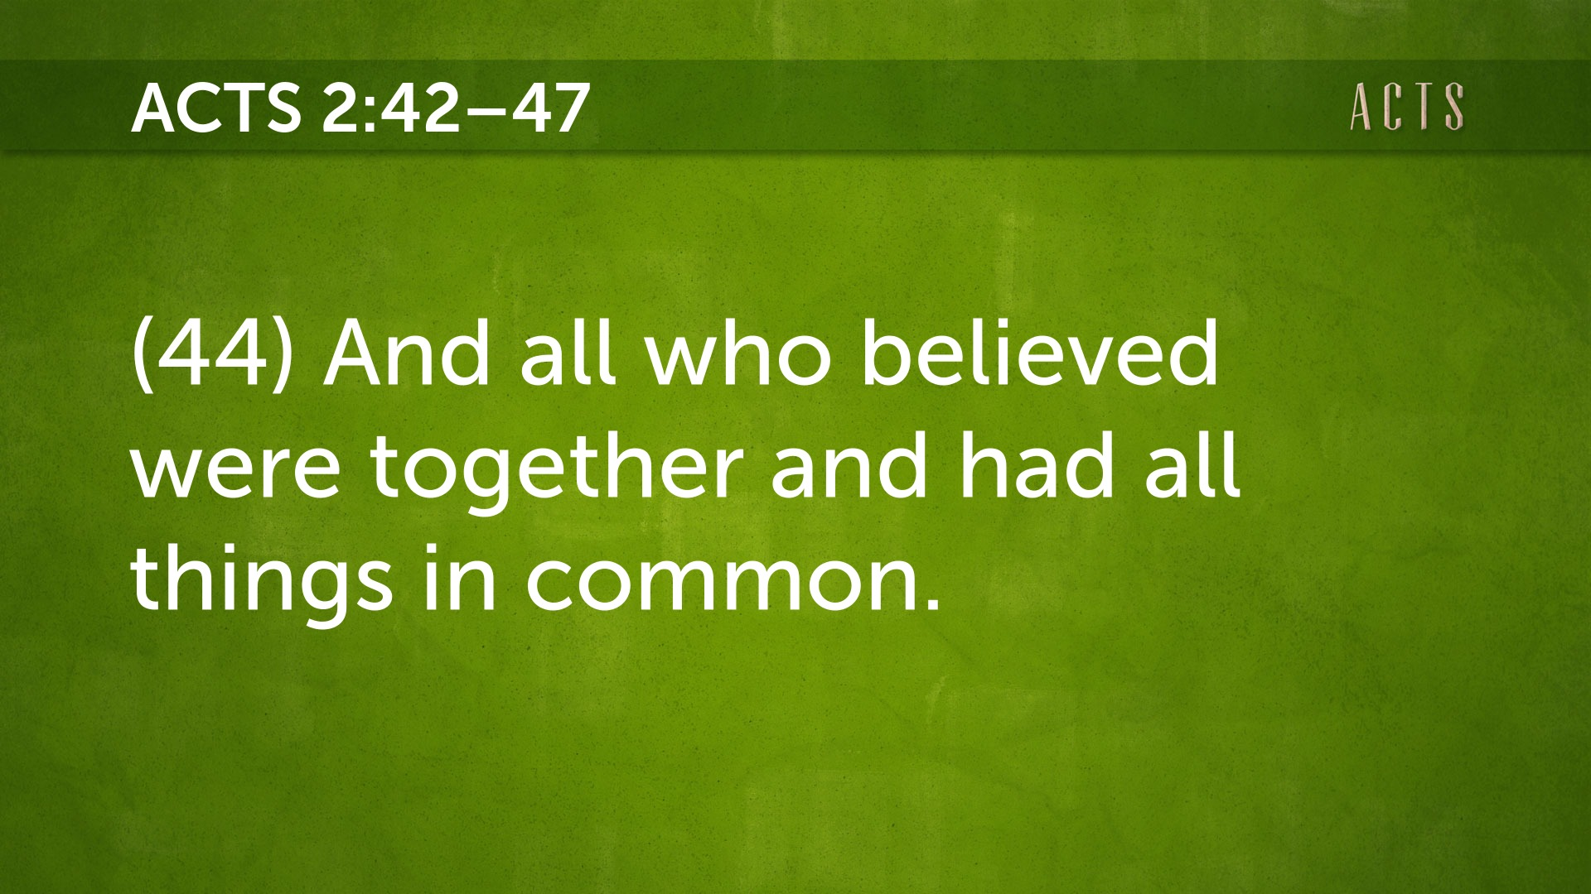

Slide 7
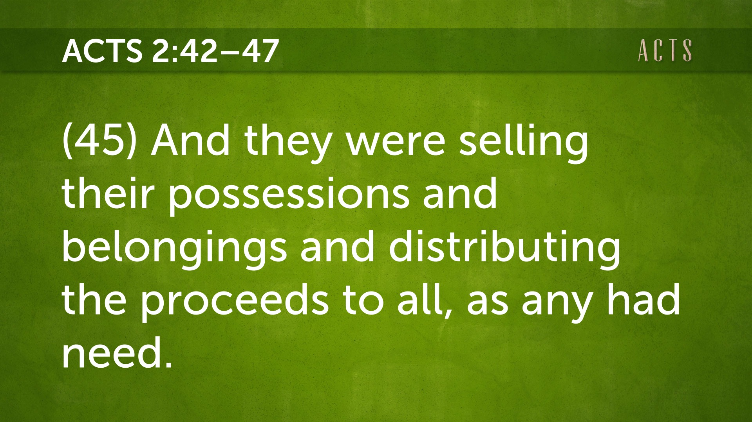

Slide 8
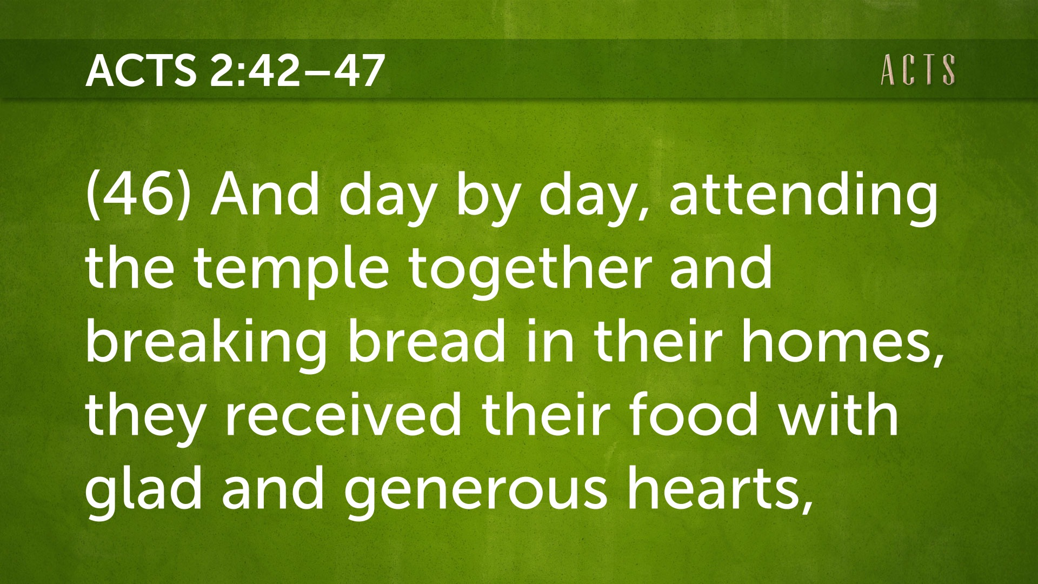

Slide 9
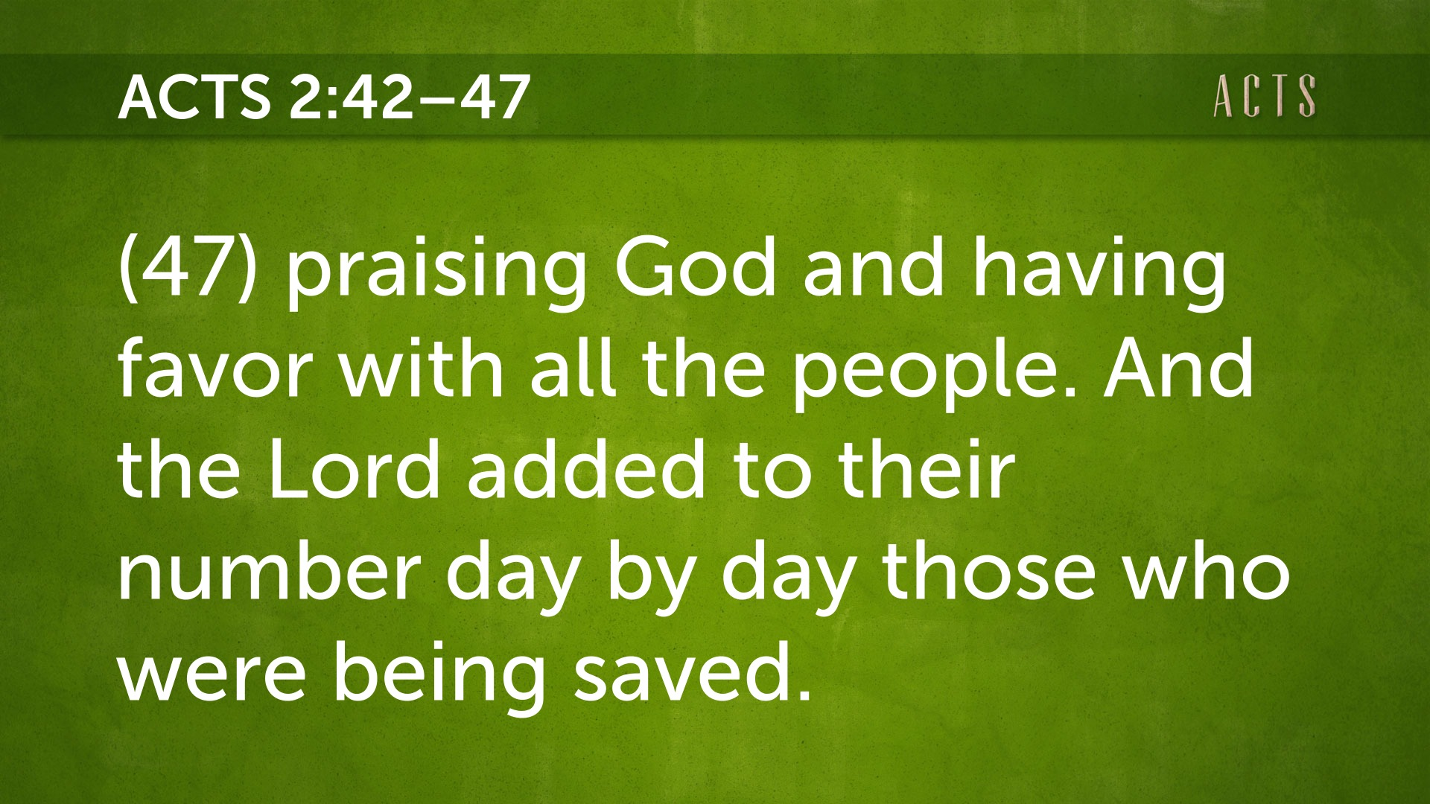

Slide 10
The Fellowship of the Believers
(ESV)
42 And they devoted themselves to the apostles’ teaching and the fellowship, to the breaking of bread and the prayers.
43 And awe came upon every soul, and many wonders and signs were being done through the apostles.
44 And all who believed were together and had all things in common.
45 And they were selling their possessions and belongings and distributing the proceeds to all, as any had need.
46 And day by day, attending the temple together and breaking bread in their homes, they received their food with glad and generous hearts,
47 praising God and having favor with all the people. And the Lord added to their number day by day those who were being saved.

Slide 11
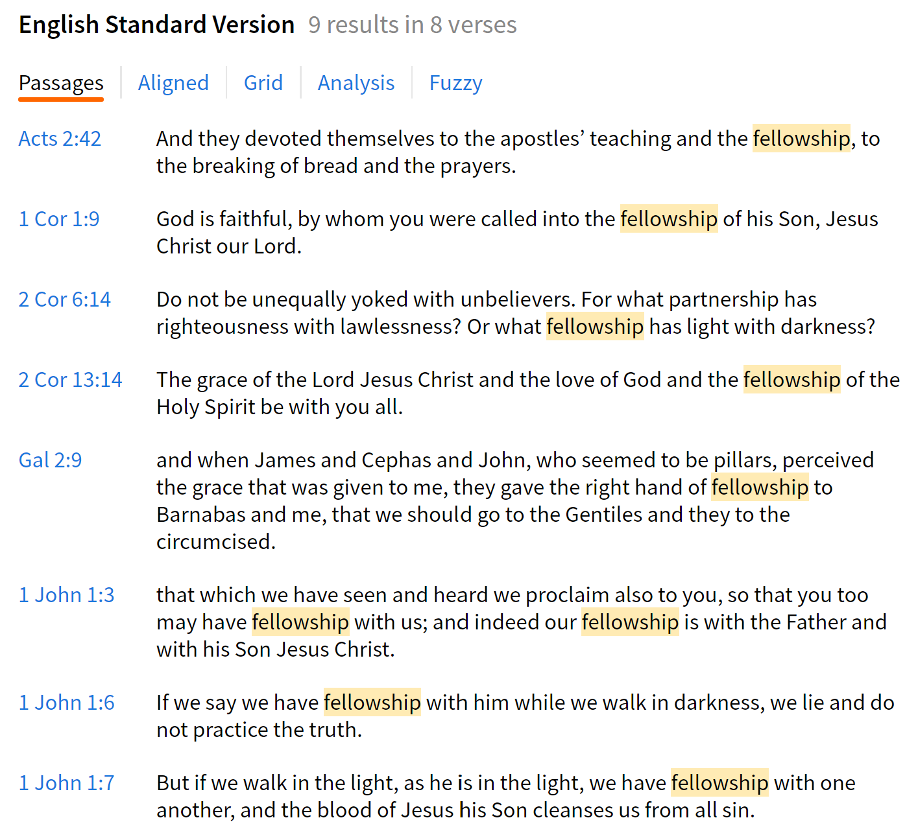
OBSERVATIONS:
Fellowship is not seen in the Gospels.
Fellowship did not “start” until AFTER the church was born.
Yet we see a companionship between Jesus and His Disciples.
Fellowship started when the Holy Spirit was given.

Slide 12
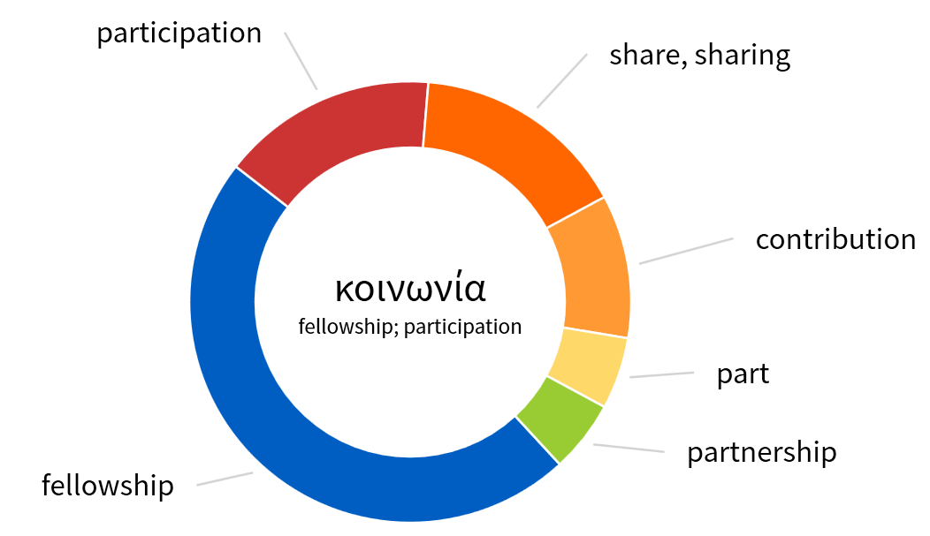
κοινος – common, defiled

Slide 13
Point #1 – A Committed Fellowship
A.) Biblical teaching and sound doctrine
B.) Devoted fellowship (connecting and contributing)
C.) Breaking bread (sharing and caring)
D.) Prayer (individual and corporate)

Slide 14
Point #2 – A Common Fellowship
κοινος
A.) They shared a common goal (v. 44).
B.) They gave to a common need (v. 45).
C.) They formed a common bond (v. 46).
D.) They found a common favor (v. 47).

Slide 15
Point #3 – A contributing Fellowship
A.) They purposed for growth.
B.) They partnered in ministry.
C.) They pursued a new way of life.
D.) They participated in the gospel.

Slide 16
Point #4 – A Called Fellowship
A.) You have been called out (εκκλεσια)
B.) You have been called up (active duty in God’s Army)
C.) You have been called by God (spiritual gifts)
D.) You have been called to (actively participate)

